Slide 1

Opportunistic Shutdowns Management
Mohamed Elsayed
STMI 2019 Amsterdam

Slide 2

Agenda
Definitions
Shutdown Management Workflow
Planning Phase
Decision & Pre- Execution Phase
Execution & Control Phase
Close-out Phase
Conclusion

Slide 3

Definitions
Shutdown & Turnaround
A turnaround is a scheduled periodical major maintenance event to enhance and return process units to its designed reliability and production capacity by performing predefined maintenance tasks with minimum risk within accepted quality, schedule and budget.
Opportunistic Shutdowns
Unplanned period during which a plant, area, process, or asset is removed
from service based on external or internal triggers .
Triggers
External Trigger like Feed Stock shortage (Gas / Water).
Internal trigger like Unexpected failure in major Equipment .

Slide 4
Shutdown Stages
Planning
Execution
&
Control
Close out
Initiation
Planning
Decision
&
Pre Execution
Close out
Execution
&
Control
Opportunistic shutdown stages
Planned Turnaround stages

Slide 5

Objectives
Ensure Readiness, flexibility, and fast response to unexpected shutdowns .
Control the waiting plant shutdown activities.
Maximize unexpected plant shutdown benefits.
Minimize shutdown risks while execution phase .
Utilize plant resources and minimize external resources .
Early Decision Making process (shutdown scope/duration).

Slide 6
Work flow
Shutdown activities List Management
Identify & Classify SD Activities
Detail Planning
Pre Execution & Decision Making
Freezing Scope
Execution & Control
Safety Management
Progress Management
Resource Identification
Shutdown schedule
Plant Shutdown Decision
Zero-time shutdown plan
Contractor / Vendor Release
Close out
Plant Start up
Close out Meeting
Shutdown deliverables
Quality Management
Cost Management

Slide 7
Planning Phase
Shutdown activities List Management
Identify & Classify SD Activities
Detail Planning
Pre Execution & Decision Making
Freezing Scope
Execution & Control
Safety Management
Progress Management
Resource Identification
Shutdown schedule
Plant Shutdown Decision
Zero-time shutdown plan
Contractor / Vendor Release
Close out
Plant Start up
Close out Meeting
Shutdown deliverables
Quality Management
Cost Management

Slide 8

Planning Phase
Shutdown activities List Management
List and Identify waiting shutdown activities (Daily planning meeting).
Classify activities (shutdown Scenarios )
- 5 Day - 10 Day - Steam Shutdown - TAR
Update, review and discuss the list weekly (Weekly S/D Meeting)
Detail planning for each activity. ( Job Plan- Resources – Duration )
Submit Shutdown Activities PTW’s to Permit Office.
Preliminary shutdown schedule (5, 10, Steam S/D).
Accumulated Resources Identification .

Slide 9
Planning Phase
Planning Phase Deliverables
Shutdown Activities Master List .
Preparation List .
Shutdown Packages .
PTW permits.
Shutdown preliminary Schedule for each scenario.
Resources required sheet.
Budget estimation for each scenario.

Slide 10
Pre Execution Phase
Shutdown activities List Management
Identify & Classify SD Activities
Detail Planning
Pre Execution & Decision Making
Freezing Scope
Execution & Control
Safety Management
Progress Management
Resource Identification
Shutdown schedule
Plant Shutdown Decision
Zero-time shutdown plan
Contractor / Vendor Release
Close out
Plant Start up
Close out Meeting
Shutdown deliverables
Quality Management
Cost Management

Slide 11

Pre Execution Phase
Shutdown decision and final scope
Shutdown committee meeting .
Committee Structure :
Plant Manager, MFG MGR ‘s (Maint, OPS, Tech, Safety) ,
Planning Team Leader, Reliability Representative .
Committee Roles:
  Review / Agree on shutdown triggers, objectives, Critical-Path, and Freeze Scope.
  Review Cost associated and Allocate S/D Cost Center.
  Review / Evaluate / Select shutdown best Scenario , Scope , and Duration based on situation and dominating inputs:
  - Feed Stock condition / forecast
  - Plant Equipment condition.
  - Site Production plan / Marketing forecast .
  - Safety Impact
  - Resource availability (Man Power, Expertise, Vendors, Special tools ,….
  Decide the shutdown start date and activate communication plan.

Slide 12
Pre Execution Phase
Communication Plan
Ready-made actions to launch shutdown activities including some steps to ensure effective communications, logistics and Safety managing.
  Communication (Shutdown Trigger, Critical-Path, duration, logistics, final schedule PTP including start date, etc…)
  Organization (including Major Activities Job Owners).
  Shutdown Cost Center.
  Daily Follow Up Meeting timing .
  Communication channels .
  Number of expected external manpower / vendors / contractors.
  Safety Training matrix for the external resources.
  Logistic management (Transportation, Site gate accesses, accommodation)
  Zero – Time flow chart .

Slide 13
Execution & Control
Shutdown activities List Management
Identify & Classify SD Activities
Detail Planning
Pre Execution & Decision Making
Freezing Scope
Execution & Control
Safety Management
Progress Management
Resource Identification
Shutdown schedule
Plant Shutdown Decision
Zero-time shutdown plan
Contractor / Vendor Release
Close out
Plant Start up
Close out Meeting
Shutdown deliverables
Quality Management
Cost Management

Slide 14
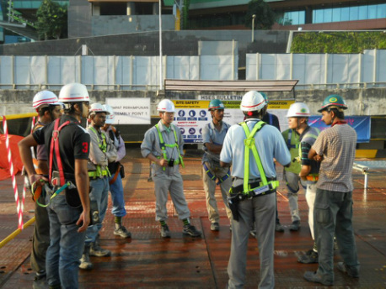
Execution & Control
  Safety Management
Contractor / Individuals Selection.
Training and assessment for selected external manpower .
Workshop Daily Mass TBT.
Collect feedback , comments, and incidents reporting.
Close supervision .
Site Audits and Walk Downs.
Visible MGT Leadership and Commitment.
Incentives for positive safety Behavior .
Daily Workshop TBT
External MP Training

Slide 15

Execution & Control
Quality Management
Controlling the main four maintenance pillars affecting Quality (4Ms).
1- Material
- Right material Specifications.
- Trusted suppliers .
- Material Receiving inspection and Quality Check.
- Material reserved and preserved against WO.
2- Manpower
- Selection of competent persons. Test and Pre-Qualify upon need.
- Preference List (previous successful S/D performers)
- Close Supervision and 100% accountability by Job Performers.
3- Methodology
- Detailed procedures when needed ( Ex . ITP, WPS, Method Statement..)
4- Machine
- Inspection for the external rental equipment ( ~ at contractor facility)
- Inspected / Calibrated tools , good condition, suitable for task.

Slide 16

Execution & Control
Schedule Management
Daily shutdown meeting
- Safety Highlights and statistics.
- Daily activities status .
- Challenges and Actions.
- Next day Activities .
Shutdown Progress curve .
Critical-Path close monitoring and support dead-line.
Shutdown Changes Management . (Shutdown Committee)
- Added Activities / Activity Scope Change / Schedule Changes.
Separate Meetings for new findings .

Slide 17
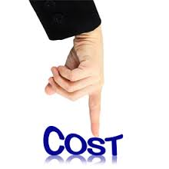
Execution & Control
Cost Management
Allocate Resources and materials against each S/D work order.
Cost Estimation to the best Accuracy available.
Allocate S/D separate Cost center .
Monitoring for cost spending during execution.
Any change in scope shall follow company DOA .

Slide 18
Close out Phase
Shutdown activities List Management
Identify & Classify SD Activities
Detail Planning
Pre Execution & Decision Making
Freezing Scope
Execution & Control
Safety Management
Progress Management
Resource Identification
Shutdown schedule
Plant Shutdown Decision
Zero-time shutdown plan
Contractor / Vendor Release
Close out
Plant Start up
Close out Meeting
Shutdown deliverables
Quality Management
Cost Management

Slide 19

Close Out Phase
Support Start-up activities .
Major Activity Post-Start-Up check.
External Manpower and Contractor Release / De mob.
- Release is Based on shutdown schedule activities.
- External Manpower Recognition (collect feedback)
Shutdown Close out Meeting and Communication.
Conduct S/D Lesson Learn Session .
Shutdown close out deliverables .
- Shutdown Report .
- Shutdown KPIs (Safety , Quality, Time, Cost).
- Shutdown Findings Sheet .
- Lesson learned and action plan.
Revisit Waiting Shutdown List for Update / Refine.
-.

Slide 20


Slide 21
Kick off
Meetings
Strategic Planning
Turnaround Execution
Scheduling
&
Pre Turnaround
Scope Definition
Detail Planning
Contacting
&
Purchasing
Turnaround Close out
Turnaround Time Line
Initiation
6-Months
Planning
12-Months
Execution
1-Month
Close Out
3-Months

Slide 22
Opportunistic Shutdown Time Line
Planning Phase
Scheduling
Resources Identification
Scope Identification
Detailed Planning
Turnaround Execution
Decision Making
&
Pre Execution
Turnaround Close out
SD Trigger
Decision Making
1-3 Days
Execution
5-30 Days
Close Out
3-Months

Slide 23
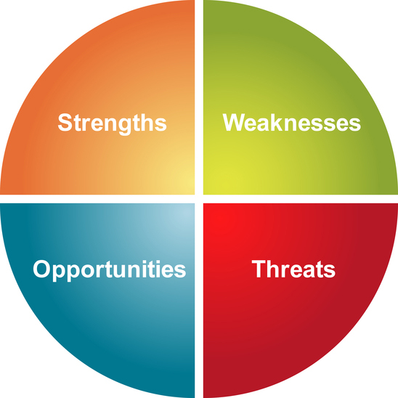
Opportunistic shutdown Management
It is a systematic process to deal with unplanned outages and shutdowns, ensure readiness, flexibility and fast response to unplanned shutdown , Control waiting plant shutdown activities, minimize outages risks during execution phase, support early decision process with shutdown best scenario , maximize outage benefits and achieve outage objectives safely , high quality ,on time and with optimum resources.
Unexpected Shutdown

Slide 24


