Slide 1
Increase in Performance of Static Seals
with innovative gasket products from FRENZELIT
Dipl.-Ing. Peter Übelmesser
Senior Manager Key Account Chemistry
Frenzelit GmbH

Slide 2

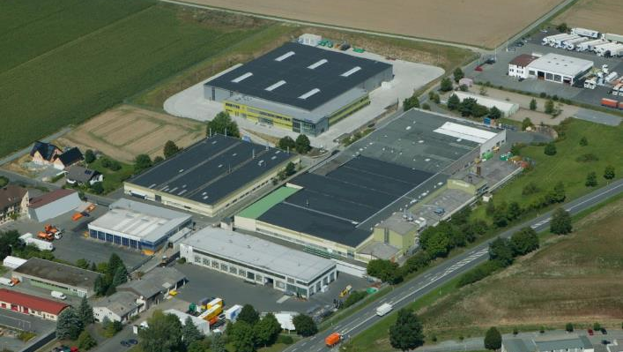
Frenzelit GmbH, Bad Berneck (D)
  480 employees globally
  turnover ~ 90 Mio. €

Slide 3
Supply chain competence
R&D
material production
application engineering
gasket production + logistics
partner
FRENZELIT

Slide 4
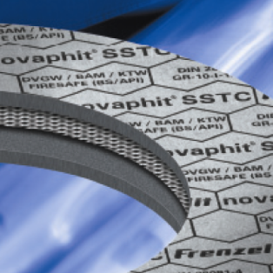
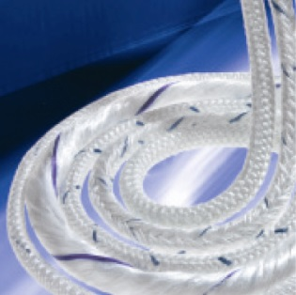
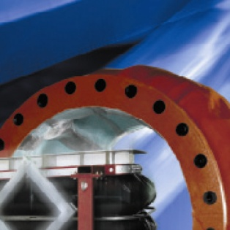
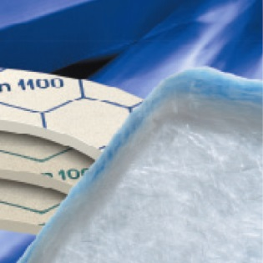
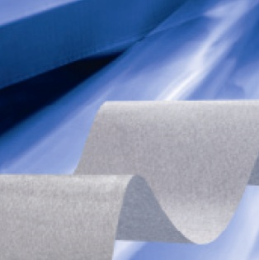
Our product range
Gaskets
Technical Textiles
Expansion Joints
Insulation
New Materials

Slide 5
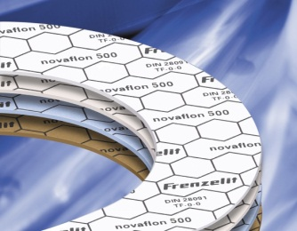
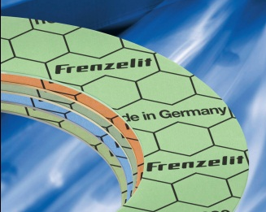
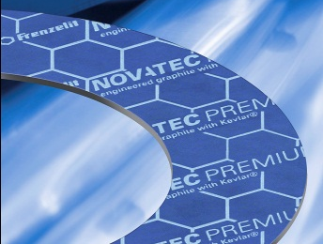
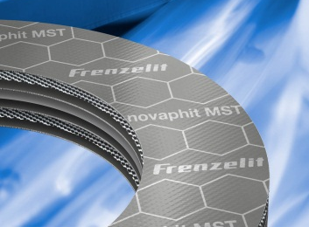
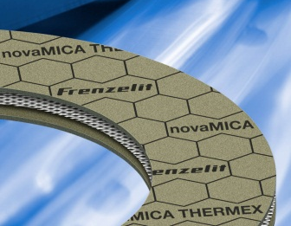
Material Competence in Gasket Materials
PTFE-gasket material
novaflon®
Elastomere-bound fiber gasket
novapress®
Engineered graphite with Kevlar®
novatec®
Graphite gasket
material
novaphit®
Mica based gasket material
novamica®
Fluoropolymer
Aktive fillers
Aramid fibers
Glass fibers
Aktive filler
Various binders
Aramid fibers
Functional fillers
of graphite
Expanded graphite
purity > 99%
Stainless steel
reinforcement
(AISI 316 L)
- Expanded metal
- Steelfoil
Mica
Stainless steel
AISI 316 L
High efficiency
binders
up to 260 °C
up to 83 bar
up to 200 °C
up to 100 bar
up to 300 °C
up to 100 bar
up to 550 °C
up to 250 bar
up to 1000 °C
60 bar

Slide 6
Increase in Performance of novaphit® by XP-Technologie
novaphit® SSTC^{TA-L}
novaphit® MST
Reinforced with expanded metal (1.4404)
High performing expanded graphite
Additional performance by XP-Technology

Slide 7
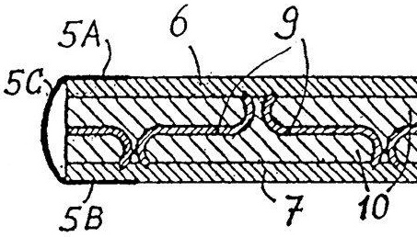
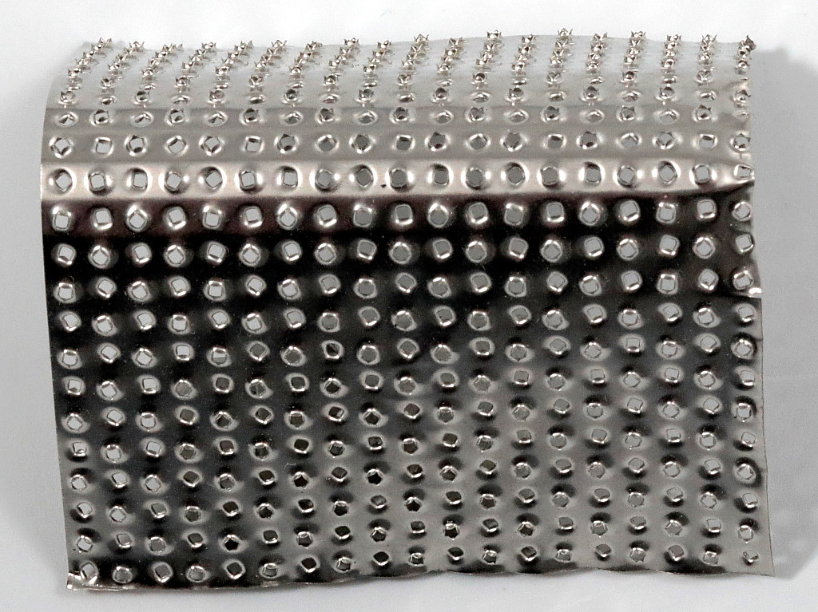
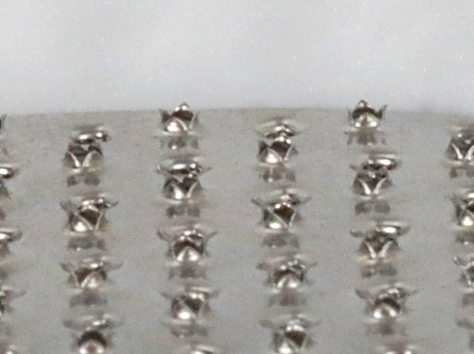
Close-up of Tanged Metal Insert

Slide 8
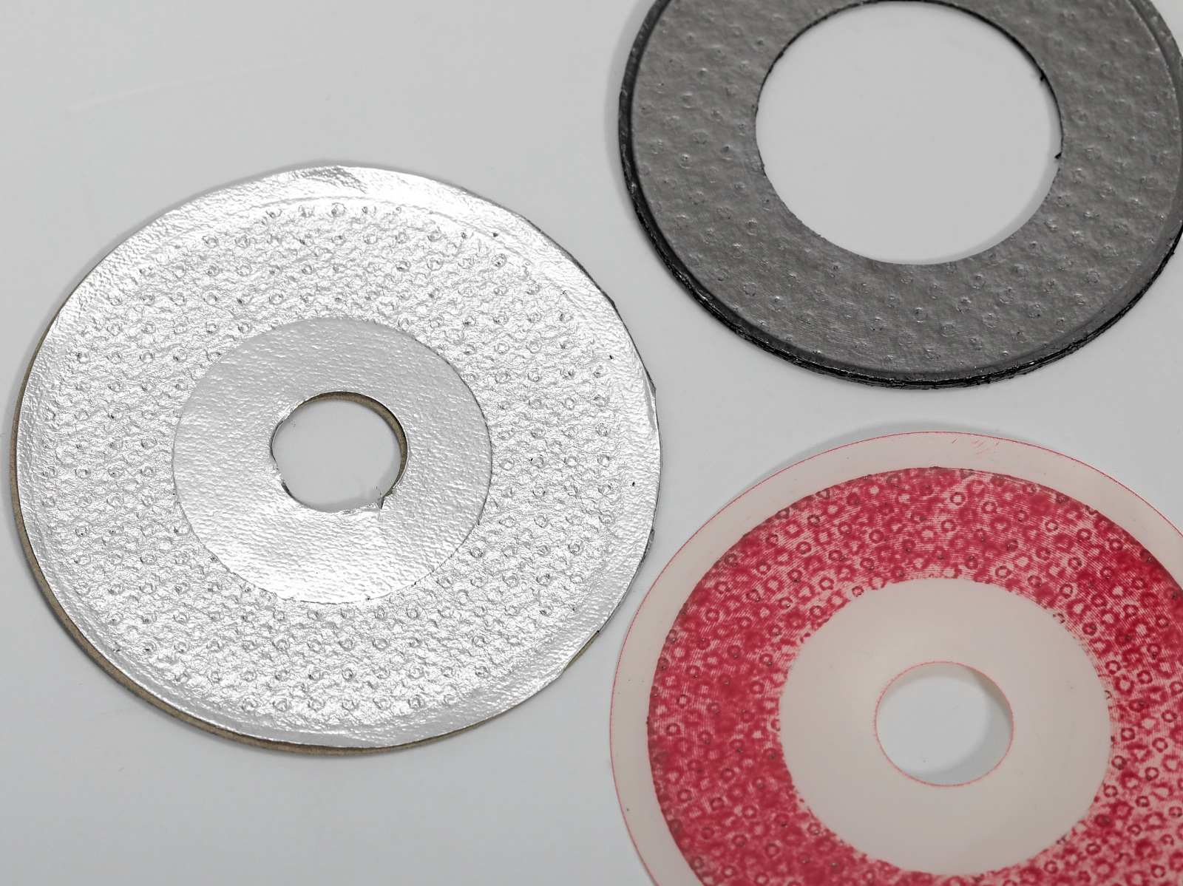
Weak Point Tanged Metal – Danger of Flange Deformation

Slide 9
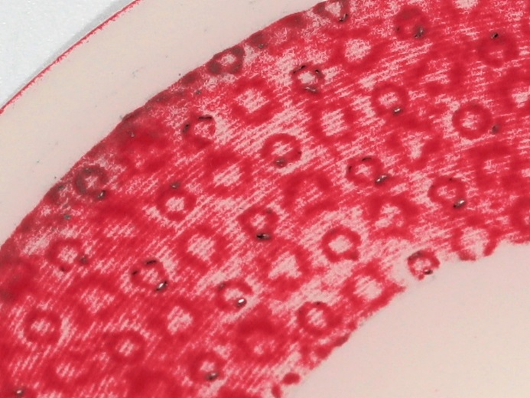
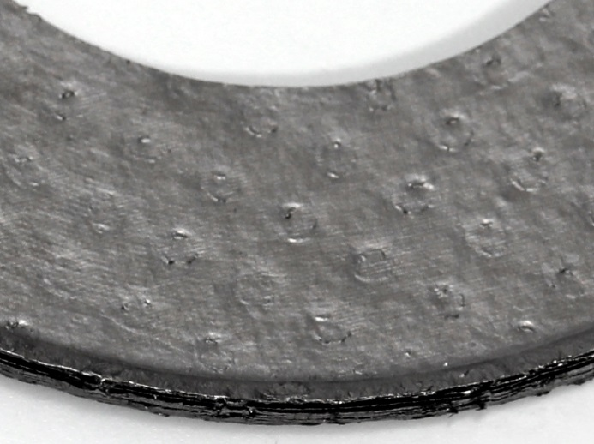
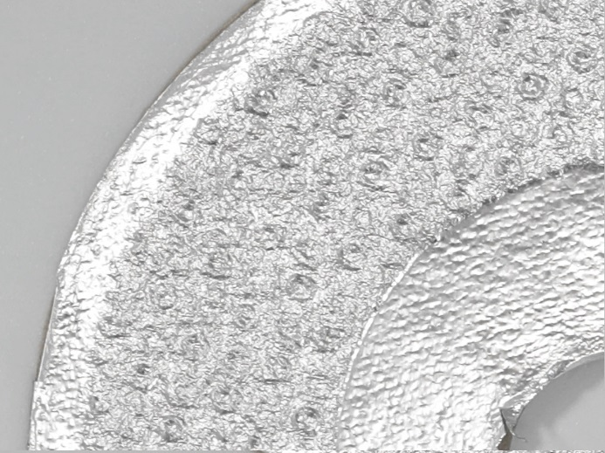
Weak Point Tanged Metal – Danger of Flange Deformation

Slide 10
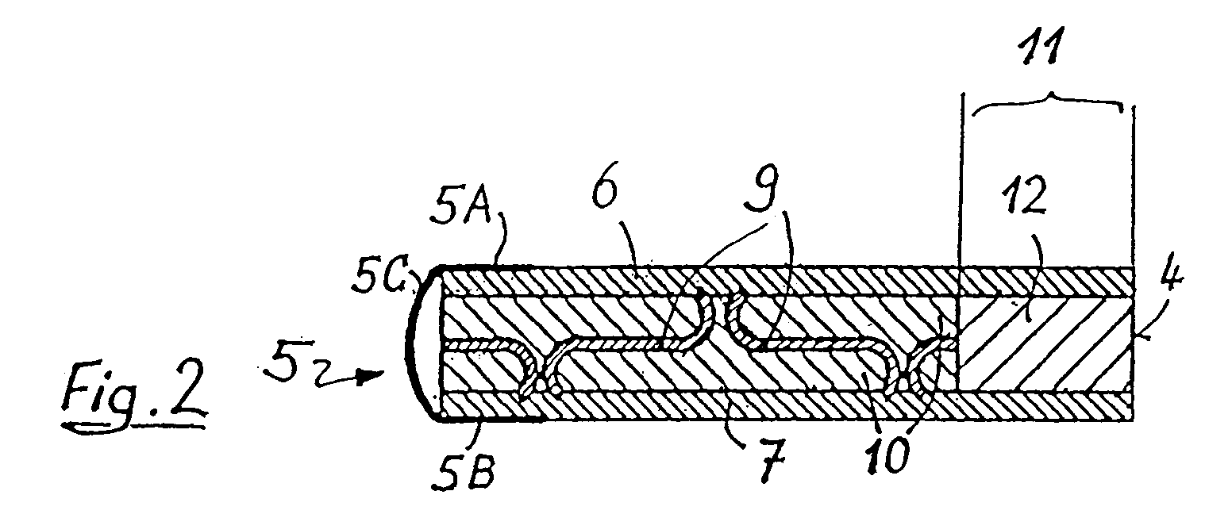
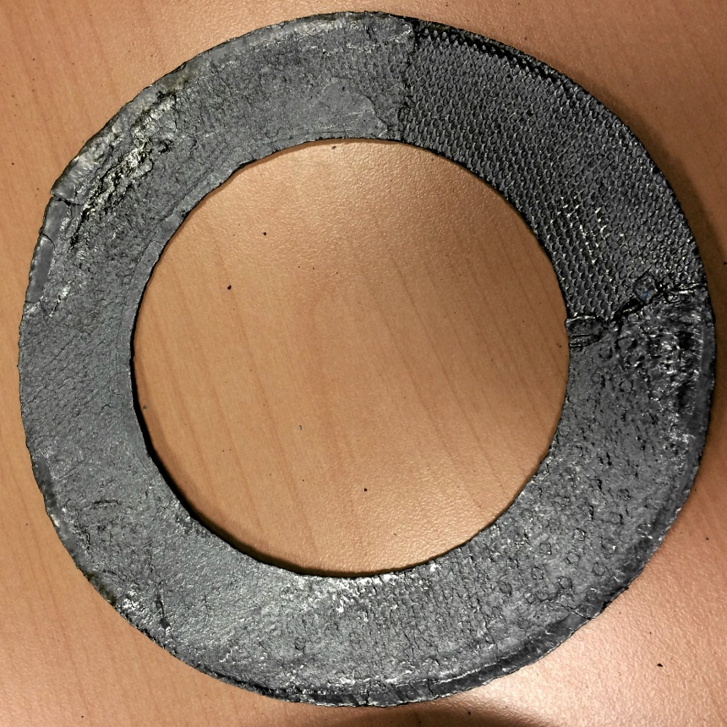
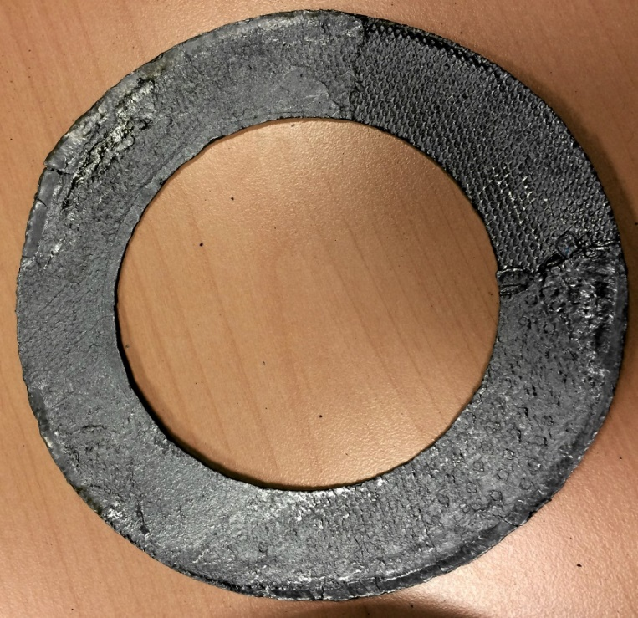
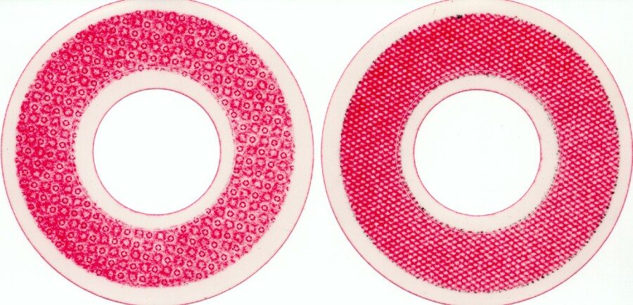
Flangedeformation caused by Gaskets
→ Example: Tanged Metal as Metallic Reinforcement
Metallic Reinforcement

Slide 11
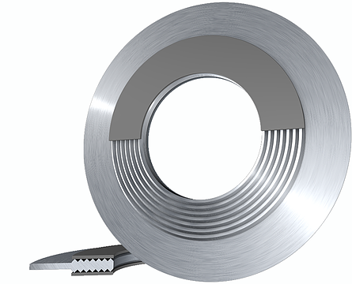
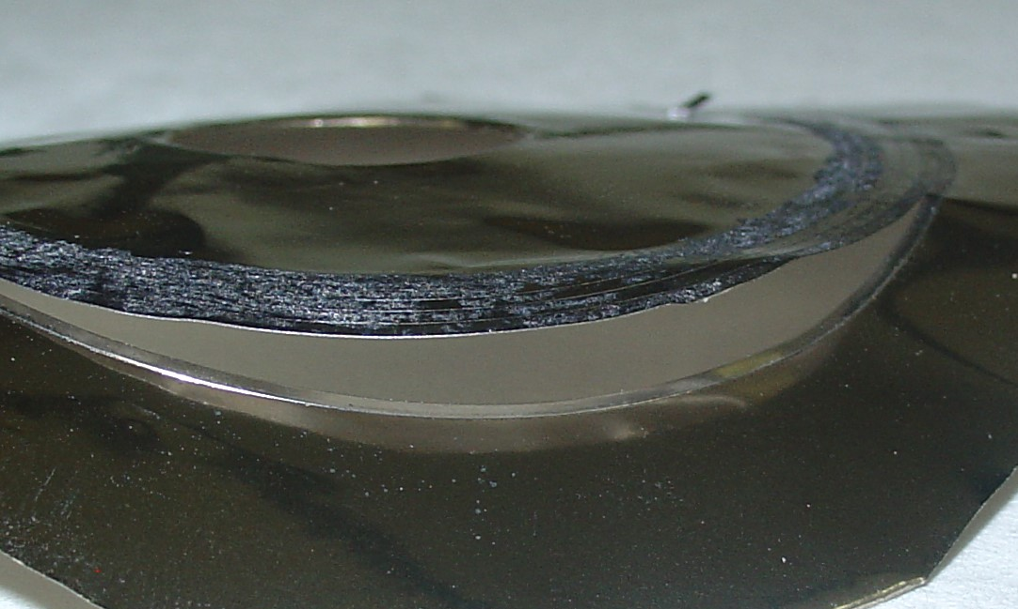
Flangedeformation by Camprofil Gaskets
Metallic Reinforcement

Slide 12
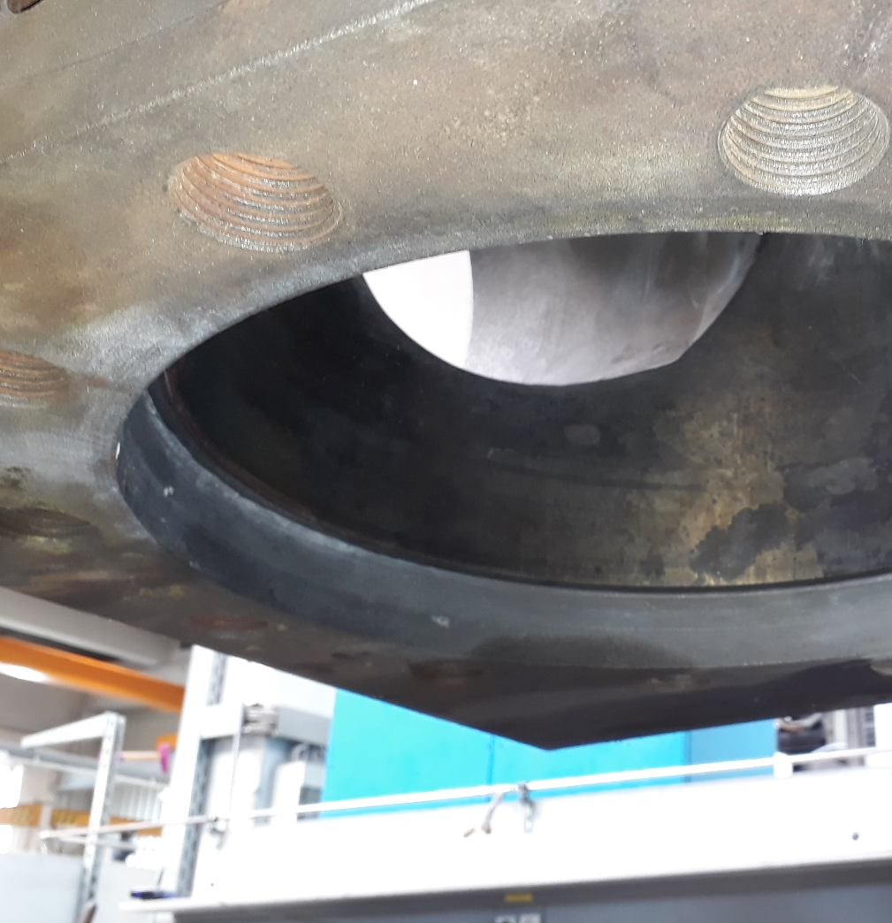

flangedeformation by camprofil gaskets - practical example
Damage caused by metal camprofile

Slide 13
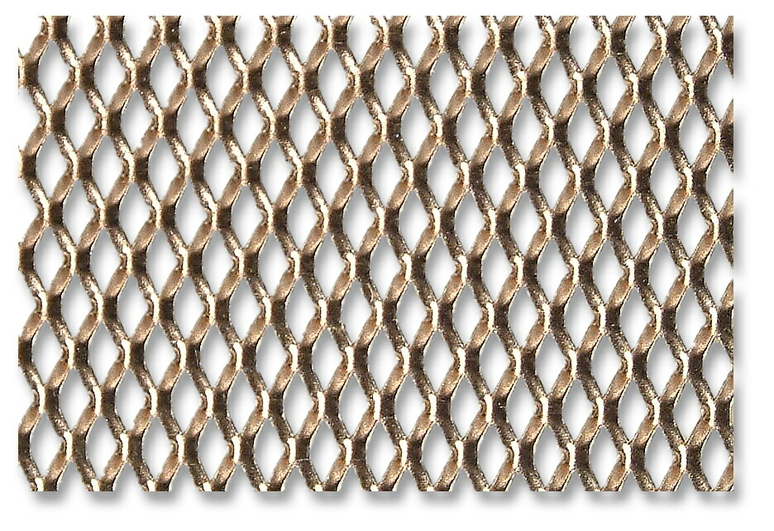
novaphit® - Technology
Expanded Metal as Closeup View
Metallic Reinforcement

Slide 14
Working Principle of Reinforcing Structures
tanged metal:
Expanded metal:
Gasket thickness 2mm, Q=30 N/mm², sensitivity: medium
P_{i}
P_{i}
Metallic Reinforcement

Slide 15
TGA Netzsch 209 IRIS
80% N₂; 20% O₂
time: 8h
High Performing Graphite

Slide 16
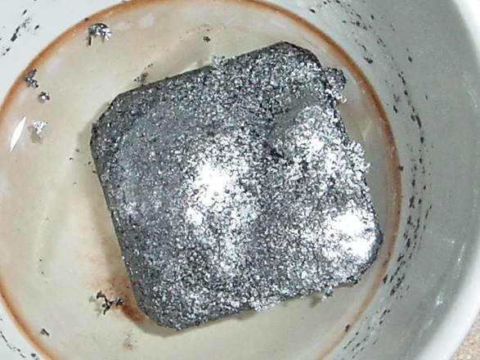
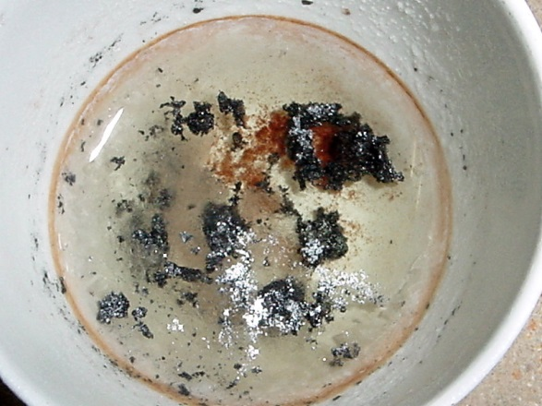
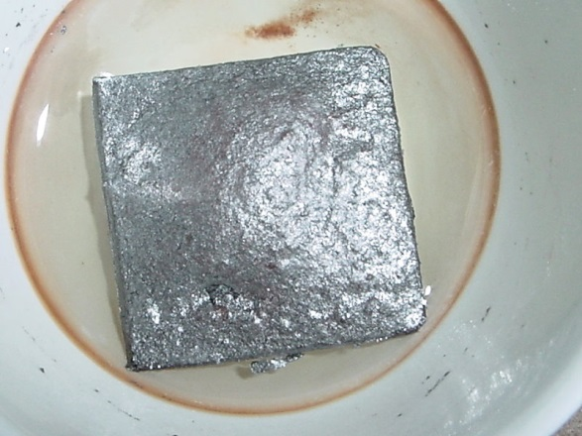
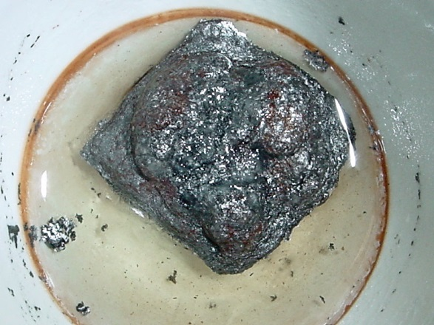
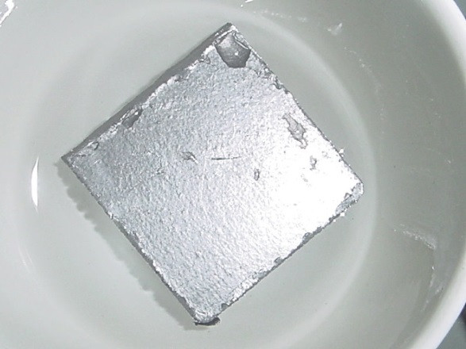
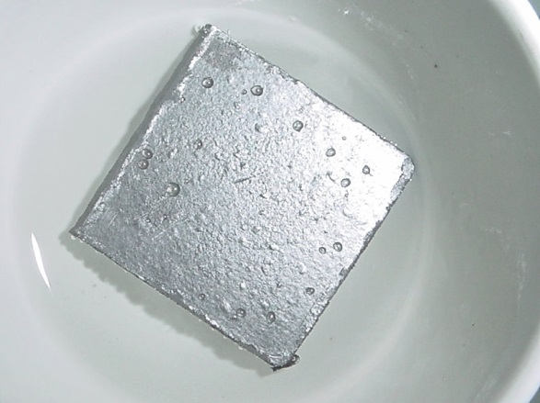
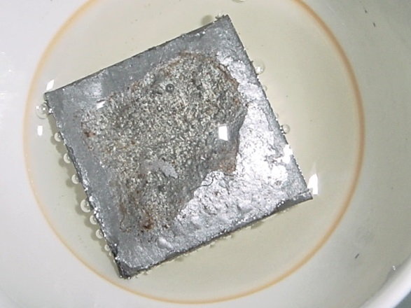
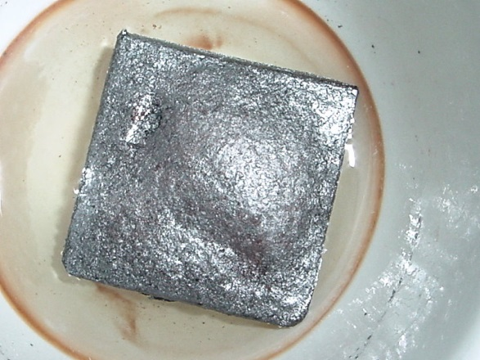
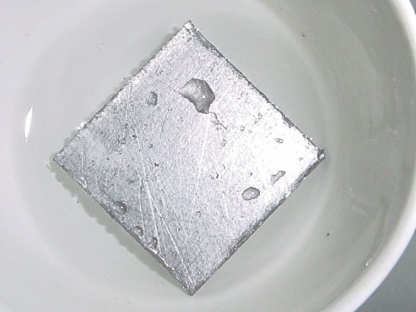
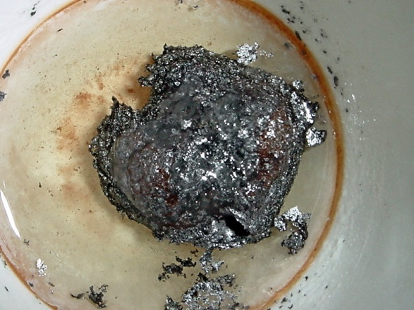
    Oxidations of Graphite Films in Molten Salt of
    KNO₃ at 350°C
high performing graphite film
no name graphite film
day 96
day 30
day 1
day 3
day 60
High Performing Graphite

Slide 17
What is the Practical Influence of Mass-Loss by Oxidation?
High Performing Graphite

Slide 18
Is there any Improvement?
XP-Technology

Slide 19
Enhanced Stability against Oxidation by XP-Technology
graphite purity 99%
Mass-loss by oxidation acc. to DIN 28090-2, TGA at 670°C/h
XP-Technology

Slide 20
What Else?
XP-Technology eliminates one principle weakness of Graphite
Have a look…
XP-Technology

Slide 21
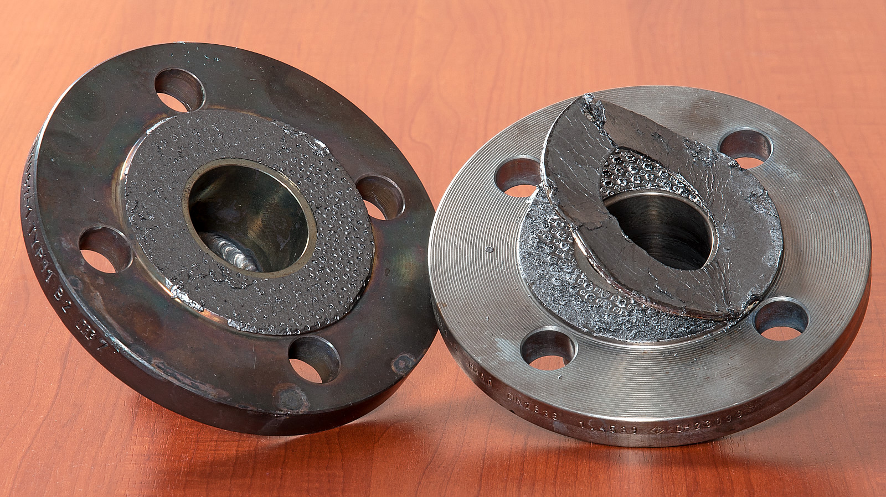
Conventional Graphite Gaskets
48 h @ 300°C
@ 30 MPa
air
XP-Technology

Slide 22
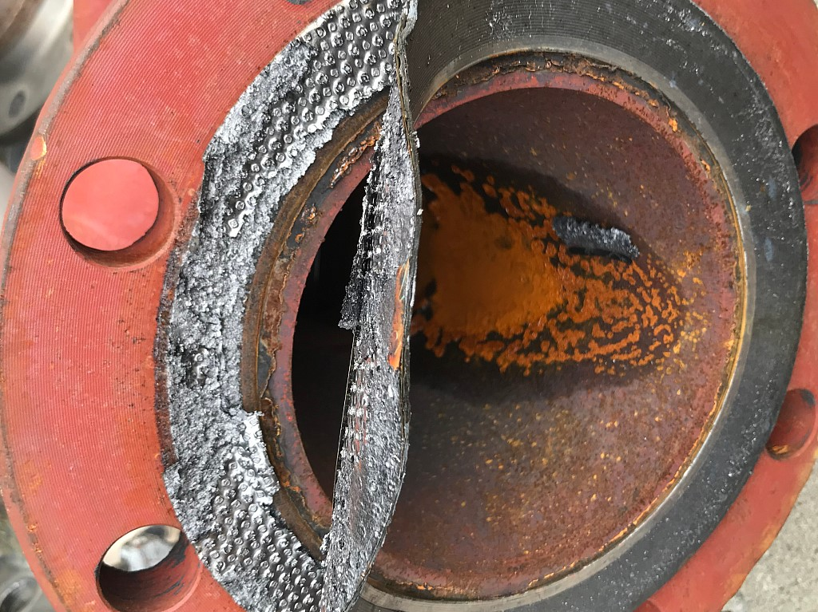
Conventional Graphite Gaskets
(Power Plant of Chemical Production Site)

Slide 23
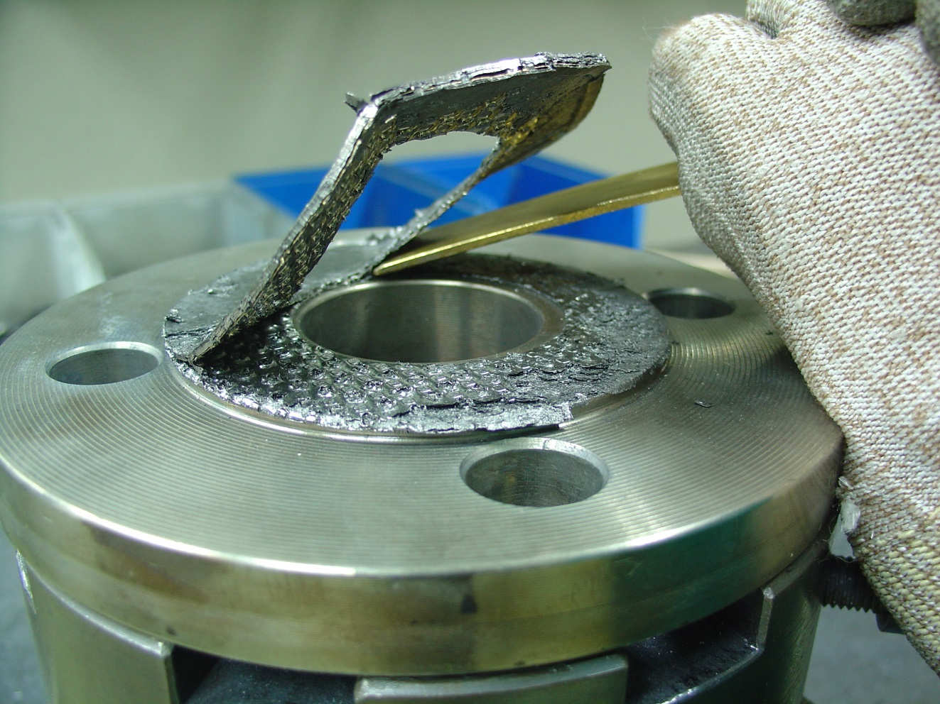
Conventional Graphite Gaskets
Time intensive dismounting of gaskets
Danger of damaging flanges
XP-Technology

Slide 24
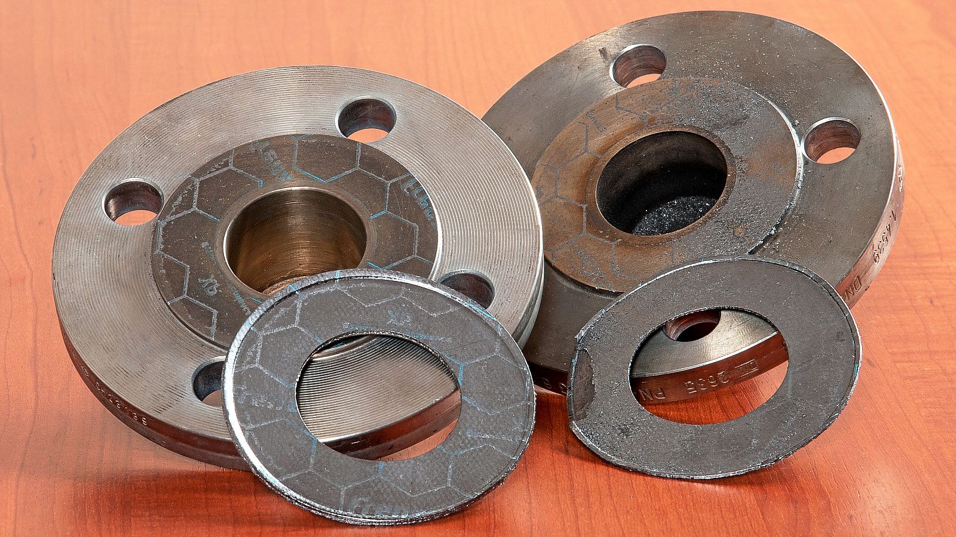
novaphit® with XP – Technology
48 h @ 300°C
@ 30 MPa
air
XP-Technology

Slide 25
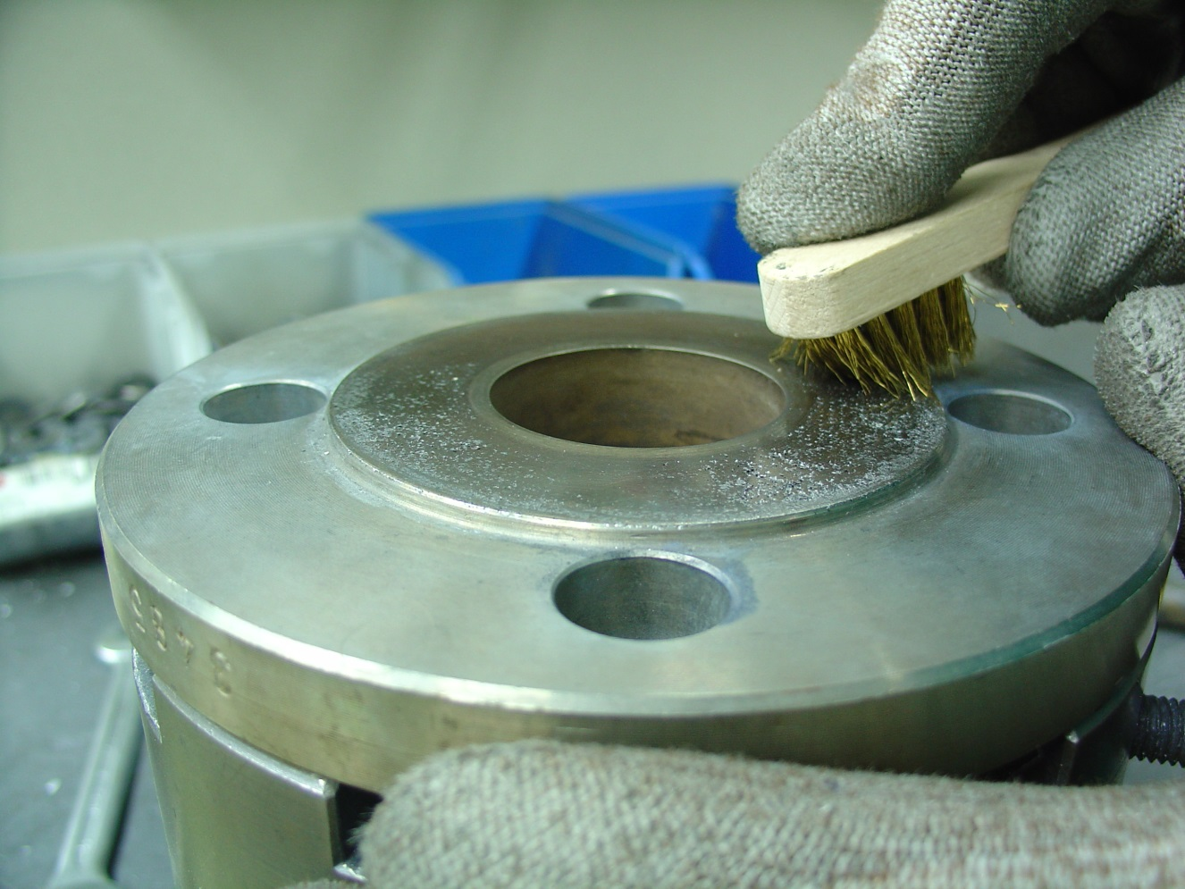
novaphit® with XP – Technology
Easy cleaning of flanges
Low risk of damaging flanges
XP-Technology
Notes:
Normally, residues are easy to brush off

Slide 26
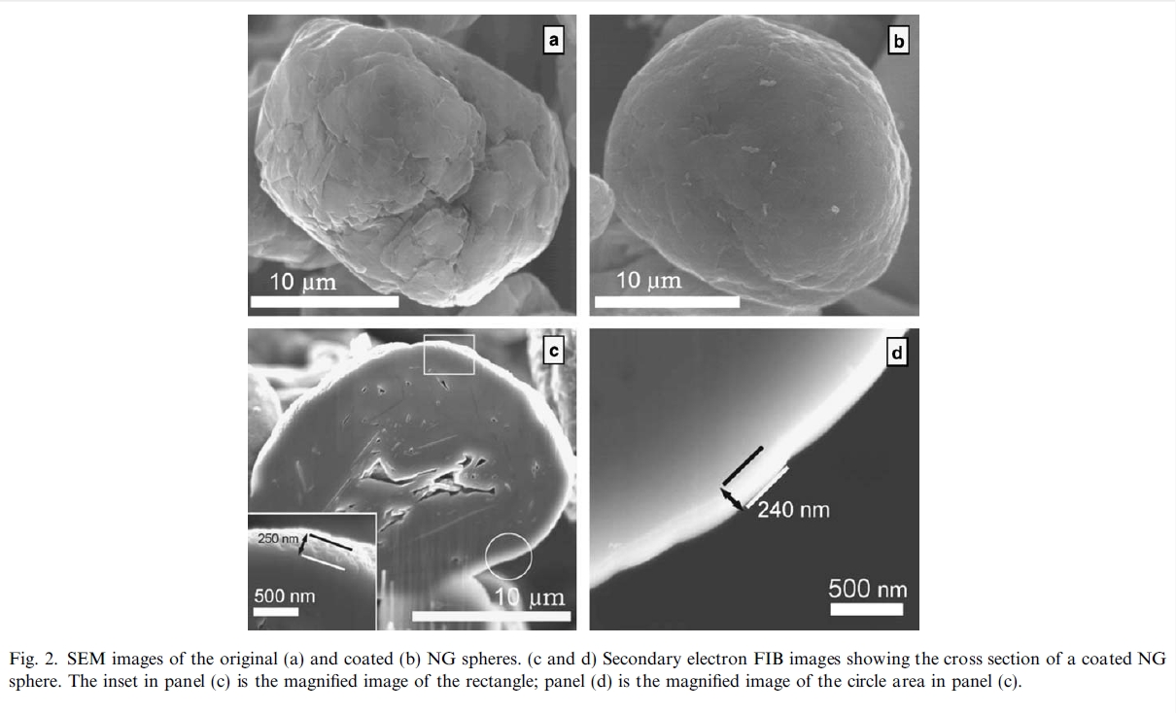
XP- technology for novaphit®
principle of action
HL Zhang et al., Carbon 44 (2006) 2212–2218.

Slide 27
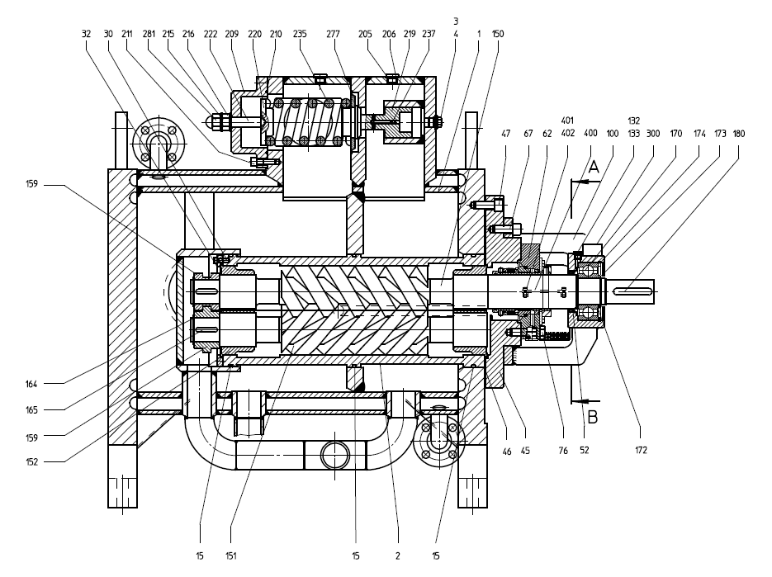
Leistritz Pumpen GmbH
Pump: L2NG-106/180-AHMKVI-G
Medium: Vaccuum Residue und Heavy Fuel Oil
Gasket: novaphit® SSTC TA-L with XP Technology (46)
Design Temperature: 260°C
Design Pressure: 10 bar
XP-Technology

Slide 28
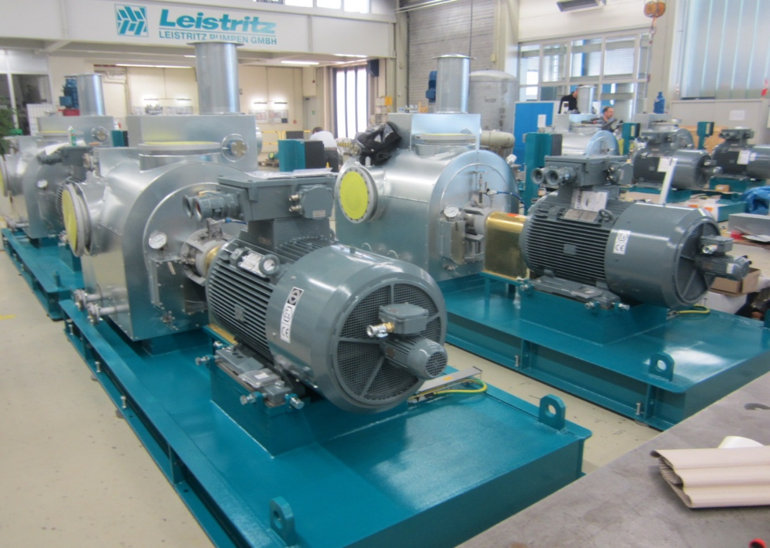
Leistritz Pumpen GmbH
Type: L2NG-220/125-AHMKRA-G
Medium: Bitumen
Gasket: novaphit® SSTC TA-L with XP - Technology
Design Temperature: 270°C
Design Pressure: 16 bar
XP-Technology

Slide 29
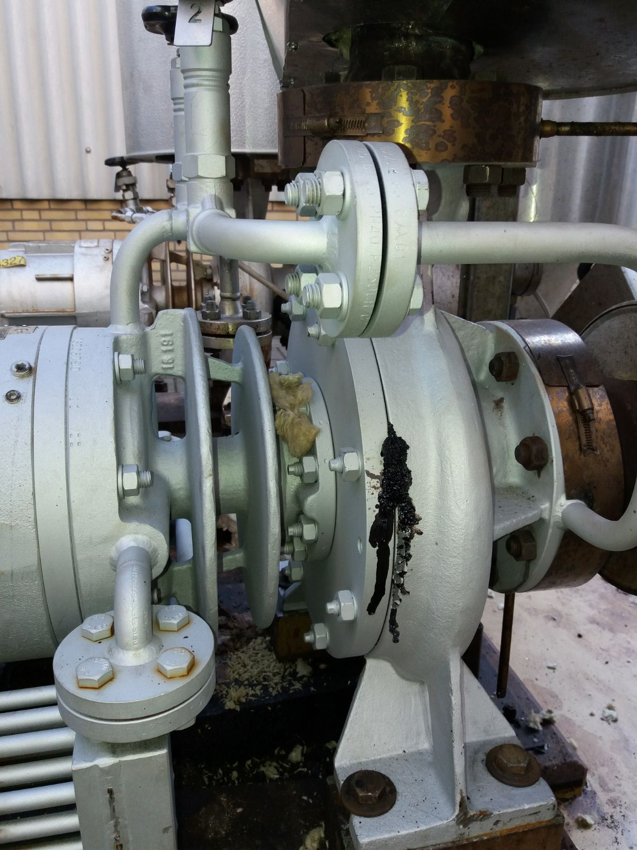
Typ of pump: magnetic clutch
Medium: Dowtherm RP
Max. temperature: 350°C Pressure: 16 bar Type of gasket: originally novaphit® VS Width: 4mm Leakage after 6 month
Optimized construction with increased number of bolts
New gasket type: novaphit® SSTC TA-L with XP -Technology Width: 6mm > 12 months without leakage
XP-Technology

Slide 30
Summary novaphit® with XP-Technology
Works in the complete temperature and media range of graphite gaskets
No damage of flanges caused by not recommended metallic reinforcement (tanged metal)
No risk of damaged flanges by simplified cleaning processes (XP-Technology)
Reduced maintenance costs by quicker dismounting of gaskets (XP-Technology)
Increased longterm performance (XP-Technologie)
XP-Technology

Slide 31
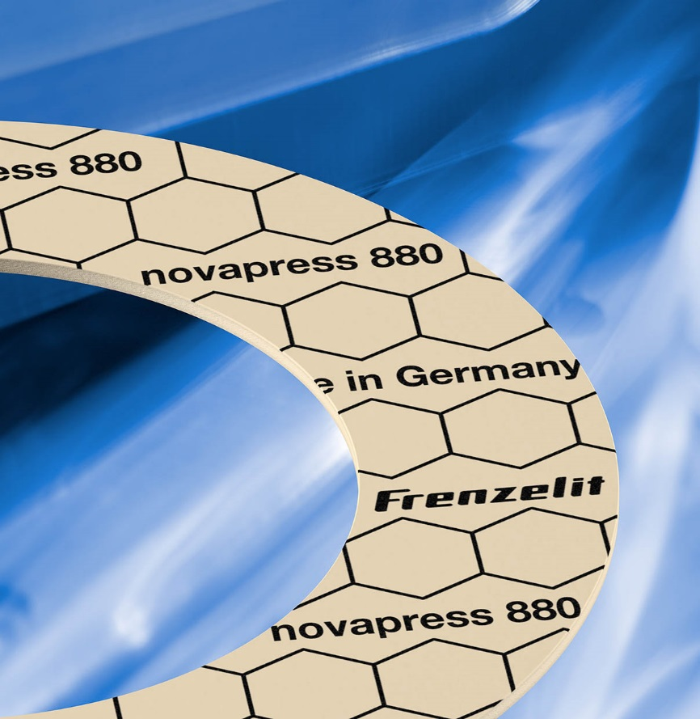
Increase in Performance at NBR/Ar Gaskets
novapress® 880
Notes:
14
Entwicklungssprung 1: bislang unerreichte 13555-Kennwerte
Entwicklungssprung 2: signifikant verbesserte Anpassungsfähigkeit bei gleichzeitig immer noch sehr guter Mechanik unter Temperatur
Weltneuheit: Gasket Code Technology

Slide 32
Forderung aus VCI-Leitfaden
Q_{min} bei 40 bar max. 30 MPa
Q_{Smin} bei Q_{A} 30 MPa max. 10 MPa
Notes:
14
Die beiden Punkte zeigen wichtige Eckdaten, die von modernen Dichtungen erfüllt werden müssen, wenn man sie gemäß VCI-Leitfaden (Verband der Chemischen Industrie) einsetzen will. Dieser Leitfaden erleichtert die Umsetzung der TA Luft für Norm-Dichtungen – also Rohrleitungen. Es muss nicht jeder Flansch berechnet werden, wenn die Dichtungen die Anforderungen des VCI-Leitfadens erfüllen.
Der grüne Punkt (Qmin) stellt die FP dar, bei der die Dichtung die Leckageklasse L0,01 bei der Montage erreicht.
Der blaue Punkt (Qsmin) bezieht sich auf die Entlastungskurven (der Übersichtlichkeit wegen im Diagramm hier nicht gezeigt) – also die minimale FP im Betrieb, bei der Dichtheit L0,01 noch gehalten wird.
Für Laien empfiehlt es sich hier, eine fiktive Belastungskurven und die dazugehörige Entlastungskurve per Pointer anzudeuten.

Slide 33
Notes:
14

Slide 34
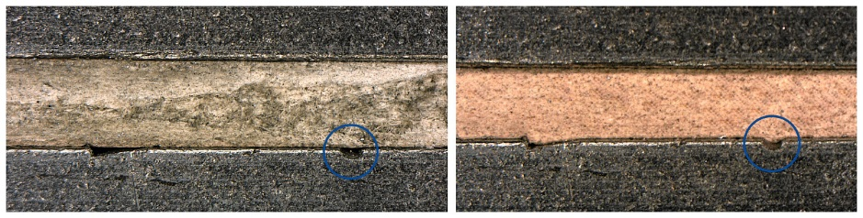
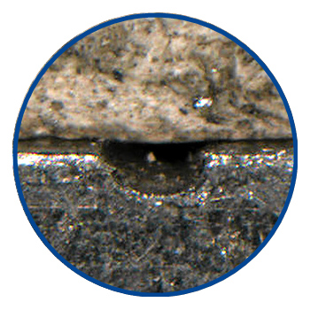
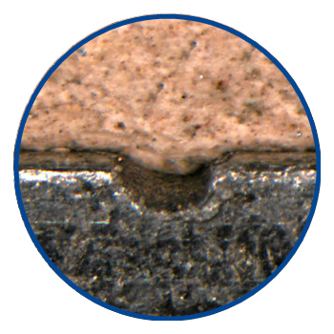
Extreme Adaptability
Surface pressure 20 MPa, gasket thickness 2 mm
competitors classic
fibre gasket
novapress 880
Compressibility ASTM F36J:
6 %
Compressibility ASTM F36J:
18 %
Notes:
14

Slide 36

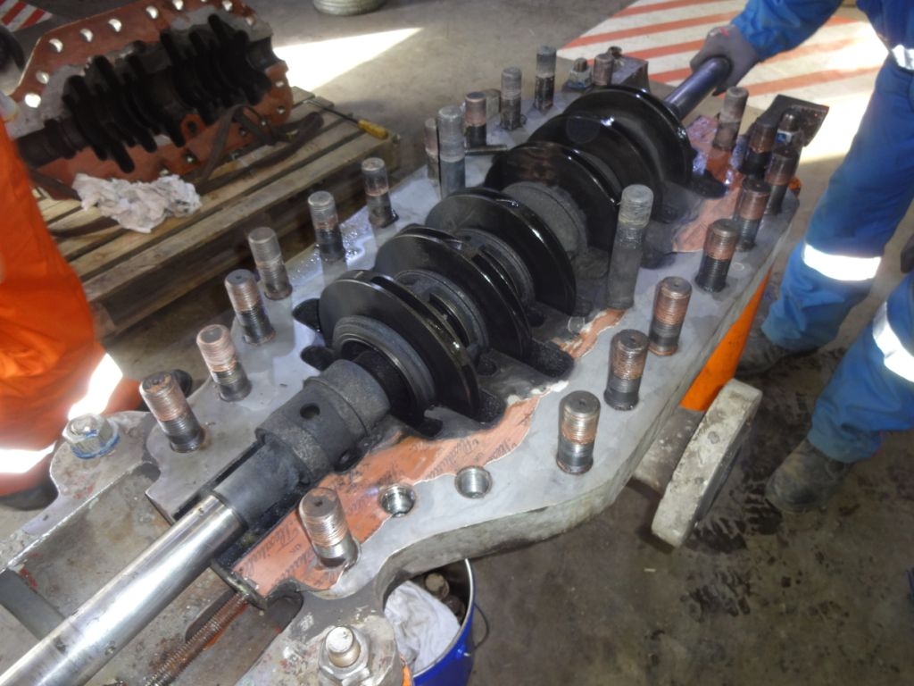
Leakage by
Corrosion and Elution

Slide 37

Leakage by
Corrosion and Elution

Slide 38

New Material novapress® 880 – Original Shape of Gasket
Result:
less leakage
But:
Not yet tight!

Slide 39



Slide 40
old shape
Aa = 416.489mm²
Qa = 30MPa
New shape
An = 229.643mm²
Qn = 54 Mpa
Qn/Qa = 1,81
An/Aa = 0,55

Slide 41

Optimized Shape
Result:
Ready for Serial Production

Slide 42

Damage and indentations
on an internal diffusor-plate
In this example a pit up to 0,3mm without flange revision is compensated by novapress® 880 (2mm)

Slide 43
Summary
NBR/Ar gaskets novapress® 880
Less machining of flanges and therefore increase of availability factors by increased adaptability of gasket material
Less corrosion on flanges and therefore less leakage due to increased adaptability of novapress® 880
Improved process safety during installation of the gasket due to increased forgiveness against flange damages or residues
Optimized shape of gaskets offers additional potential for safe flange connections

Slide 44
Annahmen für BASF LU:
zu öffnende Flanschverbindungen/a | 600000
Revisionszeitraum | 3…5 Jahre
Gesamtzahl Flansche/LU | 1800000
Anteil FA in den Flanschen [%] | 10
Anzahl FA in Stck | 180000
davon mit IB [%] | 30
Anzahl FA mit IB in Stck | 54000
davon ohne IB [%] | 70
Anzahl FA ohne IB in Stck | 126000
 | novapress 880 |  |  | klassische FA Dichtung
 | DN25PN40 | DN80PN40 | DN300PN40 | DN25PN40 | DN80PN40 | DN300PN40
Anteil [%] an den FA Dichtungen | 30 | 40 | 30 | 30 | 40 | 30
Anzahl FA Dichtungen mit IB in LU | 16200 | 21600 | 16200 | 16200 | 21600 | 16200
Anzahl FA Dichtungen ohne IB in LU | 37800 | 50400 | 37800 | 37800 | 50400 | 37800
Leckage [kg] im Betriebszustand für FA mit IB | 82 | 170 | 118 | 9822 | 4858 | 11192
Leckage [kg] im Betriebszustand für FA ohne IB | 191 | 397 | 275 | 5730 | 5384 | 12370
Gesamte Leckage in Kg/a je Abmessung | 273 | 567 | 393 | 15552 | 10242 | 23562
Gesamte Leckage in LU in kg/a | 1233 |  |  | 49356

Slide 45

World debut: Gasket-Code-Technology
Notes:
14

Slide 46

World debut: Gasket-Code-Technology
„Industry 4.0“
Traceability of each individual gasket regarding:
Material name
Production batch
Manufacturing period
Upon delivery (incoming goods inspection, quality assurance)
After dismounting (chemical and thermal stability)
Notes:
14

Slide 47


novapress® 880
novapress® 880 is latest state of the art and most modern FA gasket
Allows TA-Luft conforming design of flange connection systems acc to DIN 1591-1 / VDI 2290
Signifcantly improved „fitness for purpose“ due to increased adaptability (ca. 3-x !!!)
Reduced risk of leakage even with problems of flange assembly and torque
Sustainable reduction of fugitive emissions
Economic advantages due to significantly higher performance
Applicable for a wide range of media e.g. for natural gases, drinking water, chlorine, food etc. with option of standardization
Notes:
14

Slide 48
novapress® 880
Secure compliance with the VCI-criteria
Secure seal designs acc. to DIN 1591-1 / VDI 2290
Higher safety level thanks to lower leakage rate even in case of low surface pressure
Only one material for gaskets with or without eyelet („one fits all“)
Higher tolerance to flange uneveness thanks to higher adaptability (3x more !!!)
More safety thanks to traceability of cut gaskets
Economic advantages due to significantly higher performance
Notes:
14

Slide 49
Resumee
Modern gasket materials show significant increase in sealing performance!
Test us!

