Slide 1
Proper Planning of Temporary Power to Mitigate Risk, Reduce Operating Costs and Increase Efficiencies
The global Shutdown, turnaround, maintenance and inspection forum
Barney Smith
Business Development Manager
Aggreko Turnaround Services

Slide 2
Agenda
  Who is Aggreko
  Value of your Rental Company
  The Value of Early Engagement
  Temporary Power
    Challenges & Considerations
  Safety and Documentation
  Remote Telemetry to Capture Data
  Case Study

Slide 3
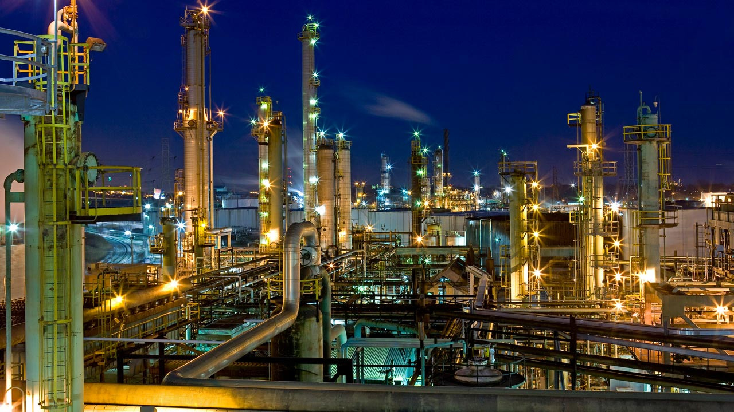
Who is Aggreko?
Supplier of mobile and modular equipment
Power generation and distribution
Temperature control and process cooling
Global footprint

Slide 4
Evolution of the Rental industry
  30 years past, equipment was owned and maintained by the site owner.
      Expensive to maintain- additional overhead
      No return on capital
  In the mid 90’s, accounting laws changed making rentals favorable to capex.
  This has created the rental industry as we know it today, with a keen focus on price, timely deliveries, cost reporting.
  Leading with price has resulted in fewer services, creating a knowledge gap where owners order from a catalogue with limited input from the suppler.
  Clients need more from a supplier than a spec sheet – they need a technical resource with value added deliverables.
  If you’re not getting this from your supplier, procurement has let you down.

Slide 5
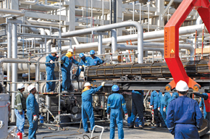
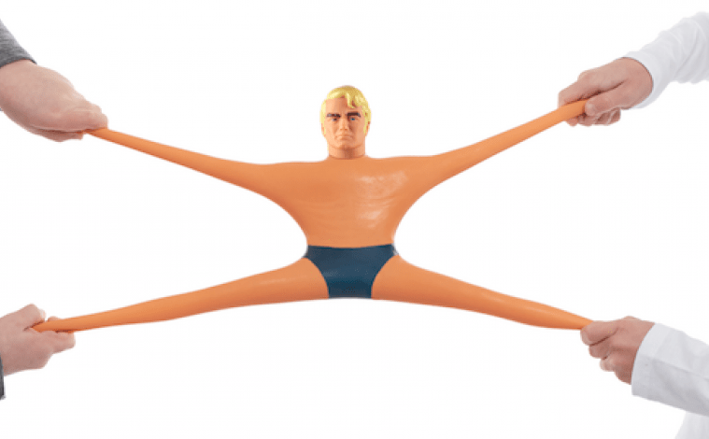
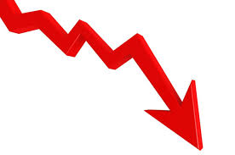
What we know about turnarounds
  High Risk Exercise
    Very hazardous environment
    Complex tasks being performed in tight quarters
    Large number of temporary workers not familiar with worksite and others
    Unfamiliar equipment in the area
  Turnarounds Stretch and Organization to it’s Limits
  Loss of Profit – “If you’re not running, you’re losing money….

Slide 6
Early Engagement delivers value
Strategic Planning
Scope Planning
Detail/Task Planning
Pre-Turnaround
Turnaround Execution
Look Back
$
$
Reduces Cost
Shortens Schedule
$
Reduces QHSE Exposure
$
$
$
Rental Company
Notes:
Here’s a graphic depiction of the steps a client goes through during the planning cycle. Aggreko’s value is significantly more when we work with clients early on. As you move clockwise, our value diminishes.

Slide 7
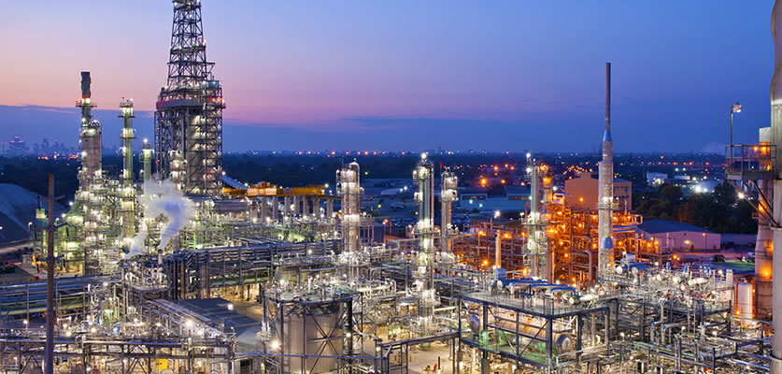
Let’s talk temporary power
Significant safety hazard to workers
Planning and documentation delivers safe, reliable and efficient systems
Crucial to a successful and incident turnaround

Slide 8
Temporary power challenges
Temporary power requirements vary based on turnaround scope, size and duration
  Power is typically not available where its needed
  Large number of contractors with different power needs
  Plans among contractors aren’t shared, so each need is independent
  Owners and contractors upsize power requirements to ensure adequate supply resulting in oversizing of equipment
  Data shows the typical power supply is oversized by 3 times
  The cost of temporary power can easily exceed € 1,000,000

Slide 9
Start early
Start early and establish a philosophy for temporary power
  Explore all available energy sources
    Is utility power available?
    Are hybrid technologies available to meet project demands?
    Is a feedstock such as natural gas available as a fuel source?
  Establishing a temporary power philosophy allows clients to align temporary power plans with corporate values to -
    Improve safety, and
    Reduce their carbon footprint

Slide 10
Grid Power with distribution vs Generators
Grid Power with Distribution
  15 kV and down is distributable
  Rental costs for distributive house power is about 40% of generator rentals – excludes fuel costs
  Reliability of distributive house power is virtually 100%
  Reportable emissions for distributive power are zero
  Eliminates the potential for petroleum releases
Generator Power
  Generators require maintenance every 250 – 400 hours of operations
  Reliability of tier 4 or stage 5 generators is impacted when oversized
  Rule of thumb for generator fuel consumption is 635 liters per day per 125 kVA of generated power (€ 960/day)
  Central power plant design is more efficient that a pod installation

Slide 11
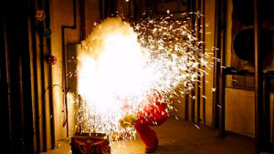
Arc Flash and arc blast
NFPA 70E, IEEE 1584
Industrial Safety and Hygiene News reports that:
  30,000 ARC flash incidents occur annually,
  Resulting in 7,000 burn injuries,
  Requiring 2,000 hospitalizations, and
  Resulting in 400 fatalities
An ARC flash happens when electric current flows through an air gap between two phase conductors or phase conductor and ground

Slide 12
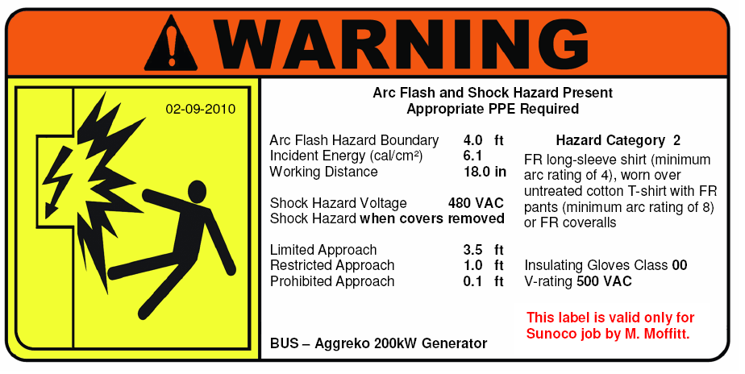
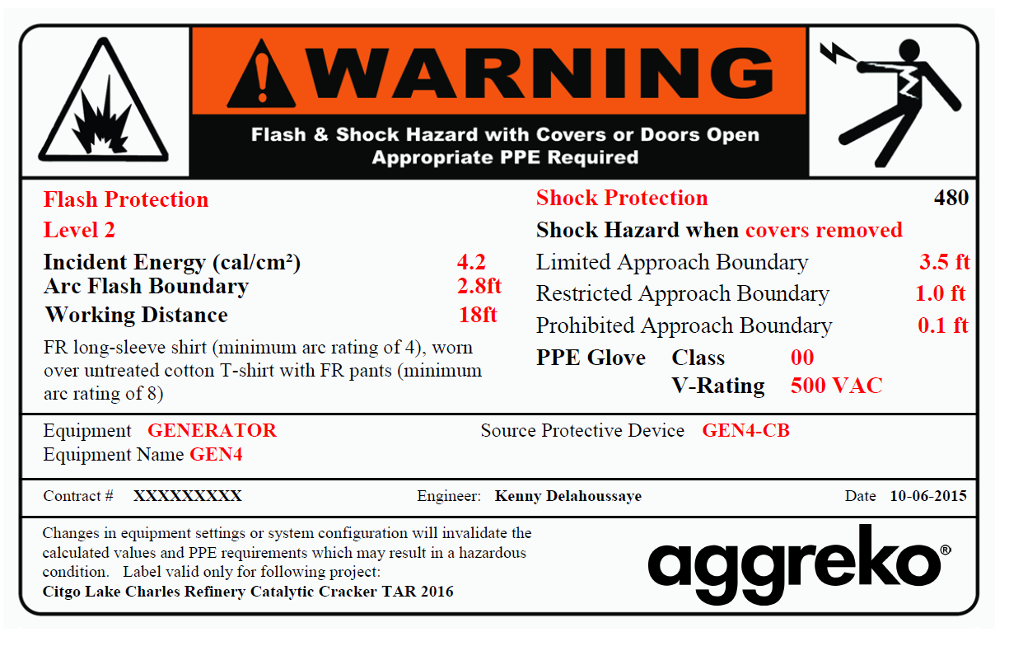
ARC Flash Labeling
ARC flash analysis and labeling doesn’t prevent an incident. It mitigates the risk by identifying -
The incident energy inside of an electrical enclosure
The PPE needed to mitigate electrical safety hazards
The boundaries required by others to remain safe
12

Slide 13
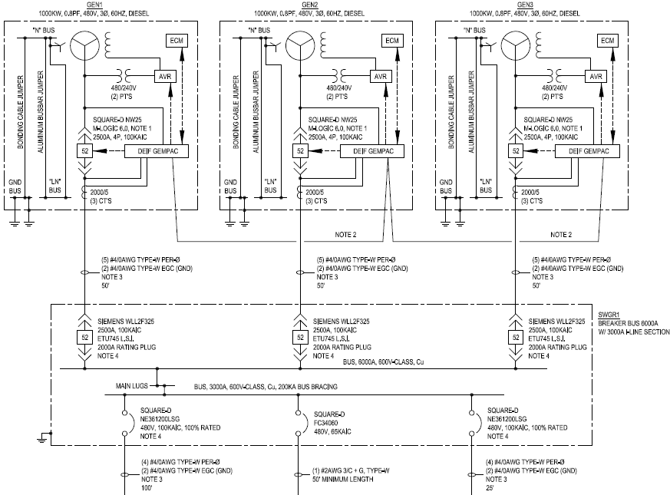
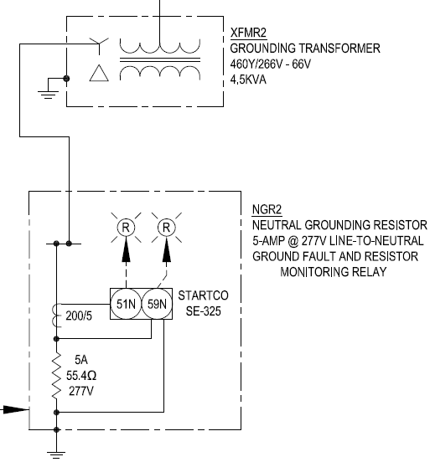
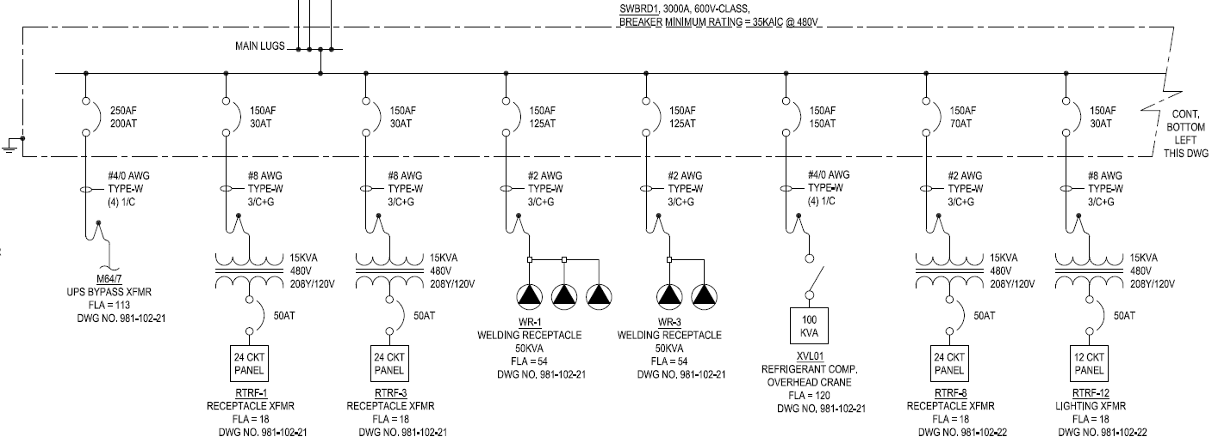
Single line drawings
Safety
Ensures design is fit for service
Efficiencies
Aids in installation and troubleshooting
Engineered Solutions to “Life Critical” situations

Slide 14
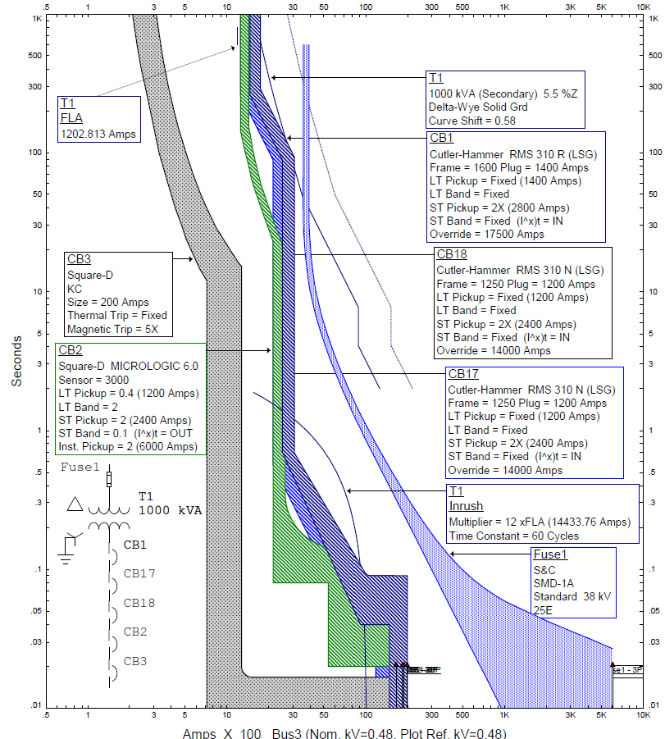
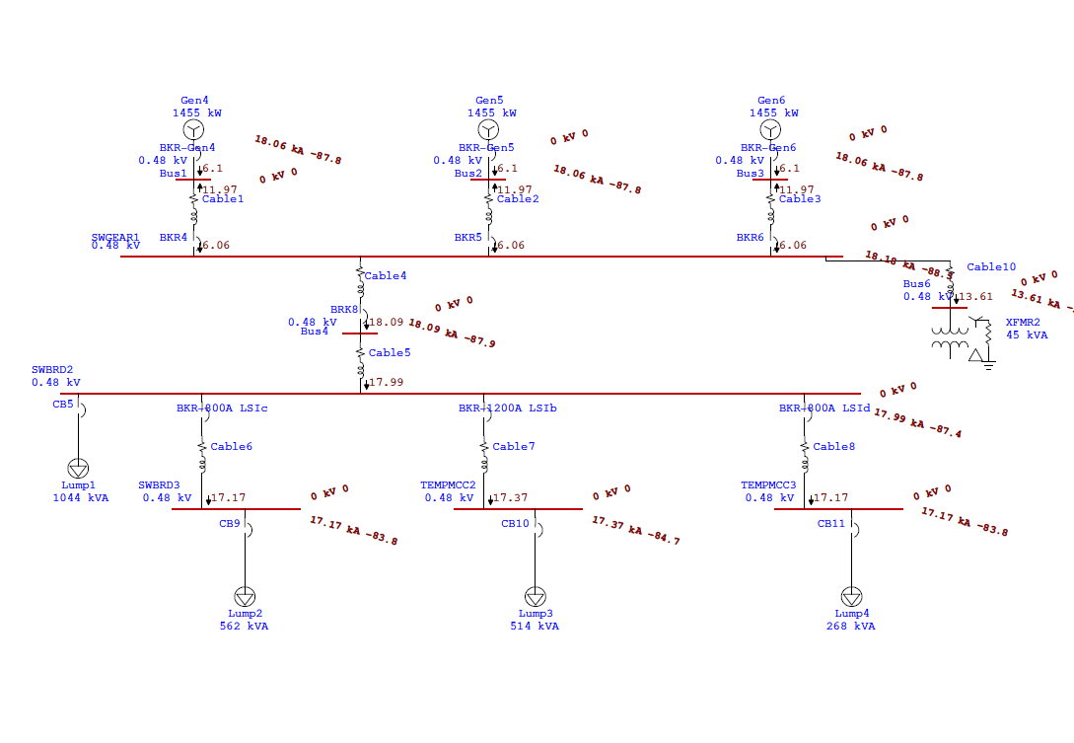
Protective device coordination
Protective devices:
Protect against overcurrent of
Protect against faults or short circuits
Settings are important:
Low settings result in nuisance trips
High settings allow fault to flow through the device creating significant hazards

Slide 15
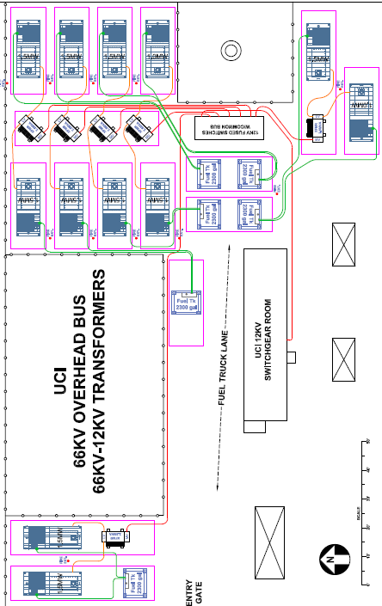
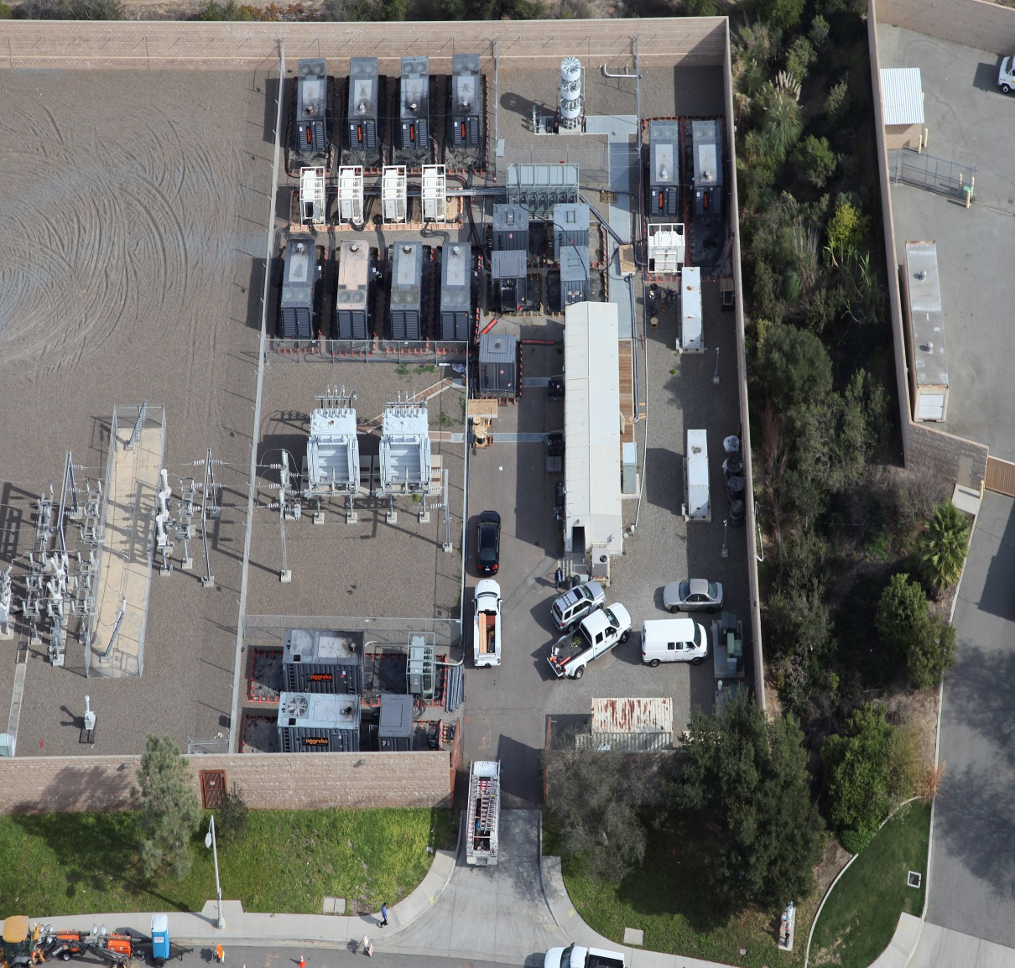
Plot drawings vs actual installation

Slide 16



Aggreko
Remote
Monitoring
(ARM) improves uptime and helps keep our customers operations running at peak efficiency.
Equipment Monitoring
!
Remote Diagnostics
Issue Resolution
Data Capture
Avoid Preventable Failures
Right-Size Equipment
Maximize Uptime
Accelerate Troubleshooting

Slide 17
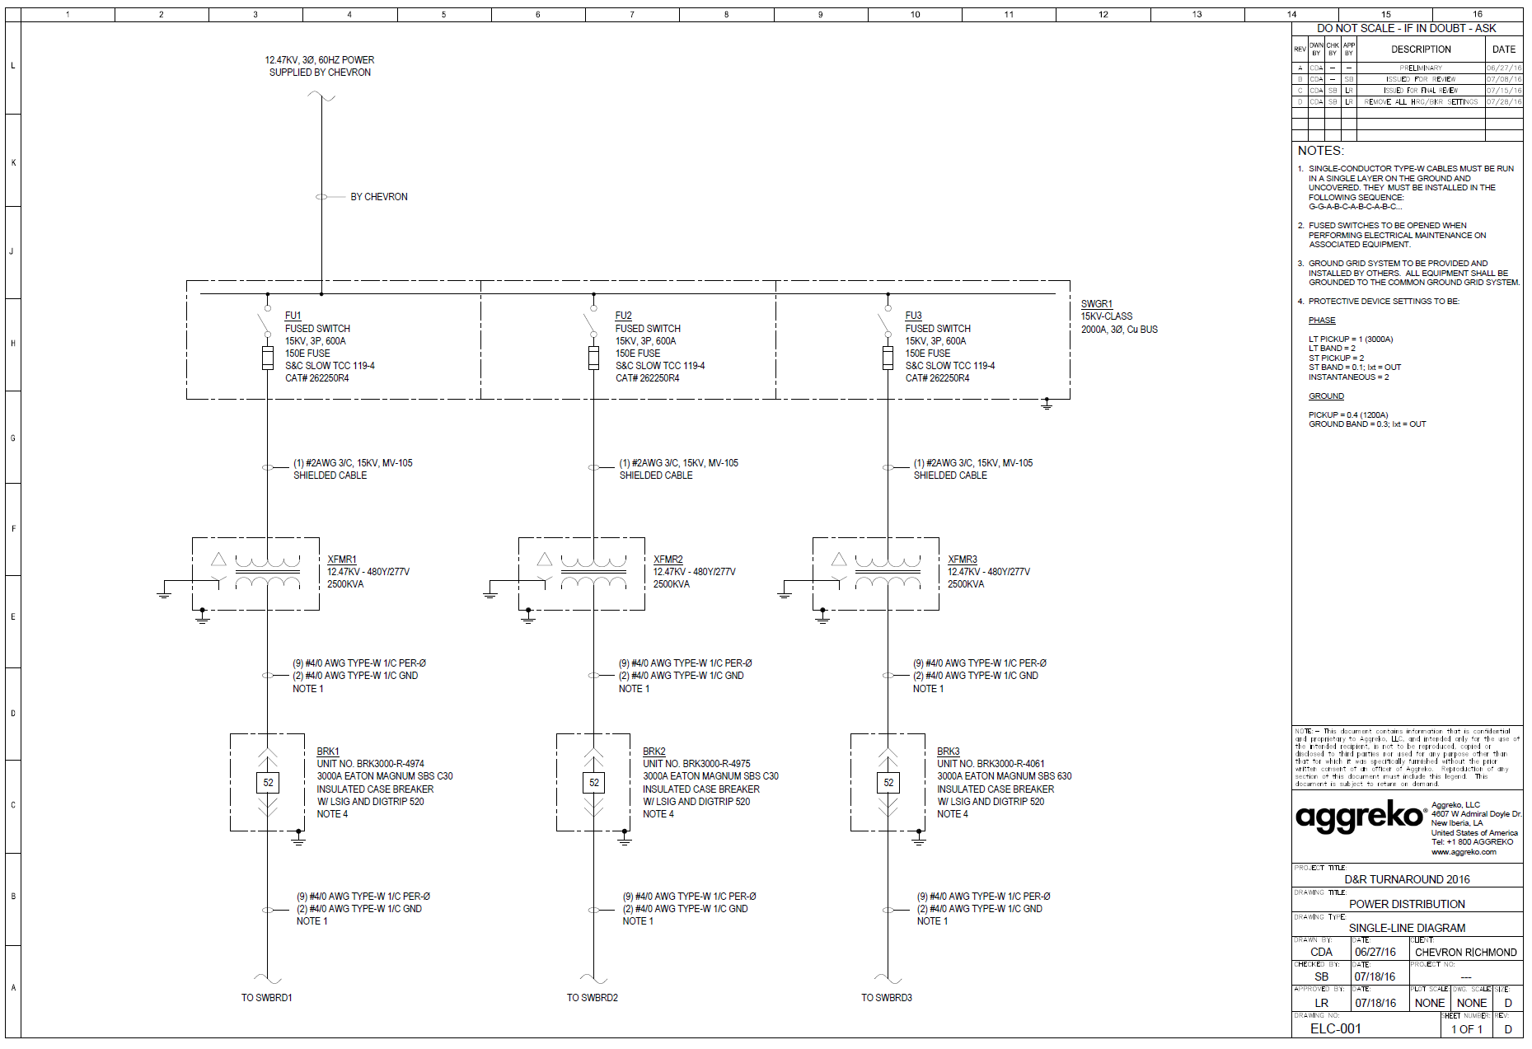
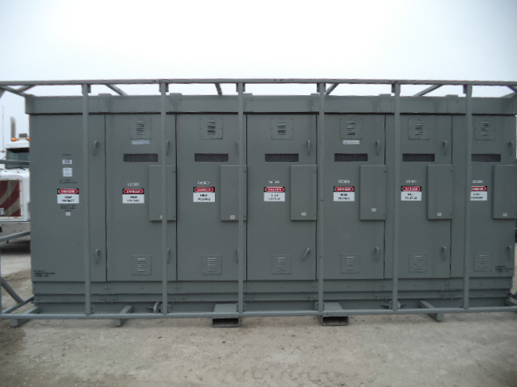
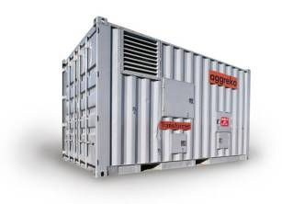
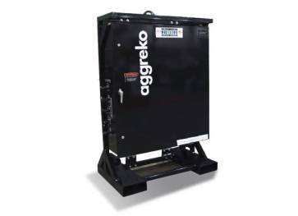
Optimizing house power
Challenge
Provide a zero emissions power solution for the FCC and Alky turnaround
Solution
13 MVA electrical distribution system
2400 – 480V
Impact
Zero emissions
Zero environmental impact – spent oil and filters

Slide 18
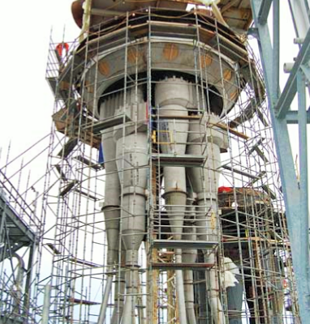
Project magnitude
  75 day outage with 1200 contractors on site
  FCC reactor head replacement
  Complex electrical distribution project – supported maintenance activities on 12 different levels up to 190 vertical feet
  830 hours – engineering and project management
  13 MVA – capacity to power 13,000 homes
  Supported 69 construction loads
  15 miles of cable – enough to encircle the refinery 3 times

Slide 19
Project timeline
  8 Months from concept to installation
  March 30 – LOI issued to develop scope
  April 12 – First exchange of information
  May 8 – Engineering and project manager onsite for project walk
  October 19 – Commercial proposal issued and PO received
  November 6 – Equipment delivery begins
  January 15 – Project commissioned
  April 10 – Decommissioning begins

Slide 20
Load Analysis – Connected vs actual
Level/Area | Equipment | Estimated Demand Factor | Connected kVA | Actual Peak kVA | Actual Avg kVA | Actual Demand Factor
Ground (Pump Row) | Transformer T1 | 37% | 5,983 | 800 | 200 | 13%
Reactor R10-12/Regen X10 | Transformer T2 & T3 | 70% | 3,192 | 2,000 | 1,000 | 63%
Reactor R10-12 Team | Transformer T4 | 83% | 1,737 | 1,000 | 250 | 58%
 | FCC Total |  | 10,912 | 3,800 | 1,450 | 35%

Slide 21
Value Delivered
  € 655K - Savings, distributive power vs. generators
  € 800K – Diesel cost avoidance
  € 572K - Soft savings
    Continuity of operations
    Data from recorders to right size 2023 outage – peaked at 50% of system capacity
    Environmental impact – zero emissions, spent oil/filters, petroleum releases
  Zero environmental impact

Slide 22
Things to consider
Best in Class Operators -
  Establish a temporary power philosophy in line with corporate values
  Identify temporary power requirements early during task planning
  Consider grid power as the first option
  Supply power to all contractors
  Challenge power needs
  Centralize power as opposed decentralize
  Treat temporary power installations the same as permanent facilities

Slide 23
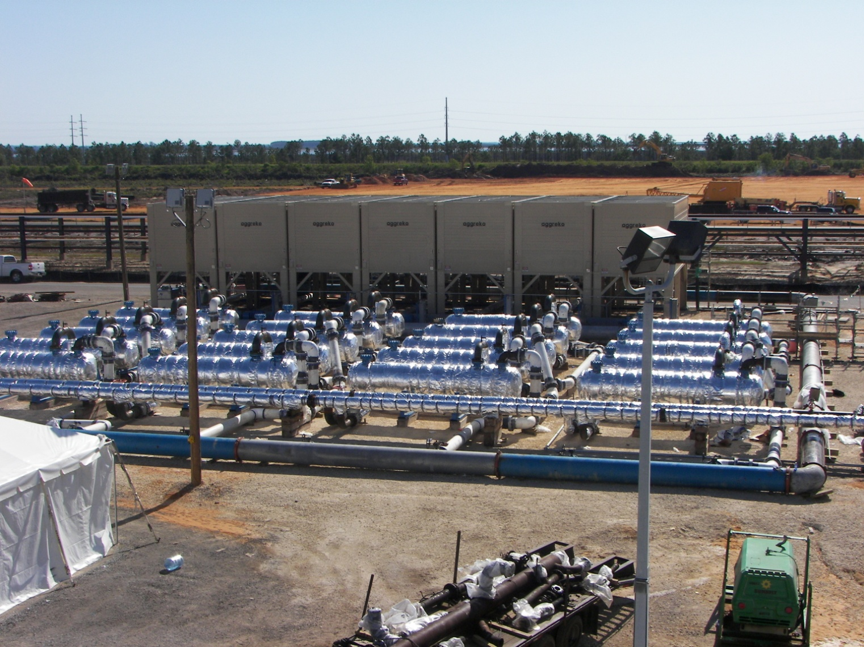
Decoupling crude and coker
Challenge
Design system to cool 75KBPD of HSFO from 176C to 65C
Solution
Complex system consisting of multiple heat exchanger trains and cooling water system
Impact
Allowed the crude unit to continue operations while the coker was out of service

Slide 24
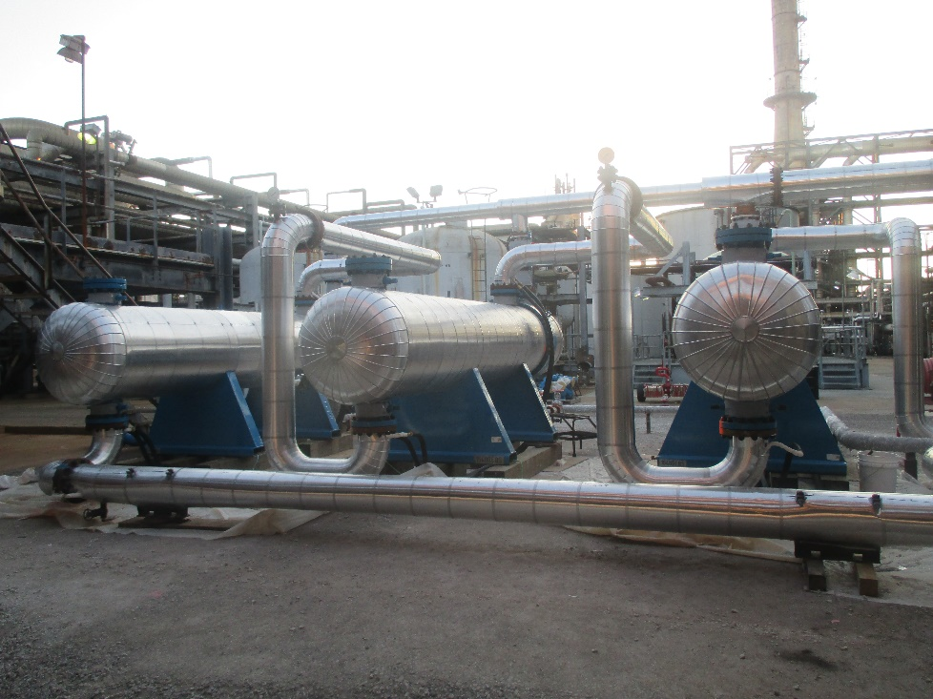
Hydrotreater reactor cooling
Challenge
Design system to cool ULSD Reactor from 150C to 37C
Solution
Three 185 m2 exchangers with receiver drum, pumps and chiller
Impact
Reduced reactor cooldown time by 49 hours

Slide 25
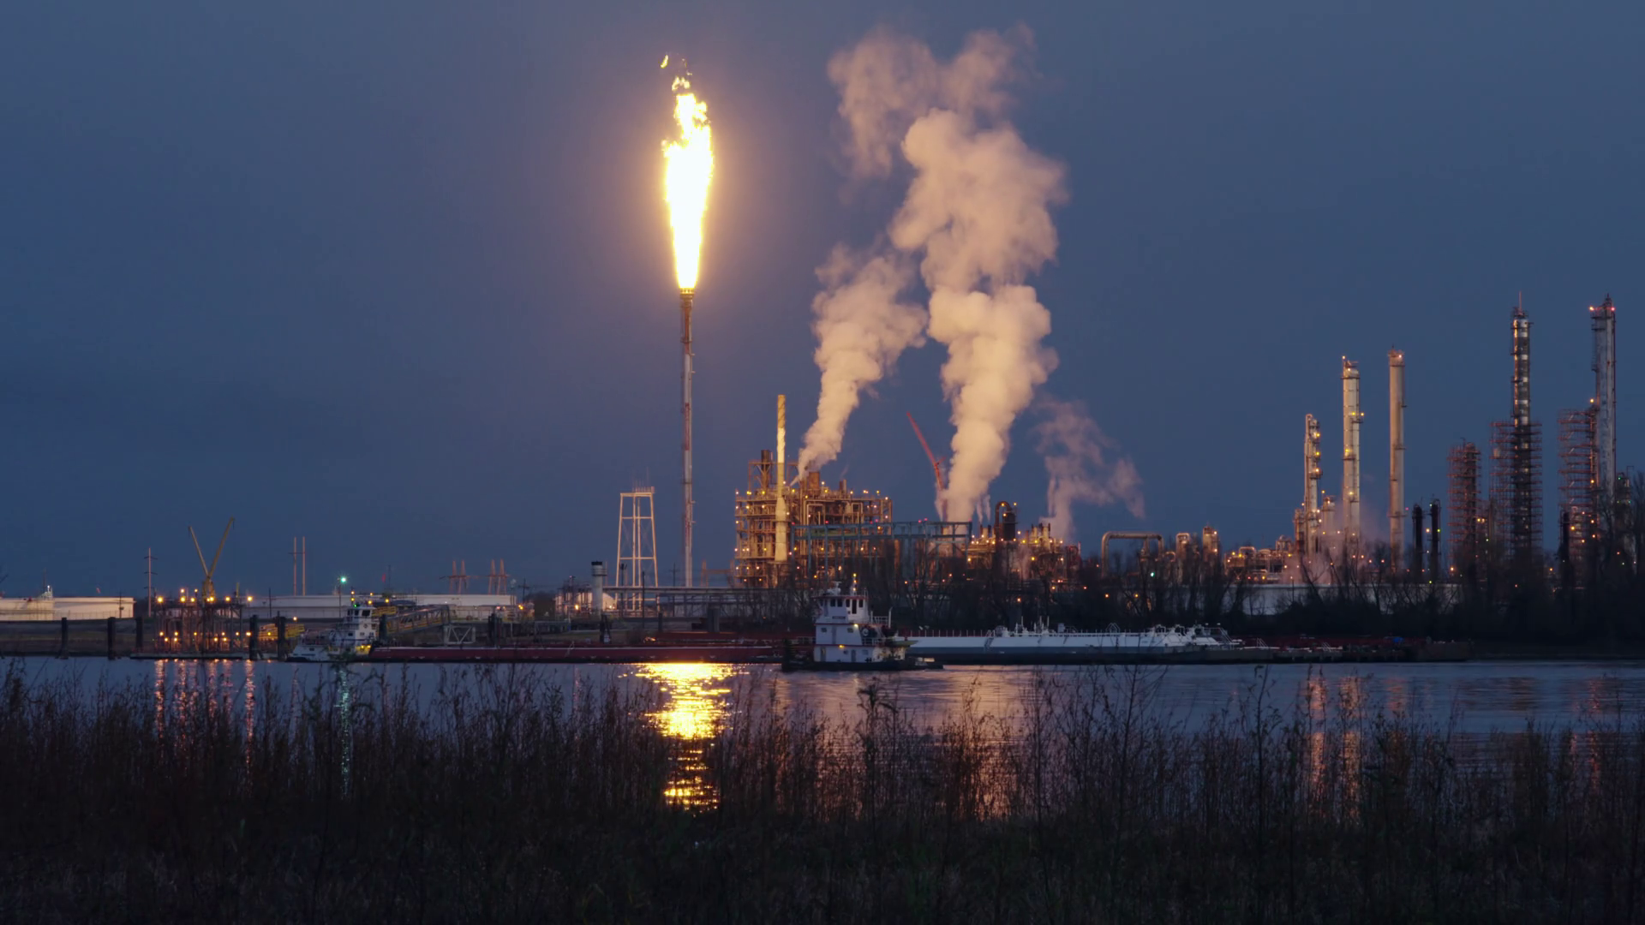
Unloading the flare during unit decontamination
Challenge
Design system to alleviate flaring during de-inventorying and steam-out
Solution
Replicated flare gas recover system to condense C3 + and effluent
Impact
Significantly reduced emissions
Flaring limited to non-condensables
Expedited steam out

Slide 26
I know what I know, I know what I don’t know, therefore I know everything
– author unknown

