Slide 1
AVOIDING ASSET CARDIAC ARREST
Investing in marginal gains that make a real impact
Notes:
I want to ask you a question that has been debated by people for millenia….Do you believe in God? What about the concept of a creator….
We have all been created in some way, and most of us have:
A heart
A brain
kidneys
lungs
eyes
ears
and so on
Just like your creator, you need to intelligently build your assets foundation data to make sure the end creation has the best start to life…
In our body, we have just a few vital organs to look after like our heart and brain…I don’t know about you but I even struggle with those two… but in an asset there are multiple hearts and brains so its a lot more complex to manage asset health…
Before anyone asks, I’m not a trained medical doctor, but I would like to think I’m a data doctor and I’ve seen some really bad and good patients in my time…
My name is Hossein Ghavimi, I’m the research and development manager at Add Energy and I’d like to give you some insights into how you can invest in marginal gains that can have a real impact for your business so you can avoid asset cardiac arrest…

Slide 2
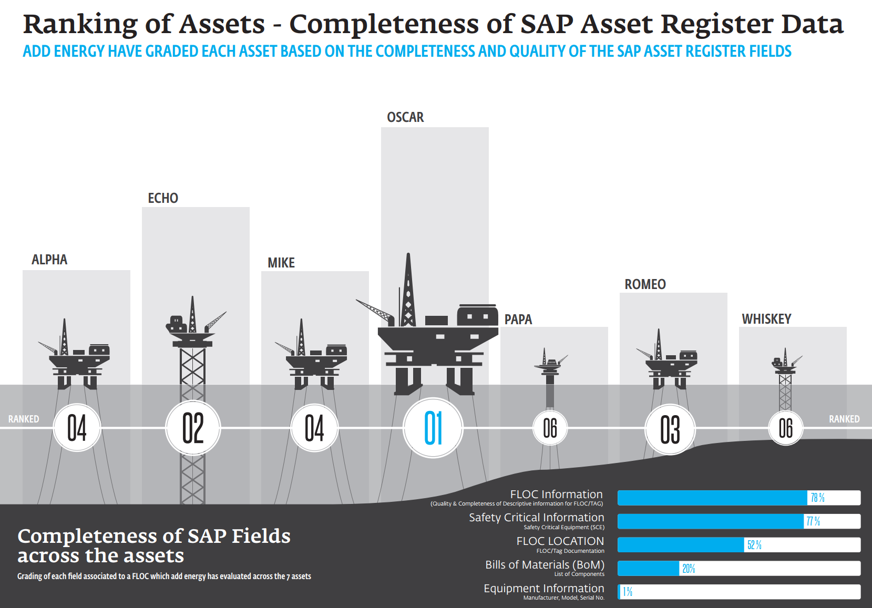
WHY DO I HAVE POOR FOUNDATION DATA?
Poor quality data handover from operations due to ambiguous contractual obligations
Lack of rigorously enforced central data standard across all assets
No continuous quality control of data gaps and changes
Belief from team that nothing useful is done with the data resulting in poor data entry

Slide 3
3 QUESTIONS TO ASK YOURSELF
For every piece of maintainable equipment, ask yourself:
What is it?
How important is it?
Where does it fit into the overall process?

Slide 4

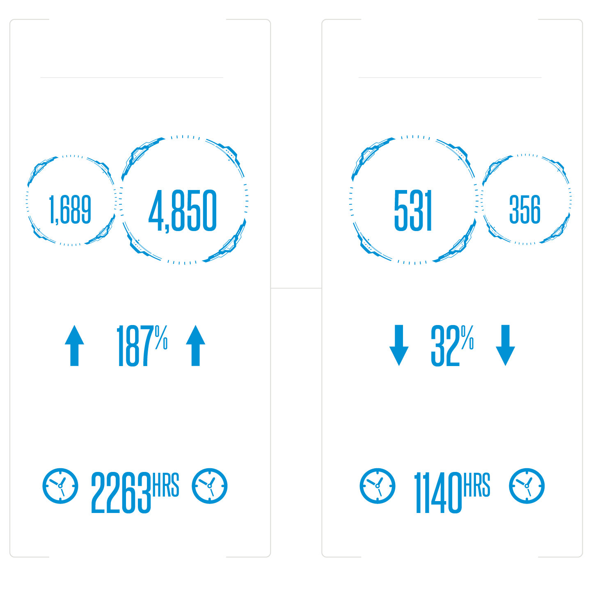
CLASSIFY AND ASSIGN CRITICALITY TO EQUIPMENT
Classification of Equipment Types
Equipment Criticality Assignment

Slide 5
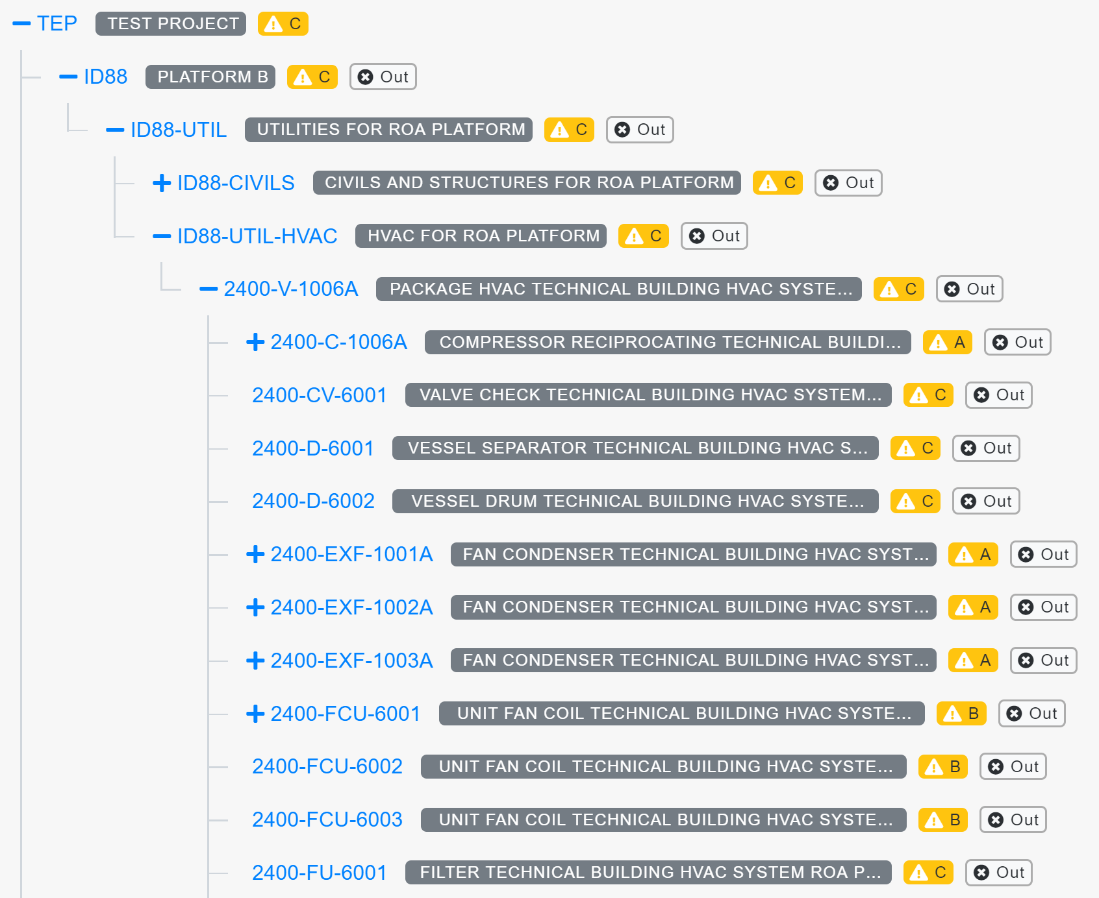
DEVELOP ASSET HIERARCHY

Slide 6

CONTRIBUTORS TO POOR ASSET HEALTH
Why is the right maintenance not done at the right time?
Ineffective maintenance that’s too generic or aligned to OEM
Over allocation of high priority maintenance
Poor PM planning leading to the spares and scaffolding not being in place
Asset is in “Firefighting mode”, where corrective maintenance overwhelms resources
Why is my health plan not working?
No effective exercise or nutrition plan, leading to random amounts of exercise and calorie intake
Lack of basic care to drink a reasonable amount of water daily and to brush teeth
Following generic health advice rather than working out what’s right for you

Slide 7

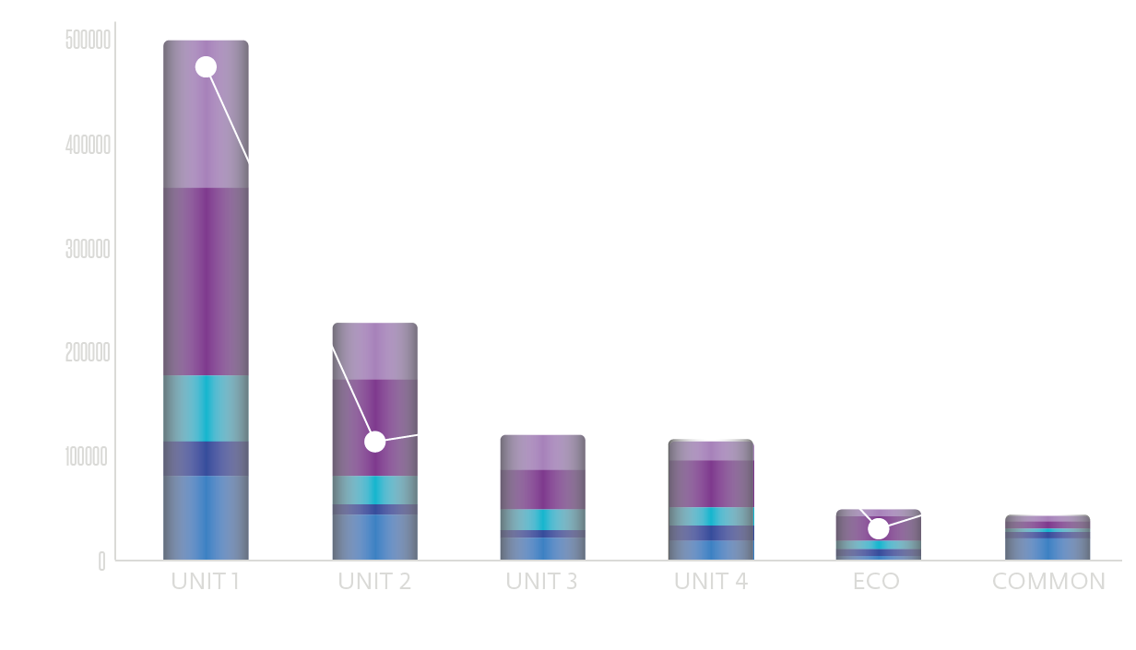
DOING THE RIGHT MAINTENANCE AT THE RIGHT TIME
To ensure you are in an sufficient state when you shutdown and to minimise downtime
$7,000,000
Worth of unnecessary Planned Maintenance removed in just six months
Notes:
Dental analogy – regular maintenance on your teeth, at the right frequency, with the correct movements will deliver good dental health

Slide 8

CONTRIBUTORS TO POOR ASSET HEALTH
Why do I have an inability to cope with maintenance backlog?
Resources not right for amount of maintenance asset needs
Maintenance is aligned to OEM recommendations in most cases and not optimized for the asset
Maintenance is not level loaded to ensure it is evenly spread
Why do I have an inability to cope with sleep backlog?
Continue to sleep less than recommended amount causing additional backlog
Watching TV or checking phone an hour before sleep
Eating dinner late

Slide 9
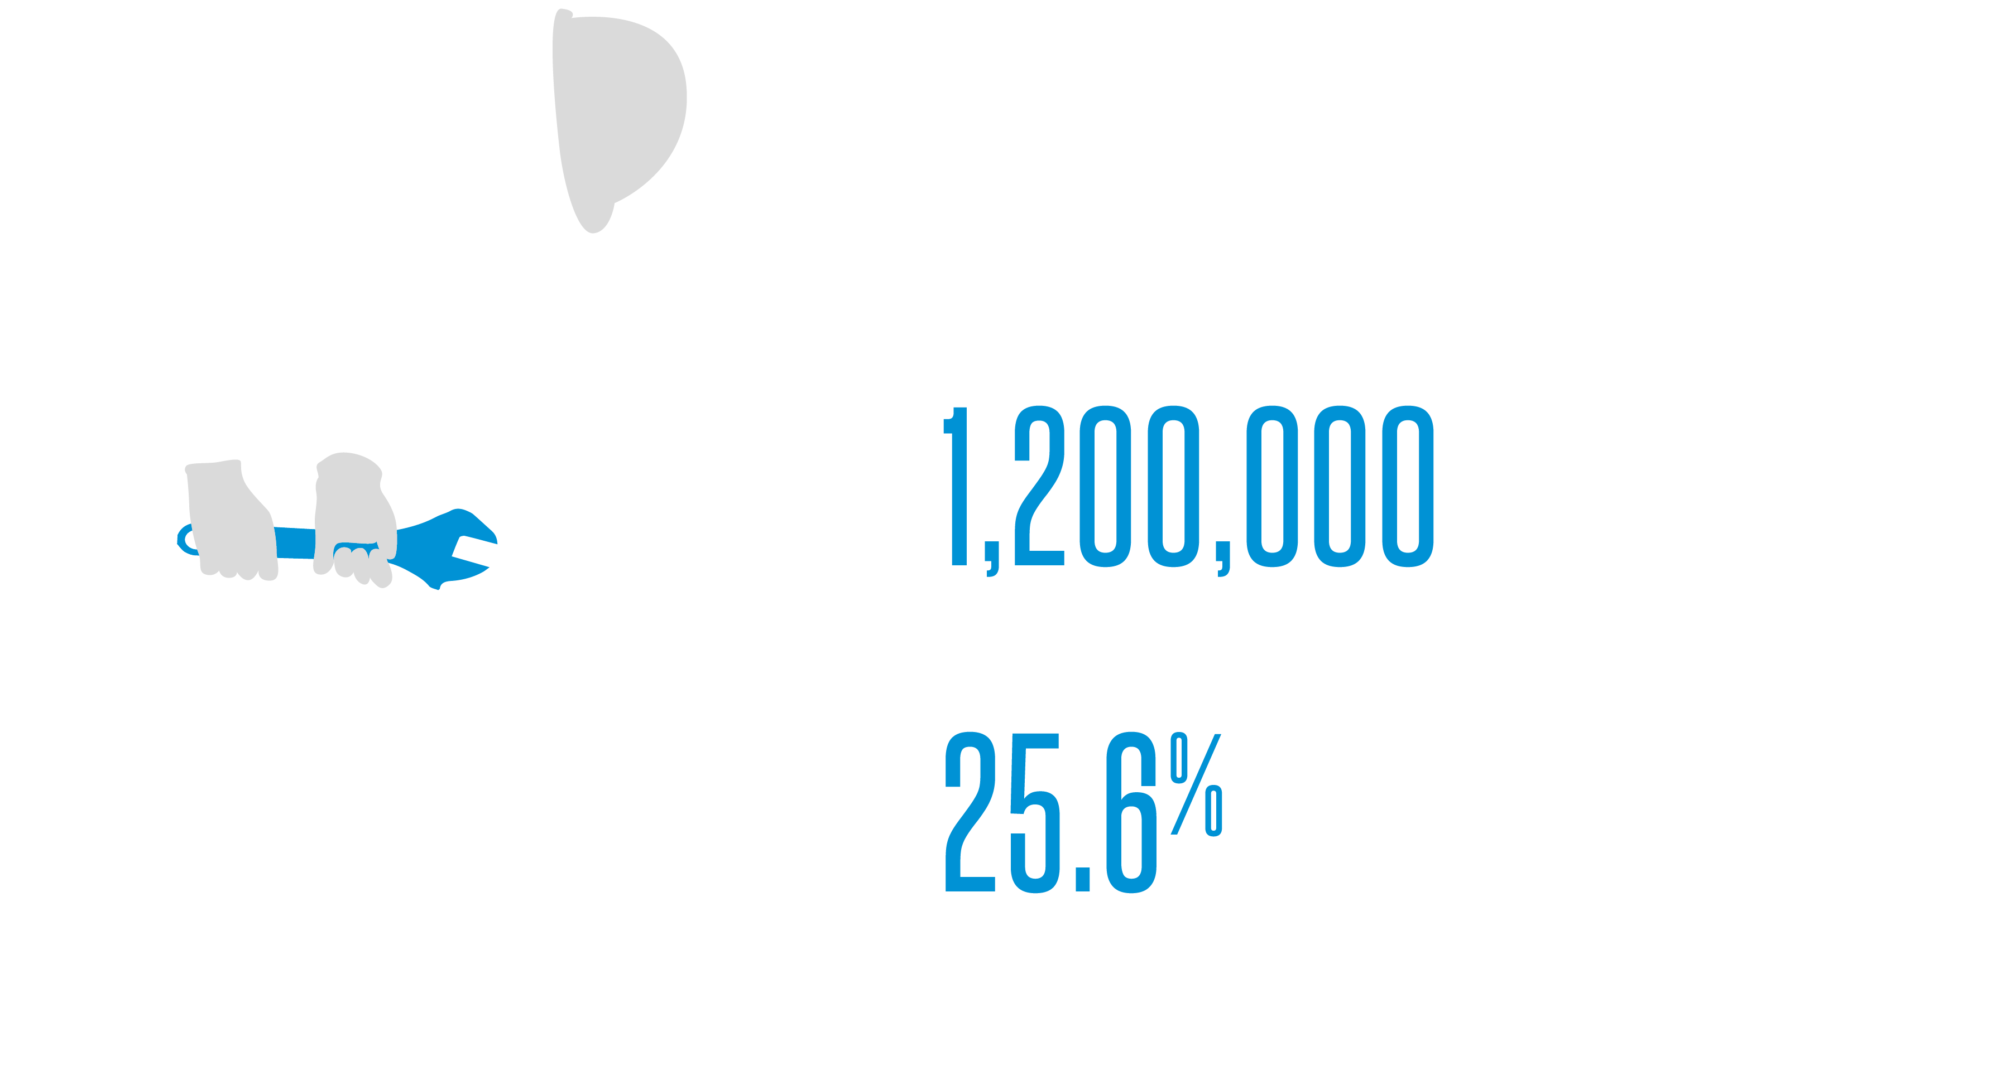
KEEPING ON TOP OF YOUR MAINTENANCE BACKLOG
Remove “fake” backlog
Cancel repeated overdue work orders
Review work coming up between a month and a year in advance
Plan work well with the right access requirements and spares in place

Slide 10
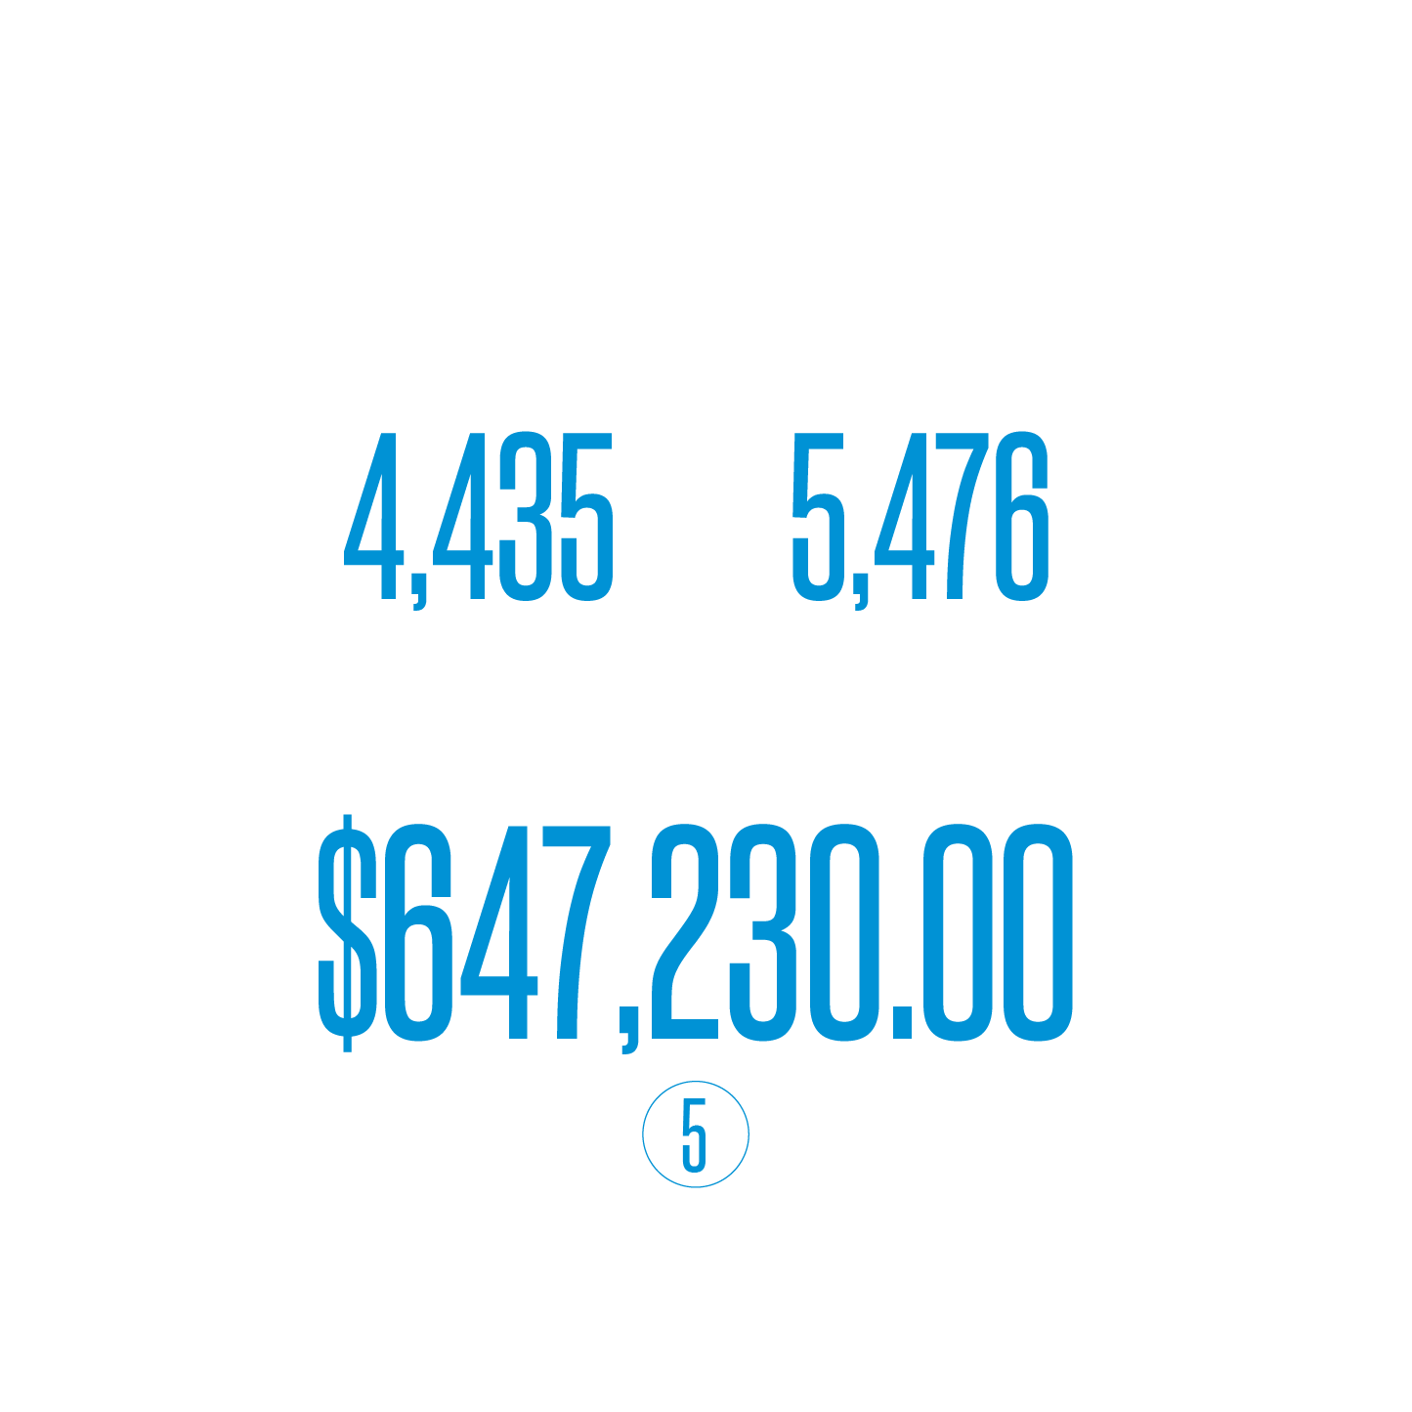

OPTIMISE AND LEVEL LOAD MAINTENANCE
Identify routing opportunities
Nest work orders
Remove redundant jobs
Optimise frequencies based on failure history
Level load mainteannce

Slide 11

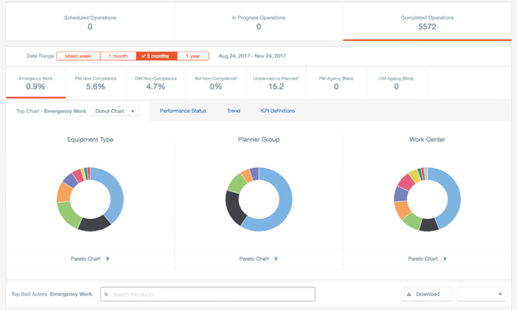
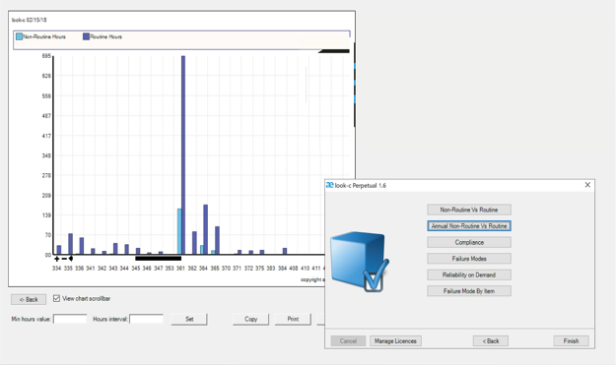
MONITORING COMPLIANCE WITH CHANGE
Continuous performance monitoring and improvement is key to good asset health
Maintenance Benchmarking and Business Performance Review
KPI Management

Slide 12
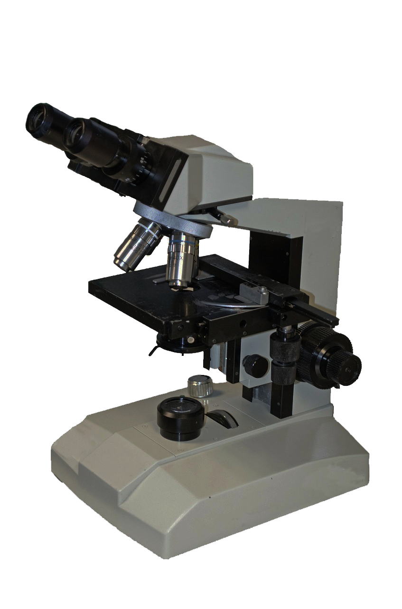
SHUTDOWNS ARE A MAGNIFYING GLASS FOR YOUR ASSET
Shutdowns will expose weaknesses caused by missed maintenance and poor planning and cost you millions
Top tips for shutdown planning
  Start planning 18 months before
  Create stage gates and action owners for shutdown planning
  Get buy in from all stakeholders into the plan
  Workshop work order estimates with team on the ground
  Carry out lessons learned after shutdown for continuous improvement
Top tips for making shutdowns easier
  Maintain your isolation valves correctly, you will rely on them during a shutdown
  Ensure vessel wall thickness tests are carried out to avoid nasty surprises during a shutdown
  Carry out thermography on vessels well in advance of shutdown, to help you plan major vessel inspection with real facts

Slide 13


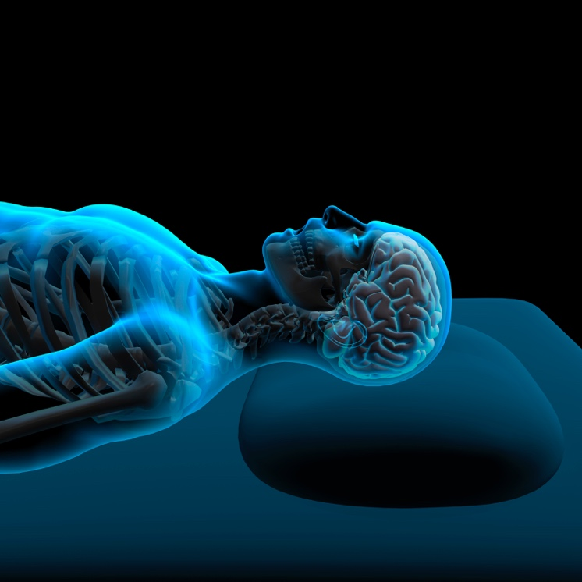

TO SUMMARIZE
Invest time and resource into data cleansing and enrichment
Review your current preventative maintenance frequencies and job plans
Prioritize your backlog
Develop a robust competency
improvement plan
Notes:
Building blocks to your success and Just like your creator, you need to intelligently build your assets foundation data to make sure the end creation has the best start to life…
Tie back in creator?
Listen the data doctor, healthy foundational data is the building blocks to your success
Start today on your asset health journey, join me at the add energy stand and try and beat me at table tennis, I don’t thin you can but im sure youll give you your best try

Slide 14




GET IN TOUCH
HOSSEIN GHAVIMI
R&D Manager
Asset & Integrity Management
Email: hossein.ghavimi@addenergy.no

Slide 15

A SNAPSHOT OF ADD ENERGY
Delivering benefits to clients in safety assurance, equipment reliability and performance
Performance Analysis
Quantifying and optimizing performance
Maintenance Optimization
Improving reliability and rationalizing cost
Asset Integrity
A framework for assurance in safety and integrity
Materials Management
Aligning materials with maintenance and risk
Operational Support
Optimizing processes and competency
Notes:
1

