Slide 1
Turnaround Change Management: An Organization’s Transformational Journey
Chris Vaughn
March 27, 2019
Global Shutdown, Turnaround and Inspection Forum
Amsterdam, Netherlands

Slide 2

Overview
Background
Initial Implementation of Best Practices
2014 TAR Results
Internal Transformation
2015 TAR Results
Drive towards Sustainability
Reflections

Slide 3
Business Conditions in 2013
Oversold production units
Business demands much higher than site production capability at the time
Need for immediate capacity release
Initiatives for capacity release included decreasing bottleneck cycle time and other production improvements
Biggest capacity release opportunity was to optimize TAR duration

Slide 4
Turnaround Optimization Initiative Objectives
Define continuous improvement process for scope optimization without compromising safety
Develop the TAR plan and train all execution team members and contractors on the changeover specific approach
Integrate Capital Projects, PHA recommendations to TAR planning and scheduling process
Integrate detail Decommission and Commission activities into every changeover / TAR

Slide 5
TAR Readiness Assessment Summary in 2013
The overall results of the turnaround readiness assessment at 2.5 months before the execution date are unsatisfactory versus the Best Practice Model.
The largest gaps noted during the assessment are the lack of scheduling efficiency, job planning progress, and key performance indicators
Operations work list tasks were also not included in the schedule which will prevent effective scheduling and execution tracking for daily task completion

Slide 6
Mindset of TAR’s in 2013
Mechanical and Project Work

Slide 8
Initial Implementation
Grass-roots effort to implement Best Practices
Lack of clear roles and responsibilities for TAR Core Team
Challenging change management strategy for mindsets and behaviors
Overcoming resistance to change
Past roll-outs of Best Practices for Work Management Process and Maintenance Standards

Slide 9

Initial Implementation
  “We don’t need a schedule”
  “We tried this in the past and it didn’t work”
  “Why are you wasting your time? We won’t use the schedule anyway”
  “Our site is too unique for a schedule”
  “Just give me a work list and we can manage how to get work completed”

Slide 10
Key Improvement Areas in 2014
Continuous Improvement effort focused on two critical areas:
    Roles and Responsibilities for TAR Steering and Core Team
    Work identification and Scope Management

Slide 11
TAR Organizational Structure
Steering Team
Core Team
    Dedicated Planner and Scheduler
Meeting Rituals
    Weekly Core Team
    Monthly Steering Team
    Daily Recap during Execution Phase of TAR

Slide 12
Early Work Identification
  Critical for proper planning and scheduling work activities
  Identifies potential long lead time items and sufficient timing to receive materials
  Minimizes expediting costs
  Allows adequate time for coordination of TAR activities
  Identify work associated with PHA Action Items to ensure timely planning for the execution work required
  Assists with safely optimizing TAR integrated schedule

Slide 13
Add On Work Request Process
All ADD-ON WORK REQUEST must be approved by Plant Manager, Site Maintenance and Engineering Manager, Unit Operations Leader
All ADD-ON WORK REQUEST must be RTO/SAFETY/ENVIRONMENTAL before submitting for approval.
ADD-ON WORK REQUEST FORMS must have the top section completed by the “Originator”, then submitted to the TAR Coordinator / Planners. Planners will then add a high level estimate, and submit the request to the Maintenance Manager for approvals.
After approval, revision week of the work order will then be changed to the outage revision week and the work order will be added to the TAR work list.
The TAR Coordinator will keep a track of all ADD-ON WORK REQUEST; approved or deferred.

Slide 14
2014 Site TAR Results
  15 Days Over Goal
  Lack of Coordination in Operations
  No trust in TAR schedule
  The challenge – How do we build a reliable schedule?
  Critique Comments
  “Operations need to have detailed deinventory and decon strategies for large equipment.”
  “Better understanding from Operations on accurate S/U sequences and timing.”
  “Need better plan from Operations”
  “Have a detail start-up and commissioning plan”

Slide 15
Internal Transformation
Critical point was 2014 Site TAR Execution and Critique
Organizational Will
Self Recognition – We can do better
Peer to peer accountability
Motivated, empowered and engaged employees

Slide 16
Critique Process
Pre-work survey sent out to team to identify strengths and target initial improvement areas
Interactive critique process initially focused on the identified improvement areas
Interactive critique process performed with all work groups represented in structured category groupings

Slide 17
Critique Identified Strengths
LOTO Plans Developed Prior to TAR **
  Saved time!
  Worked well with documented plans and coordination between shifts
  Great upgrade to perform LOTO’s in individual systems than large groups
PSSR Strategy Developed Prior to TAR **
  Detailed PSSR strategy provided guide on how to bring up the unit safely and efficiently
Use of Visual Management in Meetings **
    Daily Recap Meeting
    BBU Shift Meeting
** Areas to leverage to the site

Slide 18
Key Improvement Areas in 2015
Integrated Schedule Development
Contracting Strategy
MIQA Risk Assessments and Contingency Planning
Communicating KPI’s Current vs Target
Engaging Employees and Contractors
Visual Management of TAR Progression
Scope Management
Corporate Readiness Assessments

Slide 19
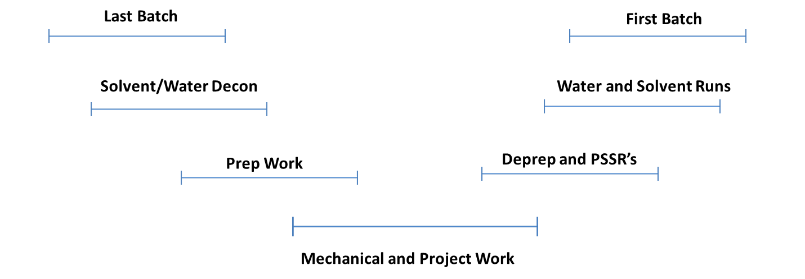
Current Mindset of TAR’s

Slide 20
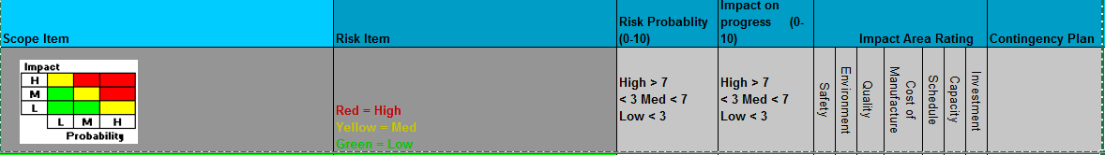
Risk Assessments and Contingency Planning
High risk inspections reviewed well in advance of TAR
MIQA resources reviewed past history and gave recommendation on potential discovery work and severity of damage
Assisted with contingency planning for additional resources and external SME resources for repairs beyond qualifications to site
Allowed us to procure repair materials well in advance
Predetermined scope and walk throughs to minimize repair timeline
Greatly assisted the Contracting Strategy for repairs

Slide 21
TAR Core Team

Slide 22
2015 Mobile TAR Safety Kickoff
September 3rd, 2015

Slide 23
TAR SHE Commitment and Objectives
ZERO injuries, illnesses, incidents, environmental releases
All injuries and incidents can be prevented
All work can be completed safely
Our success depends on teamwork
A positive attitude will help us reach our goal
Practice good housekeeping every time!
Audits will be conducted

Slide 24
Stay Safe
Follow Work Permits & Procedures
  If job changes or unanticipated conditions encountered → STOP WORK! Contact building proprietor/appropriate personnel to evaluate if a new work permit/job plan is needed
  Must have proper additional permits/paperwork attached as appropriate: Line Breaks, Rigging plans, Critical Lifts, Confined Space, Rescue Plans
Continuously Identify potential hazards and correct them - immediately
Ask yourself…
  What am I about to do and how will it affect others or the process?
  What do I need to do this job and how will I do it?
  How can I get hurt?
  What can I do to prevent an injury?
Communicate!
  Talk with each other out there
And if you’re not sure about something… ask

Slide 25
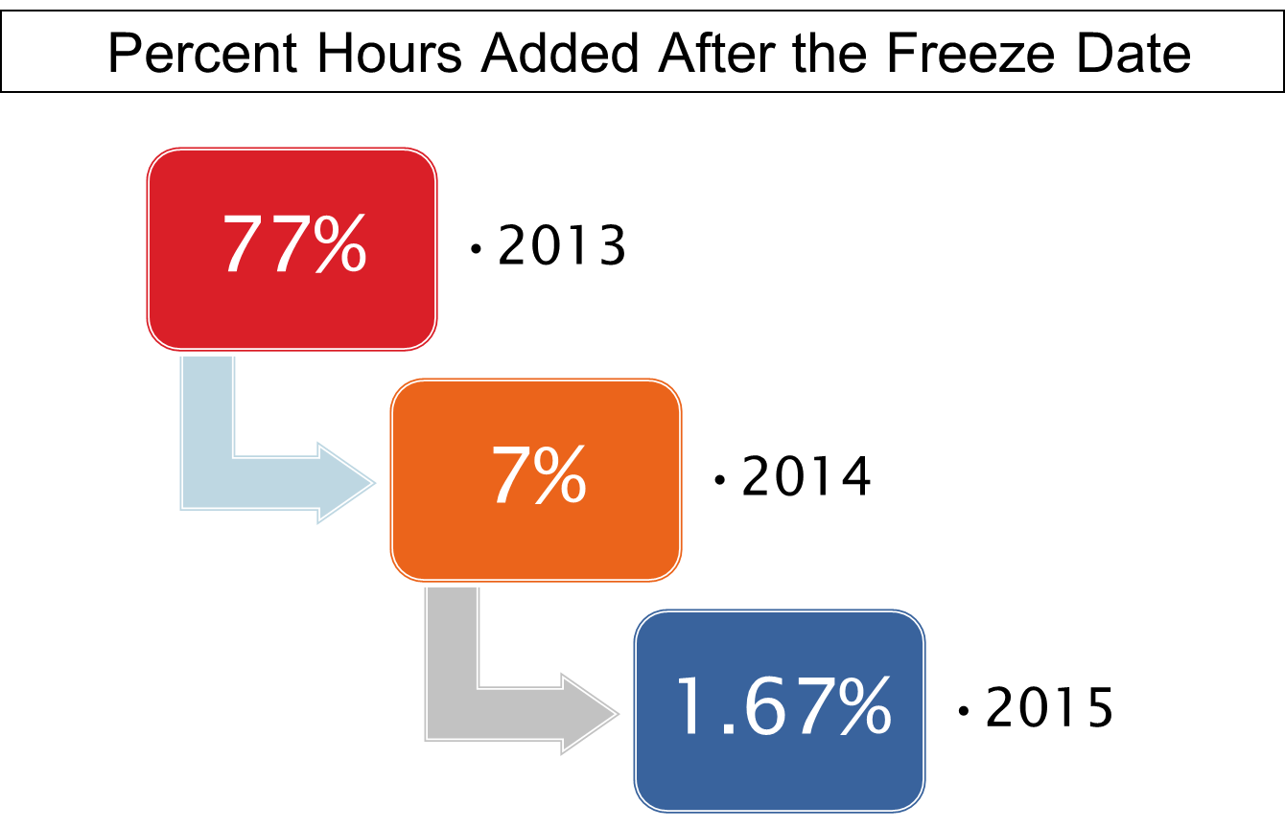
Scope Management Improvement

Slide 26
How did we manage scope better?
Communication and expectation of work identification
Work Order identification strategy implemented every quarter to identify the work required
Single Minute Exchange of Die (SMED) lean methodology implemented for correct sequencing and logic of integrated schedule
Accountability with Leadership on Add-On Requests to encourage early work identification

Slide 27
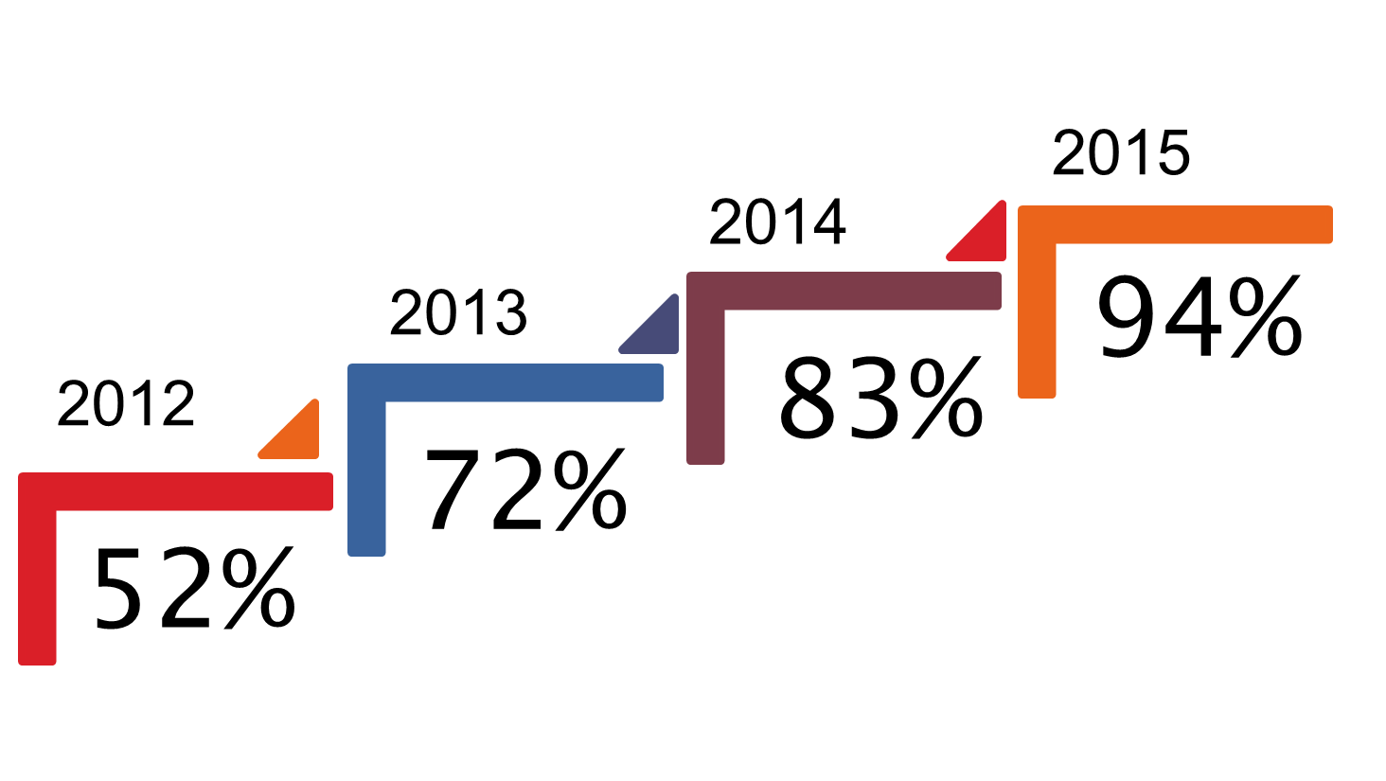
TAR Readiness Assessments

Slide 28
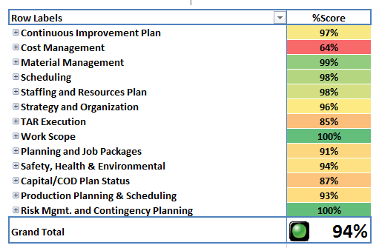
Assessment Date: 09-11-2015
Initiative: TAR Planning and Execution Optimization
TAR Leader: Chris Vaughn
TAR Assessor : Mike Tarpine – Corporate Turnaround Leader
MOBILE TURNAROUND READINESS ASSESSMENT SUMMARY
red
yellow
green
TAR Start Date 10-1-2015
TAR Duration 30 days
Preliminary Cost 1MM
Planning Status
Identified Improvements Integrate a cost monitoring process throughout the planning process that compares the planned cost with the associated TAR outlook cost Develop a cost monitoring process for execution Develop a head counting reporting plan during execution Track earned hours versus planned hours during execution. | Recommendations Integrate a cost monitoring process that tracks the planned cost in SAP and actual costs. Integrate a cost monitoring process to be used during execution that compares the planned cost per day to the actual spend that will indicate any deviations in cost. Track actual resources supplied by contractors during TAR execution using gate logs or time sheets to ensure that the planned resources required align with actual resources. Develop an earned hours versus planned hours report to indicate the efficiency of job planning and Mechanical resource performance.
 | Continuous Improvement Plans Underway Continuous Core team development led by TAR leader Detailed kitting of jobs by planned operation steps Visual management board used during daily planning execution meetings
1
1
2
2
3
3
CURRENT STATUS
IMPROVEMENT PLAN
4
4

Slide 29
2015 Site TAR Performance
ZERO INJURIES!!
ZERO ENVIRONMENTAL IMPACTS!!
On-time start-up for all production lines
Met critical production demands
Gained confidence from Supply Chain

Slide 30
2015 Critique Comments
The visual management board for daily rack-up meetings was an outstanding upgrade to our process. It kept everyone focused.
The daily safety meeting to discuss audit findings and the general climate was a strength.
All of the work groups maintenance, manufacturing, capital, contractors were integrated into one schedule.
Taking the time before the TAR to identify how discovery work from inspections was going to be handled and then integrated into the daily schedule.
Identifying maintenance engineers during the daily TAR meeting who could take lead responsibility for specific scope growth or discovery work

Slide 31
Drive towards Sustainability
Clear TAR Objectives communicated broadly and well in advance of TAR
Organizational Will
Transparent and simple processes
Peer-to-Peer Accountability
Utilize Critique Process as Continuous Feedback Loop
Engagement from all levels of employees

Slide 32
Reflections
Strong Leadership commitment and alignment required
Transparency and visibility of TAR processes will accelerate improvements
Highest level of energy was during initial implementation
Commitment to the process
Requires multiple approaches to employee engagement
Support for TAR managers and leadership is critical
Patience is required at times
Avoid playing the blame game or mastering deflection
Avoid getting caught up in the moment and forgetting what the big picture is

Slide 33
"Too often employers and fans think that if you are winning, the team is great and if you are losing, there is something wrong within the team. That is not the case at all"
Paddy Upton
Head Coach (Delhi Daredevils IPL team, Sydney Thunder BBL Team, Rajasthan Royals IPL Team), Leadership Coach

Slide 34

YOUR FEEDBACK MATTERS

