Slide 1

Using Asset Real Time Data from Planning to Execution to Optimise Shutdown Management
Ali Izadi
Superintendent Maintenance Analysis and Improvement
March 2019

Slide 2
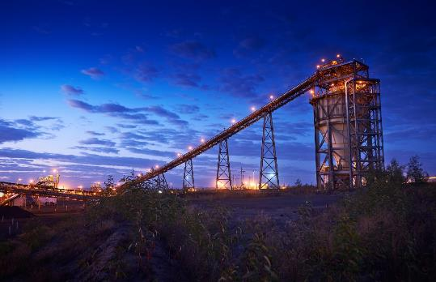
Topics
  About BHP
    Our Charter
    BHP’s Portfolio
    BHP global Locations
    Strength in diversity
    An overriding commitment to health, safety, environment and communities
    Upholding ethical business practices
  Shutdowns Execution
  Using Asset Real Time data from planning to execution to optimise shutdown management
  Using Virtual/ Augmented Reality to execute complex maintenance tasks safely and efficiently
  Managing emerging work with minimum impact on budget and resources
  Measuring performance of plant turnarounds and shutdowns using productivity tracking throughout the project
  Improve the planning, scheduling and execution of future shutdowns through data collected from prior projects
Disclaimer
Forward-looking statements
  This presentation contains forward looking statements, which may include statements regarding plans, strategies and objectives of management, future performance and future opportunities. These forward looking statements are not guarantees or predictions of future performance, and involve known and unknown risks, uncertainties and other factors, many of which are beyond our control, and which may cause actual results to differ materially from those expressed in the statements contained in this presentation. BHP’s Annual Report on Form 20-F filed with the US Securities and Exchange Commission identifies, under the heading Risk Factors, specific factors that may cause actual results to differ from the forward-looking statements in this presentation. BHP does not undertake any obligation to update or review any forward-looking statements.
  No offer of securities
  Nothing in this presentation should be construed as either an offer to sell or a solicitation of an offer to buy or sell BHP securities in any jurisdiction, or be treated or relied upon as a recommendation or advice by BHP.

Slide 3
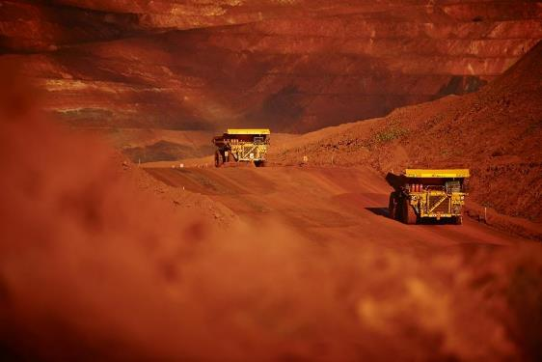
About BHP
  We are a leading global resources company
  Our purpose is to create long-term shareholder value through the discovery, acquisition, development and marketing of natural resources.
  Our strategy is to own and operate large, long-life, low-cost, expandable, upstream assets diversified by commodity, geography and market.
  At BHP, we have a unique perspective on the extraordinary potential of natural resources to provide the essential building blocks of progress.
  We are among the world’s top producers of major commodities, including iron ore, metallurgical coal and copper. We also have substantial interests in oil, gas and energy coal.
  We have a global footprint with assets in Australia, Chile, Peru, Mexico, USA and Canada.
https://youtu.be/SnO77vD0ka8

Slide 4
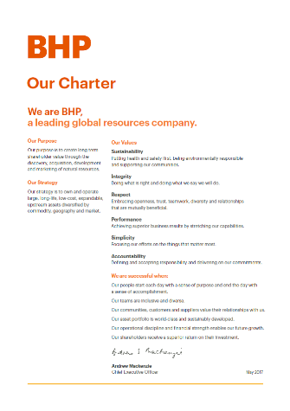
Our Charter
Our Values
  Sustainability – Putting health and safety first, being environmentally responsible and supporting our communities.
  Integrity – Doing what is right and doing what we say we will do.
  Respect – Embracing openness, trust, teamwork, diversity and relationships that are mutually beneficial.
  Performance – Achieving superior business results by stretching our capabilities.
  Simplicity – Focusing our efforts on the things that matter most.
  Accountability – Defining and accepting responsibility and delivering on our commitments.

Slide 5



















Leading diversified global mining company
Large, long-life, low-cost, expandable, upstream assets diversified by commodity, geography and market
Operated
Non-operated
Additional
Minerals Australia
Western Australia IO
Queensland Coal
NSW Energy Coal
Olympic Dam
Nickel West
Minerals Americas
Escondida
Pampa Norte
Jansen
Antamina
Cerrejón
Samarco
Petroleum
Shenzi
Angostura
Pyrenees
Macedon
Atlantis
Mad Dog
Bass Strait
North West Shelf
Smaller assets

Slide 6
BHP global locations
United Kingdom Production Unit
Corporate office
Minerals Americas office
Jansen
Algeria Joint Interest Unit
Corporate office
Corporate office
Corporate office
Petroleum office
Gulf of Mexico Production Unit
Corporate office
Gulf of Mexico Joint Interest Unit
Corporate office
Trinidad and Tobago Production Unit
Global Asset Services Centre
Cerrejón
Marketing and corporate office
Australia Joint Interest Unit
Australia Production Unit
Antamina
BHP Billiton Mitsui Coal
Samarco
Western Australia Iron Ore
BHP Billiton Mitsubishi Alliance
Pampa Norte
Olympic Dam
Escondida
Nickel West
Minerals Australia office
Minerals Americas office
Minerals Australia office
New South Wales Energy Coal
Minerals Australia
Minerals Australia office
Global headquarters
Minerals Americas
Australia Joint Interest Unit
Australia Production Unit
Petroleum
Includes non-operated sites
BHP principal office locations

Slide 7
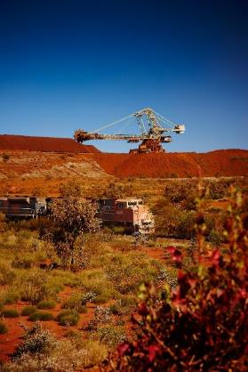
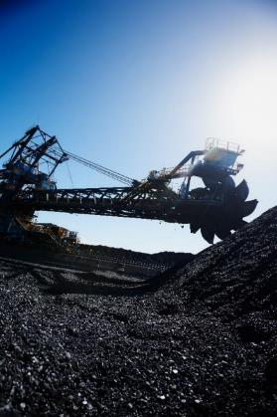
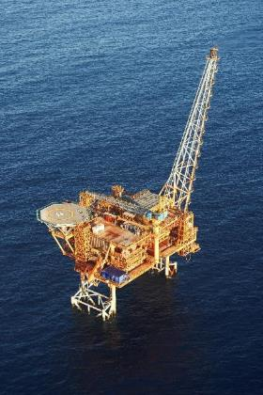
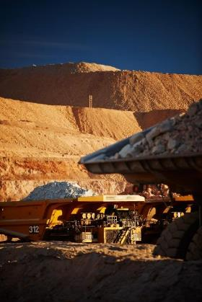
Strength in diversity
Iron ore
Coal
Petroleum
Copper
Notes:
The diversified nature of our business sets us apart from other companies and provides resilience and flexibility through volatile market conditions to enhance value.

Slide 8
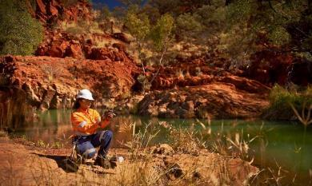

An overriding commitment to health, safety, environment and communities
  In FY2018
  Our total recordable injury frequency (TRIF) performance was 4.4 per million hours.
  Our high potential injury rate (injury events where there was potential for a fatality) dropped by eight per cent
  to 56.
  Our total greenhouse gas emissions were 16.5 million tonnes of carbon dioxide equivalent.
  Our voluntary social investment totalled US$77.1 million.
  We became the first major resource company to produce a comprehensive report of our water strategy, risk and performance.
Newman
Escondida
Notes:
We value an overriding commitment to the safety of our people and to respecting our environment and the communities in which we work.
We maintain a relentless focus on the health and safety of our people and the communities in which we operate. While this is an encouraging result, our efforts to protect the health and safety of our people will be unrelenting.
There are numerous examples where, together, the company and community have identified opportunities and designed solutions. These funds support local programs, such as:
An education program in Zamzama, Pakistan that has seen 800 children graduate from the program with another 2,000 currently studying in 13 model schools;
An education program in New South Wales, Australia that provides Aboriginal and disadvantaged preschool-aged children with access to a school readiness program;
ANDA project which addresses the needs of people displaced by conflict and vulnerable communities in the Cordoba District of Colombia to complement poverty reduction efforts by the national government;
The EMPOWER Business Program in Canada, which encourages entrepreneurship and economic diversification among First Nations communities; and
Bush Blitz, a unique species discovery program in Australia. We will not have a business unless we can live in harmony with everyone and everything impacted by our work.

Slide 9

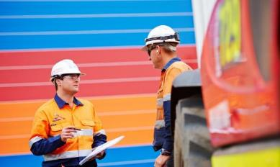
Upholding ethical business practices
  Working with Integrity
  Like safety, working with integrity – doing what is right and doing what we say we will do – is the starting point for everything we do.
  We care about how results are achieved as we do about the results themselves.
  All BHP employees are accountable for acting in accordance with the BHP Code of Business Conduct.
  Suppliers, contractors and partners working with or for us are also required to act in accordance with these requirements.
  Each Business, Group Function and Marketing leader has the responsibility for ensuring the requirements of the Code of Business Conduct are embedded across BHP.
Perth corporate office
BMA Coal
Notes:
The Code of Business Conduct represents our commitment to upholding ethical business practices and applies to every employee, our suppliers and contractors, and our business partners working for us. The Code of Business Conduct makes it clear that commercial objectives can never compromise our commitment to working with integrity.

Slide 10
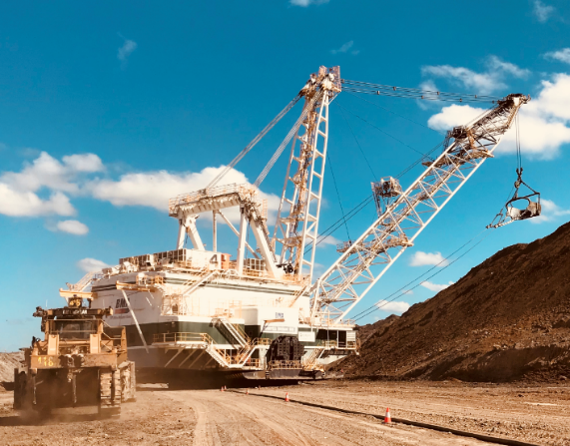
Shutdowns and Turnarounds at BHP
  Number of Shutdowns
  Only in East Coast in average we execute 12 Dragline and Shovel Major Shutdowns per year
  More than 100 Coal Handling and Preparation Plant Shutdowns per year
  More than 500 Pit-Stop mini shutdowns per year
  Complexity of Shutdowns
  From Draglines and Shovels to Wash Plants and small Workshop Pit-Stops
  Shovel Shutdown durations are between 2 weeks to 6 weeks
  Dragline Shutdown durations are between 4 weeks to 16 weeks
Perth corporate office
https://youtu.be/_BRaNlxFKpU
BMA Coal

Slide 11
Shutdown Planning and Execution Steps at BHP
JOB SCREENING
SCOPING
Being developed by Subject Mater Expert based on Safety, Cost, Available Resources, Job Interactions
PLANNING
Prioritizing based on H-Importance and H-Urgency tasks
All identified required maintenance tasks that are captured in CMMS (System Generated and/or Manually Entered)
Pre-Developed and exists in Standard Work Instruction, or
Estimate Cost
Prepare paper works for execution team
Prepare required Resources; Labour, Equipment, Tools, Materials
Prepare Risk Assessments
SCHEDULING
EXECUTION
CLOSE-OUT
Determine required Ramp Down and Ramp up time
Schedule Job Tasks, Steps, Duration and Sequences
Manage Available Resources, to Safely Execute Scheduled Tasks
Measure performance KPI’s
Completed Tasks Quality Control
Close completed tasks in CMMS and record actual cost, hours worked.
Raise Subsequent Notification for uncompleted works
Provide shutdown report to Reliability team
Communicate with all stakeholders
Perth corporate office
BMA Coal
Notes:
Review of all detailed scopes of work assigned to the shutdown event to optimise execution efficiency
Coordination of shutdown activity, including resources, personnel and operational activity, during execution to provide a safe and efficient maintenance service
Facilitate ramp down and ramp up activities during the shutdown event
Engaging with multiple stakeholders to deliver efficient shutdown execution ensuring resource utilisation is optimised
Engage with production and maintenance teams to prioritise resources to maintain optimal machine availability
Provide input into the shutdown schedule to identify opportunities to reduce duration and risk
Provide coaching and leadership support for both scheduling and execution teams
Lead planning and execution meetings to deliver effective shutdown outcomes
Ensuring conformance with the BHP Billiton Charter, the BHP Billiton Group Level Documents, Code of Conduct and relevant statutory obligations
An overriding commitment to health, safety, environment responsibility and sustainable development
Meeting the supervisor level requirements of the Operating Discipline Standard STD-IOH-SAF-009
As a Section 44 Appointed Person, ensuring compliance to the requirements of the Mine Safety and Inspection Act and Mines Safety Inspection Regulations
Maintaining a high profile in the promotion of safe working conditions and practices to ensure a safe working environment

Slide 12
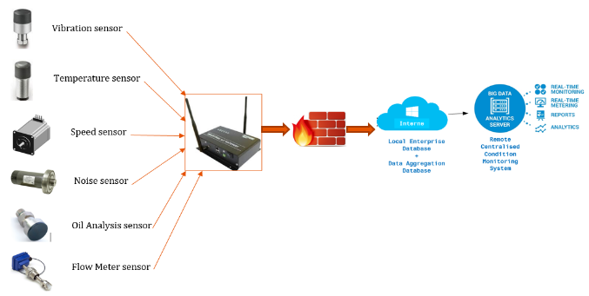
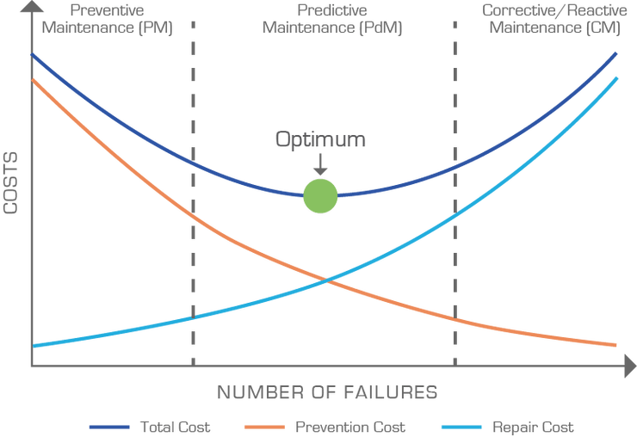
Optimising Shutdown Planning and Scheduling
  Total Real Time Condition Based Maintenance
  Using Asset Real Time data
  Planning and Scheduling Shutdowns at the Right Time with Minimum Cost
  Reduce Inventory Level and Cost
  Optimize required labour and tools
Perth corporate office
BMA Coal

Slide 13

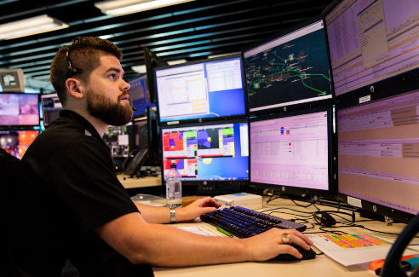
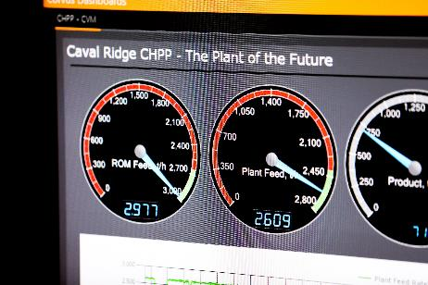
  Total Real Time Condition Based Maintenance
CASE STUDY
Mobile Fleet Health Control Centres
Continuous evaluation of all/ most Asset condition parameters
Online analysis base on a complete snapshot of the Machine condition
Assist with implementing Proactive maintenance strategy
Assist with Failure Root Cause Analysis by capturing all machine condition parameters at the time of the failure
Obtain data from remote locations
Easy access to Asset Health Historical Data
Extend component life
Avoid unplanned downtimes
Perth corporate office
BMA Coal

Slide 14

Optimising Shutdown Executions
  Virtual Reality and Augmented Reality Technology
  Executing Shutdowns Safe and Efficient with minimum job interactions
  Using Virtual/ Augmented Reality to execute complex maintenance tasks safely and efficiently
  Using Virtual/ Augmented Reality in Maintenance Training
Perth corporate office
BMA Coal

Slide 15
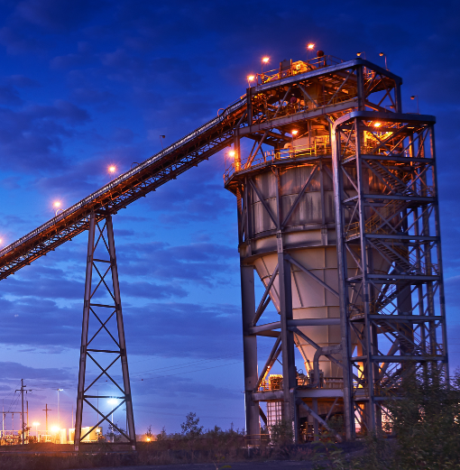
  Virtual Reality and Augmented Reality Technology
CASE STUDY
3D Laser Scanning Inside Bins
  Bins are used as bulk material storages at mine sites
  Bin Internal Wear Liner Plates are subject to Erosion/ Corrosion and wear
  Wear Liner failure can result in significant structural damage to bin wall
  As per Condition Based Strategy, regular Wear Liners Thickness Measurement is required
Perth corporate office
BMA Coal

Slide 16
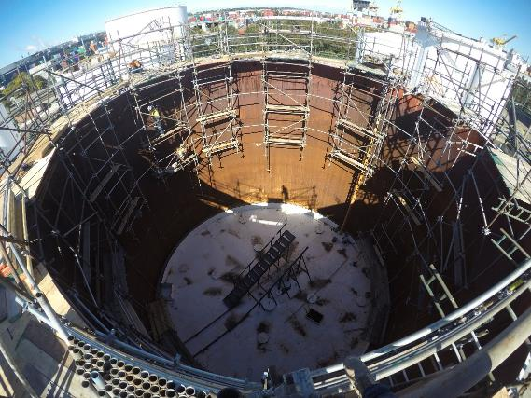
Case Study - 3D Laser Scanning inside Bins
Traditional methods to measure Bin Wear Liner Thickness
  Gain access by erecting scaffolds inside the bins
  Using Ultra Sound Testing Tools
Very High Safety Risks to people due to;
    Work at Height
    Work in Confined Space
Expensive
Time Consuming
*Photo is an example and for reference only.

Slide 17
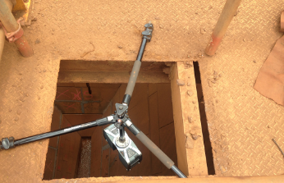

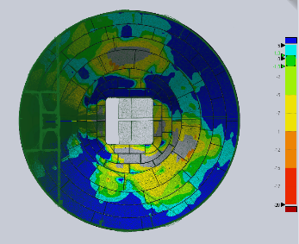
Case Study - 3D Laser Scanning inside Bins
Using new 3D Scanning Technology
Scan internal surface of bins by help of Laser Scanning Tools
Eliminate significant safety risks
    Confined Space Entry
    Work at Height
Significant Time and Cost Reduction
Accurate measurement and precise reading
Easy to understand and analyse data
*Photos are examples and for reference only.

Slide 18
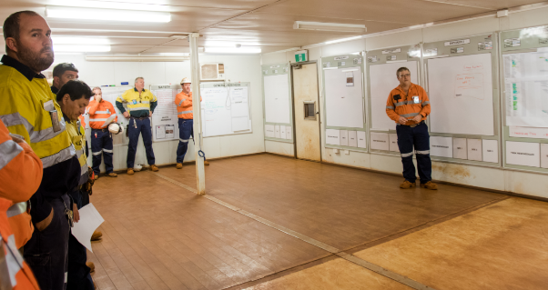
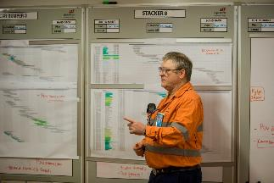
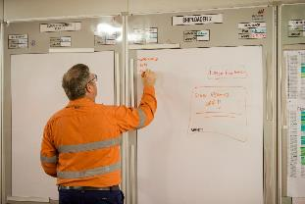
Managing Emerging Works at Shutdowns
  Managing emerging work with minimum impact on budget and resources
  Providing continuous updates through Information centers and Information Boards
  Assigning Area Leaders/ Area Supervisors for each work zone
  Provide regular updates twice per day and track tasks progress as per Gantt Chart
  Escalation Board for at risk tasks
  Issue Management of Changes process where needed to control Safety/ Cost Risks

Slide 19
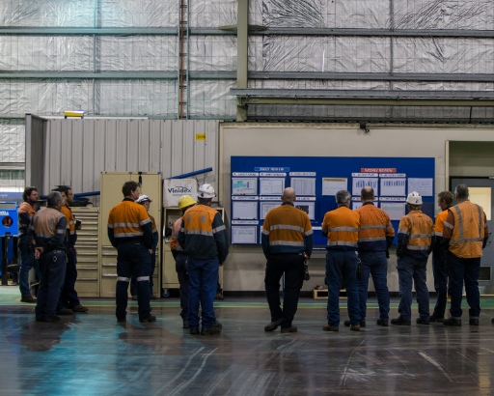
Turnarounds and Shutdowns – Close Out
  Measuring performance of Turnarounds and Shutdowns using productivity tracking throughout the project
  Recording all shutdown performance data, including;
      Ramp Down/ Ramp Up Duration
      Isolation Time
      Execution Time
      Tool Time
    Measuring Adherence to Schedule
    Conduct Shutdown Overrun Root Cause Study
  Tracking historical total downtime duration

Slide 20
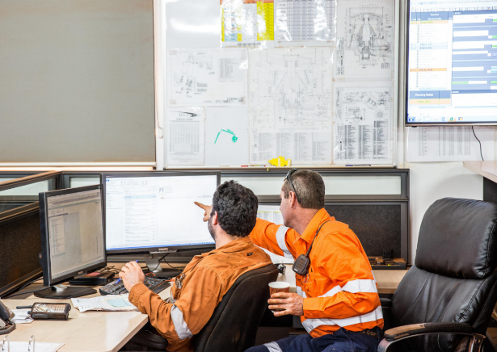
Shutdowns and Turnarounds Continuous Improvement
  Improve the planning, scheduling and execution of future shutdowns through data collected from prior projects
  Optimize Shutdown frequencies
  Reduce Shutdown Ramp up / Ramp Down Durations
  Reduce Shutdown Duration
  Identify the Root Cause of the failure
  Eliminate the Failure Mode
  Extend Asset Life
  Optimise Asset Performance
Perth corporate office
BMA Coal
Notes:
The Code of Business Conduct represents our commitment to upholding ethical business practices and applies to every employee, our suppliers and contractors, and our business partners working for us. The Code of Business Conduct makes it clear that commercial objectives can never compromise our commitment to working with integrity.

Slide 21
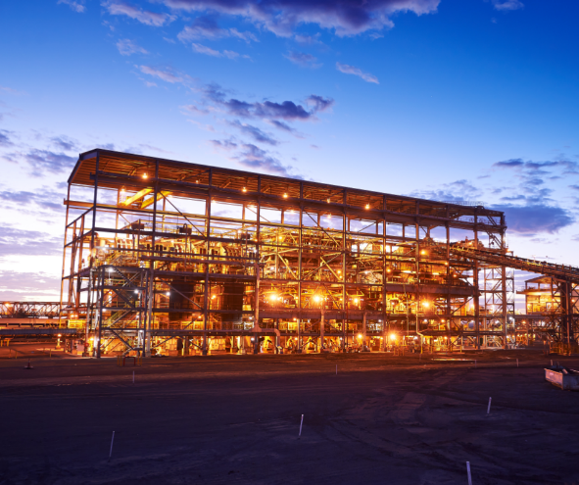
Optimize Shutdown Frequency and Duration
CASE STUDY
Optimize Shutdown Frequency at Coal Handling
and Preparation Plant
Increase Coal Handling and Preparation Plant Shutdown Intervals from 2 Weekly to 4 Weekly
Remove online tasks from shutdown scope
decrease replacement frequency by help of using more durable martials
Move from preventive maintenance to condition based maintenance
Identify Critical path for shutdown
Risk management and assessment process
Perth corporate office
BMA Coal

Slide 22

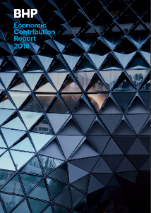







Further information
BHP produces a range of publications, which can be viewed or downloaded at bhp.com
Or visit us on social media
.
bhp.com
twitter.com/bhp
linkedin.com/company/bhp
youtube.com/bhp
facebook.com/bhp

