Slide 1
Total Cost Management for Turnarounds: Neste Case Study

Slide 2

About Elmer Sachteleben
Degree
MSc in applied physics
Experienced certified cost engineer (CCE)
Experience
Head of Cost Engineering Academy
Teacher at the Dutch Association of Cost Engineers (DACE)
Has provided consulting services in process assessment, development, and implementation to major multinational companies
…such as Shell, Unilever, Bayer, Cargill, CB&I, Mott MacDonald, Heineken, Vopak, Enbridge, Yara, and Rijkswaterstaat
Notes:
Head of Cost Engineering Academy - providing traineeships, developing courses and organizing workshops in the field of project controls and turnarounds

Slide 3

About Cost Engineering
20+ years of industry experience
>80 employees
Operating worldwide
Helping companies complete projects and turnarounds within time and budget
Notes:
Global experience in project controls and turnarounds for over 20 years and still growing
TA management & control is in our DNA
Expert perspective on TA culture and environment
Certified and dedicated problem solvers
Dynamic and energetic approach
Passionate about our job
Processes aligned to your organization
We take care to make your TA successful
Knowledge sharing

Slide 4





What we do
Consultancy
Cleopatra Enterprise
Academy
CESK
Notes:
Consultancy: help improve processes, and deliver helping hand executing Tas
Academy: train people to develop their skills and implement improvement processes
Cleopatra:
CESK:

Slide 5

























Clients and Industries
Bulk storage
Construction industry
EPC(M)
Food and Nutrition
Infrastructure
Offshore
Oil & Gas industry
Heavy industry
Pharmaceutical industry
Petro-/chemical industry
Power industry
Mining & Minerals
Notes:
This is just a grasp of the clients we are serving. We serve a wide variety of industries and we have been doing this since 1996. We basically state that we can support any industry that performs complex technical projects. These include Oil & Gas, pharma, mining, energy, Offshore & Marine and infrastructure.

Slide 6
Current state of Turnarounds
Schedule delays and cost overruns are a recurring problem:
32%
Succesful
68%
Failed to meet expectations
Based on turnarounds executed since mid-2012 in the onshore and offshore upstream, gas, refining, chemical, and power sectors
Source: AP-Networks
Notes:
http://www.rlginternational.com/docs/default-source/news-insights/pec-2016-whitepaper.pdf?sfvrsn=8
A recent industry trend is executing more capital project work during turnarounds. This is noteworthy because capital intensive turnarounds are particularly challenging. AP-Networks’ database of medium and high-complexity turnarounds executed since mid-2012 in the onshore and offshore upstream, gas, refining, chemical, and power sectors shows that 32% were successful while 68% failed to meet their project goals (including 40% that AP-Networks categorized as “train wrecks”).

Slide 7

Current state of Turnarounds
Poorly executed TAs have huge cost implications on a company
Millions of dollars loss of revenue
Loss of market share

Slide 8
There is still hope…
Digital technologies, when applied comprehensively and efficiently, can reduce overall project costs by 45%
10% increased data accessibility and quality can result in:
  productivity improvements from 20% - 50%
  return on assets to increase by 10% - 40%
Sources
1. Navigating the digital future: The disruption of capital projects, Steffen Fuchs, James Nowicke & Gernot Strube, McKinsey
2. Measuring the Business Impacts of Effective Data, Barau, Mani & Mukherjee, University of Texas
Notes:
Productivity improvements: for example, when the work planner has access to cost estimation data, work packages can easily get assigned costs, hours and resources.
Return on assets: increases in productivity leads to as shorter shutdown period and fewer resources spent.
Voordelen:
Sneller afrekenen (achteraf)
Beter beschikbaar; voorbeeld, de werkvoorbereider kan makkelijker begroten
Systemen dwingen je tot een stukje consistentie

Slide 9








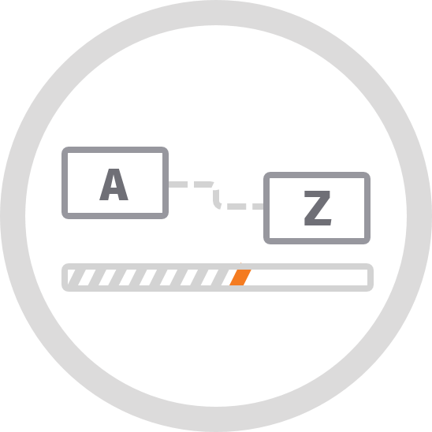


Total Turnaround Cost Management
Benchmarking
Scope Management
Progress & Cost Control
Work Package Planning
Field Change Management
Estimating / Budgeting
Scheduling
Contract Management
Tendering

Slide 10


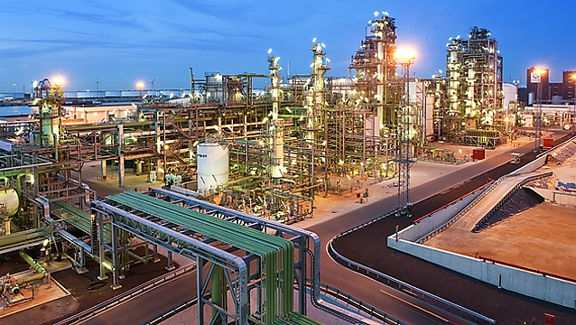
Case study: Neste
Reneweable fuel refinery company
Headquarted in Finland
Over 5,000 employees
Revenue of € 13 billion in 2017

Slide 11
Turnaround Management @Neste
Situation
  New plant in Rotterdam
  No systems in place for turnaround management
Objective
  Building a systematic approach for turnaround management
  More predictable and efficient turnarounds

Slide 12
Turnaround Management @Neste
Solution
  Total Turnaround Management with Cost Engineering Consultancy since 2013
  Package of software and cost engineers integrating several functions of the turnaround

Slide 13
Result of Total Turnaround Management @Neste
With the Total Turnaround Management of Cost Engineering…
Neste completed their 2018 turnaround within time and budget!
And even more…
8,4%
Under
Maintenance Budget
11,6%
Under
Overall Budget

Slide 14
Total Turnaround Cost Management
Benchmarking
Scope Management
Progress & Cost Control
Work Package Planning
Field Change Management
Estimating / Budgeting
Scheduling
Contract Management
Tendering

Slide 15
Estimating & Budgeting
Maturity Process
± 50% Estimate
± 30% Estimate
± 10% Estimate
Notes:
Traditionally, management would ask to deliver an estimate based on the time remaining to the ta execution. More organisations now require estimators to follow a staged approach to estimating, delivering three different types of estimates during the preparation phase.

Slide 16
Estimating & Budgeting
Deliverables
 | ± 50% Estimate | ± 30% Estimate | ± 10% Estimate
Equipment count | Preliminary | 90% complete | 99% complete
TA premises | Preliminary | 100% complete | 100% complete
Inspection data | High level | 80 – 90% complete | 100% complete
Maintenance backlog | High level | 60 – 70% complete | 99% complete
HAZOP | High level | 60 – 70% complete | 100% complete
Design changes | Preliminary | 50 – 70% complete | 100% complete
CAPEX projects | Preliminary | 80 – 90% complete | 100% complete
Leak detection and repair | Preliminary | Preliminary | 100% complete
Notes:
For this classification to work, you need to clearly define the input deliverables needed to be able to compile the required estimate type. This means that the moment the estimate is made should be driven by the maturity of these deliverables, and not to the amount of time left before execution. Missing deliverables result in a less accurate estimate, and therefore possible time and resource problems during execution.

Slide 17
Estimating & Budgeting
Methods
± 50% Estimate: Historical extrapolation
  Historical TA data, scaled to current TA and indexed to today’s price level
± 30% Estimate: Conceptual estimate
  Quantities from mechanical work packs, priced in-house
  Other disciplines factored from mechanical work, using benchmark data
± 10% Estimate: Detailed control estimate
  Quantities for all disciplines calculated and priced by contractors based on work packs
  Pricing accepted by owner

Slide 18
Historical extrapolation
Method:
Take cost and duration of previous or similar TA
Remove the incidents and non-usual items from the budget
Adjust for expected number of scope items (e.g., equipment counts, repair items, etc.)
Take into account duration and time constraints
Index costs to current price level
Escalate costs to cover for future inflation

Slide 19
Conceptual / Semi-detailed estimate
Indication of historical factors that can be used to estimate disciplines other than mechanical
Discipline | Percentage | Discipline | Percentage
Mechanical | 100% | Painting | 0.2 – 0.5%
Rotating | 2 - 5% | Cleaning | 20 – 50%
E&I | 20 - 40% | Scaffolding | 25 – 50%
Tracing | 6 – 12% | Insulation | 10 – 30%
NDT | 2 – 5% | Lifting | 15 – 30%
Inspection | 2 – 4% | Fire & Manhole watches | 5 – 20%
Miscellaneous | 2 – 5% | Materials | 30 – 60%
Vendor work / overhaul | 10 – 40%
Notes:
Source: Cost estimating for turnarounds, Gordon Lawrence (AP Networks),
Petroleum Technology Quarterly, Q1 2012

Slide 20
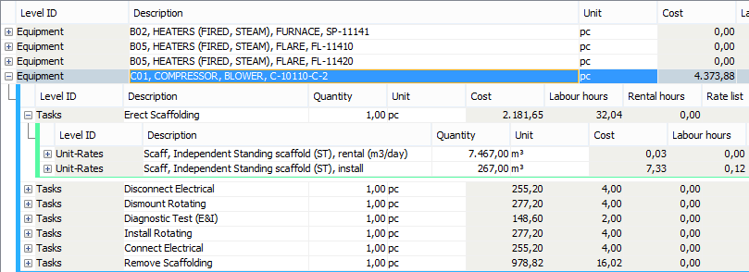
Estimating direct costs
For the main disciplines (e.g.: Mechanical, Piping, Insulation, Scaffolding, E&I, Cleaning), hours are estimated based on work packages:
Notes:
This is also the level of detail for the settlement with contractor.

Slide 21
Total Turnaround Cost Management
Benchmarking
Scope Management
Progress & Cost Control
Work Package Planning
Field Change Management
Estimating / Budgeting
Scheduling
Contract Management
Tendering

Slide 22
Tendering: disciplines
Disciplines
Mechanical / Piping
Scaffolding
Insulation
Painting
Tracing
Electrical & Instrumentation
Cleaning
Notes:
This tendering process can be done for most contractors hired for the turnaround, like…

Slide 23


Commercial Tendering Process
Determine scope
(based on history)
Create Reference Estimate
Receive market quotes
Historical
Data
Database
Award Contract or Project
Risk Assessment on Scope Changes
Bid comparison
Notes:
A distinction is made between technical and commercial bid evaluations
The technical bid evaluation compares scope, limits of supply & services, HSE performance and design features: are they performing the correct scope?
The commercial bid evaluation compares the prices of the different bids, both for the total and for parts of the scope and the financial performance: who is most economic?
Closing the loop: everything in one database

Slide 24
Tendering with unit rate contracts
Characteristics
Contractors bid on reference estimate using unit rate database
Time and cost risk “shared”
Owner – At risk for total quantities
Contractor – At risk for fixed unit price
No negotiations about payments for additional work

Slide 25
Bid evaluation
Comparing efficiency factors and overtime rates
A similar procedure is used
The different factors and overtime tariffs are compared in tables, bar charts and graphs
Example efficiency factors per activity per contractor
Activity | Contractor 1 | Contractor 2 | Contractor 3
Bolting & Hydrotest piping | 1.00 | 1.10 | 1.20
Bolting and opening & closing equipment | 0.90 | 1.10 | 1.20
Handling piping | 0.80 | 1.10 | 1.20
Welding piping SS | 1.10 | 1.10 | 1.20
Welding piping CS | 1.05 | 1.10 | 1.20
Welding piping LACS | 1.30 | 1.10 | 1.20
Equipment repairs | 1.90 | 1.10 | 1.20
(De)montage equipment | 1.18 | 1.10 | 1.20
Notes:
A similar procedure is used for the overtime tariffs/factors and the efficiency factors supplied by the contractors. First the different factors and overtime tariffs are compared by tables in a separate excel document and plots and bar charts are generated to compare them. The comparison of the labour rates, overtime tariffs and (efficiency) factors helps to obtain an idea of the feasibility of the different bids and is sometimes used to make a preselection between contractors before the real tendering phase is conducted. It is important to remember that it just provides an indication and not a definite answer to the question what is the most feasible bid.

Slide 26
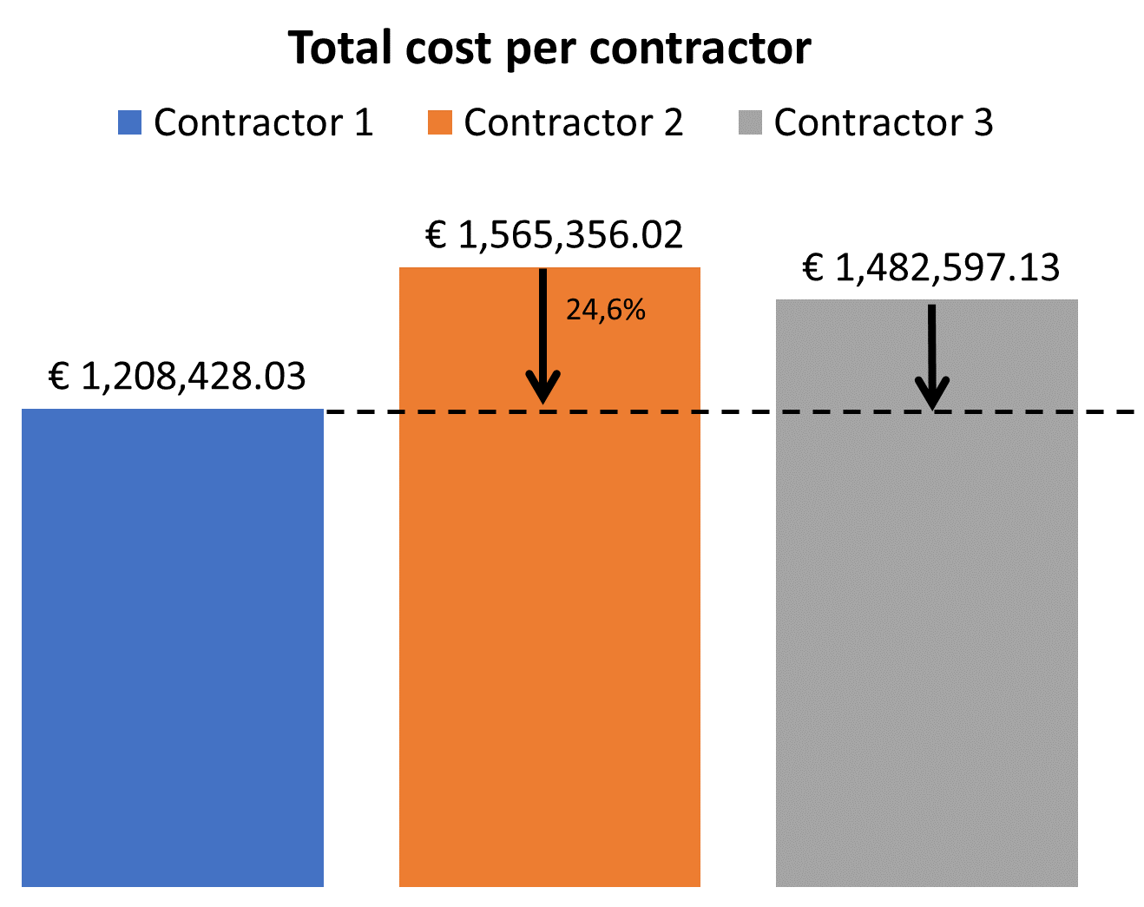
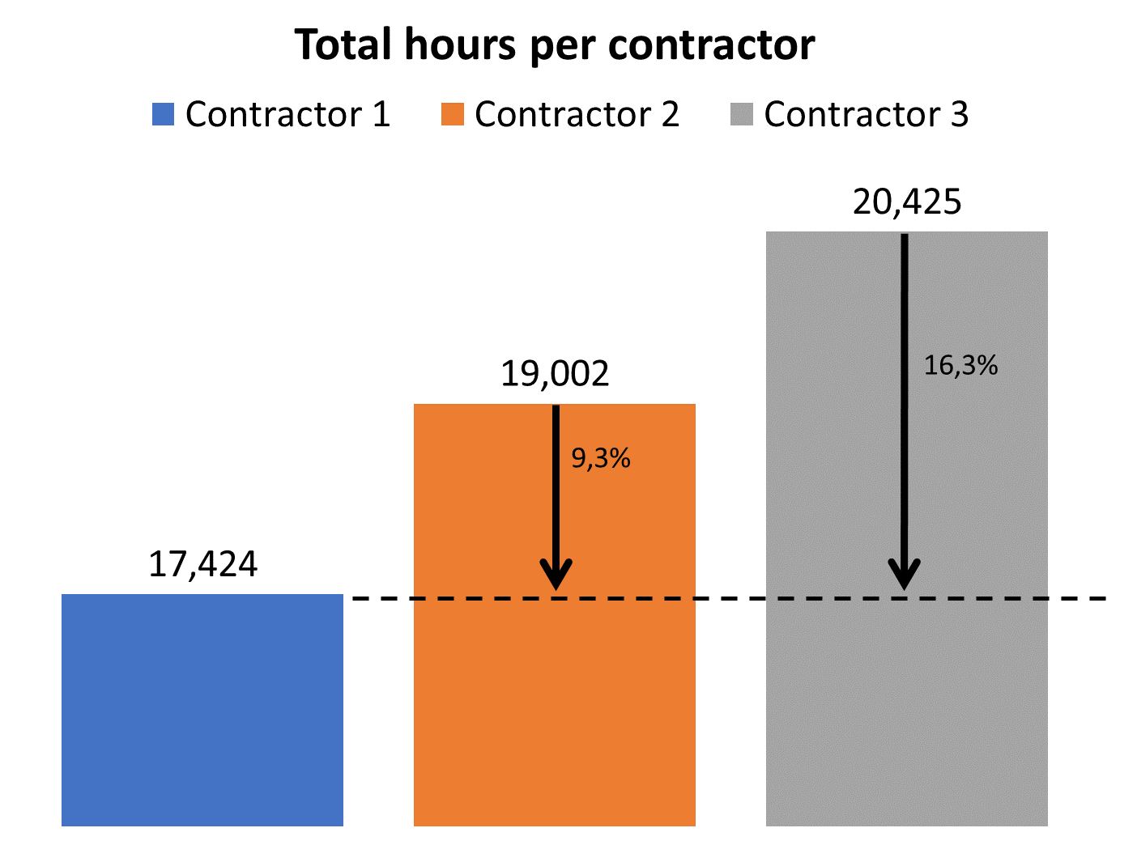
Bid comparison
Example comparison of totals between different contractors
Notes:
Mention: due to digitalising you can go much deeper than this.

Slide 27
Total Turnaround Cost Management
Benchmarking
Scope Management
Progress & Cost Control
Work Package Planning
Field Change Management
Estimating / Budgeting
Scheduling
Contract Management
Tendering

Slide 28
Progress & Cost Control
Real-time data is the most important thing for decision makers
Turnarounds have a very short time frame
Accurate daily updates to management are required
Early identification and mitigation of potential risks

Slide 29
Integrated Progress & Cost Control Work Process
Scheduling
Detail Estimating
Field Changes
Database
Financial approval process
Project Controls
Notes:
Based on the agreed contract, activities are estimated and scheduled in detail. These priced work packages are checked for financial approval. This will then be the baseline for cost control and progress measurement.
During execution, approved field changes are estimated to get to a payment agreement. After financial approval, field changes are incorporated in the baseline by the controller. All this should occur in one central database so that this information is accessible and can be shared efficiently between systems and people.

Slide 30







Field Change Management
< € 2.500,-
Approval
> € 2.500,-
Approval
Detail Estimating
Initiate
Approve

Slide 31
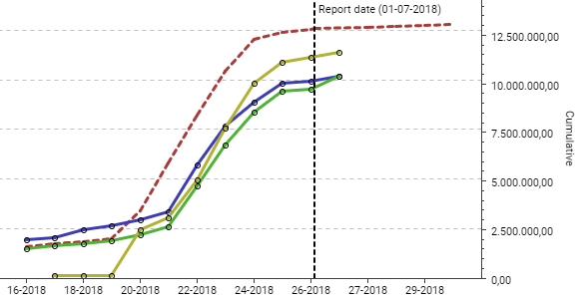

Progress & Cost Control
S-Curves
Baseline
Earned cost
Commitments
Actuals

Slide 32
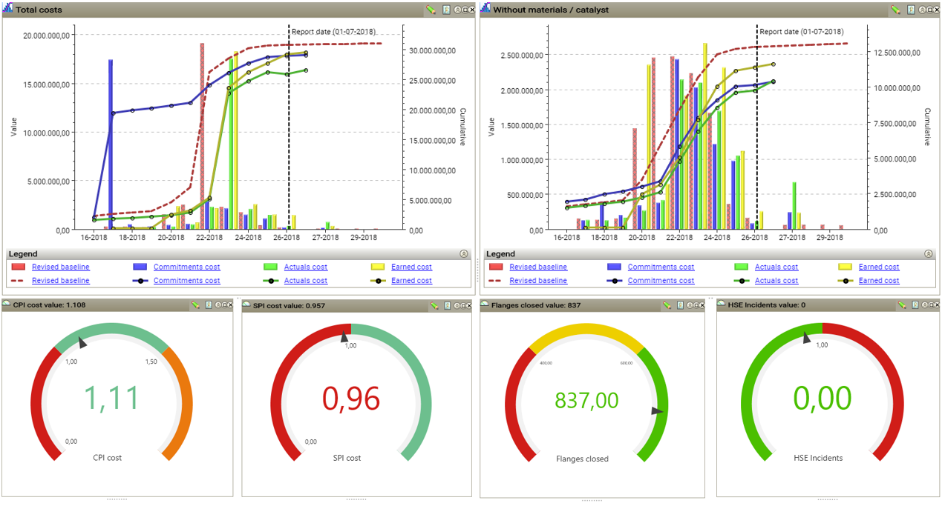
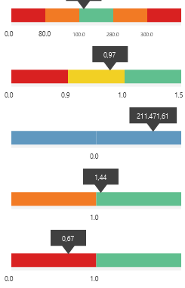
Progress & Cost Control
Control Dashboard
Total TA cost
120
Flanges closed
0.96
Actual/planned flanges closed
27.302.500
Commitments
1.08
SPI Maintenance
1,00
1,50
1,0
0.86
SPI CAPEX
CPI
SPI

Slide 33
Total Turnaround Cost Management
Benchmarking
Scope Management
Progress & Cost Control
Work Package Planning
Field Change Management
Estimating / Budgeting
Scheduling
Contract Management
Tendering

Slide 34
TA maintenance execution hours per discipline
Notes:
Source: IIR course, 2017

Slide 35
Typical benchmarks
Category | Industry benchmark
Direct costs | 100%
Staff | 31 – 53%
Facilities | 8 – 14%
Allowances & contingency | 16 – 20%
Type | Percentage of contractor’s direct labour costs [%]
Staff, pre-TA | 25%
Staff, during TA | 25%
Staff, post-TA | 8%
Tools & equipment | 6%

Slide 36
Total Turnaround Cost Management
Get started!
Benchmarking
Scope Management
Progress & Cost Control
Work Package Planning
CONTINUOUS
IMPROVEMENT
Field Change Management
Estimating / Budgeting
Scheduling
Contract Management
Tendering

Slide 37

Thank you for listening
Any questions?
STOControl.com

