Slide 1
EFFECTIVE APPROACHES FOR PLANNING & SCHEDULING TANK MAINTENANCE PROJECTS
STMI INTERNATIONAL CONFERENCE
MARCH, 2019
GEORGIA KALOGRIDAKI
FINE TELECOMMUNICATIONS

Slide 2
WHO WE ARE
Coherent and well-educated group of people
Engineers, IT and business background
PM certified
Broad consulting and training resumé
15+ years of practice in medium and large projects (maintenance, telecom)

Slide 3
WHAT WE DO
We DEAL
With the Management of Projects
We HEAL
Areas that are difficult to handle
We HELP
Companies evolve and mature
We BUILD
Custom Solutions
We INVEST
In collaboration
We CREATE
Transparency

Slide 4
AREAS OF FOCUS
MONITORING AND CONTROL
  S / T / C
  KPIs
  CONTINGENCY PLANNING
REPORTING
  PROGRESS
  LESSONS LEARNED
PLANNING AND SCHEDULING
  SCOPE (incl. SCOPE CHALLENGE)
  TIME – COST – RESOURCES
  COMMUNICATIONS
  RISK
  OPTIMIZATION (TIME – RESOURCES)
OTHER
  TRAINING
  PROCESS DEVELOPMENT
  PMO LAUNCHING
Notes:
That ‘s enough with the introductory

Slide 5
OUTLINE
Justification of importance
Common (and not so common) challenges
Overview of tank types/categorization
Our approach - Best practices
Advantages - Provided benefits
Recommendations
Conclusions

Slide 6
JUSTIFICATION OF IMPORTANCE
Why invest in tanks maintenance?
  The unique storage asset of a refinery
  Storage capacity directly related to demand management
  Crucial for company profit, operation and safety
Tank vs S/D maintenance
  Long-duration project (6 - 24 months)
  Prone to external and internal factors (poor planning, weather conditions, procurement issues)
  Dictated by safety and environmental regulations
Notes:
It is a long-duration project that needs frequent monitoring and lasts from 6 months to 1 year, depending on the tasks to be performed. There are cases where poor planning, weather conditions, procurement issues and other factors led to 2 years’ maintenance duration.

Slide 7
COMMON (AND NOT SO COMMON) CHALLENGES
OPERATIONAL COMPLEXITY
CONSTRAINT COMPLEXITY
INFORMATION AND KNOWLEDGE COMPLEXITY
ADMINISTRATIVE / MANAGEMENT / HR COMPLEXITY
PROGRAMMING AND TECHNICAL COMPLEXITY
The uncertainty due to both the programming horizon and the external conditions
Reduction or elimination of idle time
The speed and accuracy of task modeling and the development of reliable programs
The reduction in the total maintenance time for each tank and thus the increase in operational availability (opportunity cost)
The participation of many Departments with different requirements and constraints
The coordination of internal and external stakeholders (contractors, suppliers, etc.)
Speed ​​and flexibility in decision-making with respect to safety and reliability
Convince people to embrace the methodology (change management techniques)
The integration of Production Programming requirements and constraints (products, availability)
Compliance with operational certification requirements and inspection needs / findings
The interdependencies (capacity, operation, interconnection) between tanks, industrial plants and operational units
Functional, spatial and temporal constraints due to pit-stops and S/D
Dependence on evolving and future infrastructure projects
Clear and accurate real-time updates
Generation and satisfaction of increasing communication needs (in near-real time)
The gradually growing experience
Notes:
The gradually growing experience, a project that is being implemented for the first time on such a large scale as it is
Huge number of data generated on daily basis…..
Long lifecycle
Risk-prone (weather, black box)
Increased uncertainty
Very few sensors (tanks are black boxes, no history data due to the long lifecycle, lack of maintenance data)
Reactive diagnosis vs proactive
Refer to examples regarding the weather etc

Slide 8
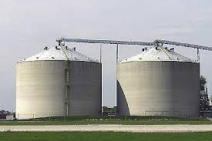
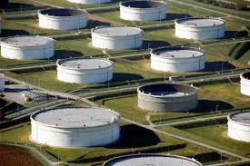
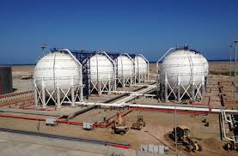
OVERVIEW OF TANK TYPES / CATEGORIZATION
Tank types
  Cone roof
  Floating roof
  Cone roof with internal floating roof
  Spherical tank (LPG)
Categorization
  Year of construction
  Product (Crude, Naphtha, GASOIL etc.)
  Last year of inspection
  Last year of maintenance

Slide 9
OUR APPROACH – BEST PRACTISES
PMI methodology
Reduction of scope fuzziness (front-loaded planning)
  Extensive use of historical data, inspection reports, technical experience (if available)
Emphasis on communication (many stakeholders involved)
Work breakdown structure (WBS)
  Implementation of templates per tank type
  Further customization based on category - 2nd stage scope
  Dynamic time and weather-sensitive job
Project planning - project execution
  Project schedules
  Progress reports
Information flow – weekly and monthly reporting – issues log file
Notes:
Focus on reducing scope creep
Coherent, representative schedules. Concern is that schedules are understandable by key engineers. Overanalyzed schedule becomes dysfunctional
What is a schedule without a monitoring? -> Capitalized on our knowledge of BI tools and Development of smart, targeted reports suitable for every stakeholder

Slide 10
OUR APPROACH – BEST PRACTISES
PRODUCTION DEP.
TEMPLATE MIND MAP per Tank
REQUIREMENTS
INSPECTION DEP.
TEMPLATE MS PROJECT
MIND MAP SoW
MAINTENANCE DEP.
PROJECT CHARTER
TOTAL MAINTENANCE PLAN
TANK
COMMUNICATIONS PLAN
BLIND LISTS & VALVES
PROJECT PLAN (MS PROJECT)
UPCOMING ISSUES
PROGRESS REPORTS
TOTAL OVERVIEW
REPORTS (weekly report, issues log, tank progress)
KPIs
Notes:
Agreed on KPIs from the beginning

Slide 11
OUR APPROACH – BEST PRACTISES
Combine enterprise knowledge, mind mapping and risk matrices
Use visual tools for WBS, templates and estimating techniques
Seek stakeholder involvement
Employ past experiences and historical data
Level tasks and resources and balance the availability of scarce or critical contractors
Collect information and plan updating
Create knowledge through experience
Notes:
Combine enterprise knowledge, mind mapping and risk matrices to optimize the project size and finalize the scope
Visual tools for WBS, systemization, templates in the company information systems and estimating techniques
Seek stakeholder involvement
Employ past experiences and historical data for detailed estimating critical tasks
Level tasks and resources and balance the availability of scarce or critical contractors
Collect information and plan updating that takes into account staffing needs, updating frequency and content of reports
Create knowledge through experience (development of historical records along with daily maintenance reports)

Slide 12
ADVANTAGES – PROVIDED BENEFITS
SCHEDULE BENEFITS
  Optimize the tank maintenance duration
  Reduction / elimination of idle time
FINANCIAL BENEFITS
  Reduce times -> Reduce costs (ship rents, shipments)
KNOWLEDGE BENEFITS
  Methodology, standards, procedures, estimations
COMMUNICATION BENEFITS
  Communication network
  Working groups
  Reports and decision making speed
SECURITY
  Better coordination
  Avoid competing demands
SECURITY
SCHEDULE
COMMUNICATION
COST
KNOWLEDGE
Notes:
The advantages and provided benefits are distributed to the five areas

Slide 13
ADVANTAGES – PROVIDED BENEFITS
Short-term benefits
Enhanced supervision and control
Medium-term benefits
Improved reliability and security
Long-term benefits
Better centralized programming
Faster troubleshooting
Targeted communication forms
Analytical monitoring of contractor work
Enhanced coordination between stakeholders
Timely change management
Enhanced, clear and timely information
Load balancing (normalization)
Reduction of risks from external factors
Continuous Knowledge Base Development (lessons learned register and accounting data)
Best practices and templates
Increased tank run time
Improved reliability and security
More efficient contract management (economies of scale - reduction of idle time)
Reduction of risks from external factors
Gradual and smooth transition to an international standard (EEMUA or API)
Developing a corporate knowledge ecosystem for tanks
Gradual decline idle times
Reduced total cost of work

Slide 14
RECOMMENDATIONS
The project is of high importance and value to a refinery. In order to achieve the before-mentioned benefits, the following are proposed:
  Establish a permanent PMO
  Link the tank projects with the company portfolio
  Align tank projects with company vision and strategy
  Handle the contractors centrally
  Implement risk management (assessment-management) with quantitative decision-making methods (e.g. optimal maintenance cycle)
  Analyze and cure delays (additional scope, rework, etc.)
  Trust frequent progress monitoring
  Embrace change
  Be proactive
  Capitalize on knowledge
  Build trust
Notes:
We have already started integrating risk management methodologies and techniques (cause & effect, paretto, monte carlo) which we don’t have time to display……

Slide 15
CONCLUSIONS
Improve tanks' life cycle costs by achieving shorter maintenance duration and longer runtime to the next scheduled maintenance
Support an effective and long-term inspection and maintenance program
Fulfill all HSE and operating requirements
Notes:
Tank maintenance is worth spending time on….. A coordinated attempt to plan tank maintenance improves tanks life cycle…

Slide 16
THANK YOU FOR YOUR ATTENTION!

Slide 17
CUSTOMIZED PMI PROJECT PROCESSES
Planning
Initiation
Closure
Monitoring and control
Execution

Slide 18
EXECUTION PHASE
Internal cleaning
Inspection
Maintenance
Hydraulic test
Product removal
Closure

Slide 19
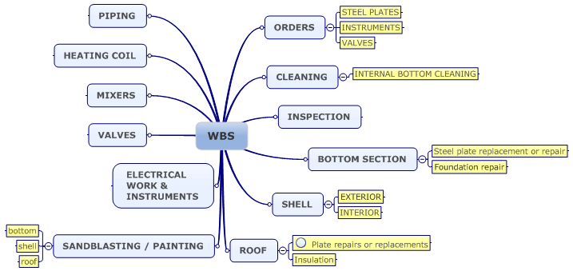
MIND MAP

Slide 20
MS PROJECT

Slide 21
EXCEL SERVICES REPORTS

Slide 22
EXCEL REPORTS

Slide 23
WEEKLY SHORT REPORT

Slide 24
ISSUE MANAGEMENT

Slide 25
MONTHLY OVERVIEW

Slide 26
TANK PROJECT OVERVIEW (BI)

Slide 27
VISIO TIMELINE

Slide 28
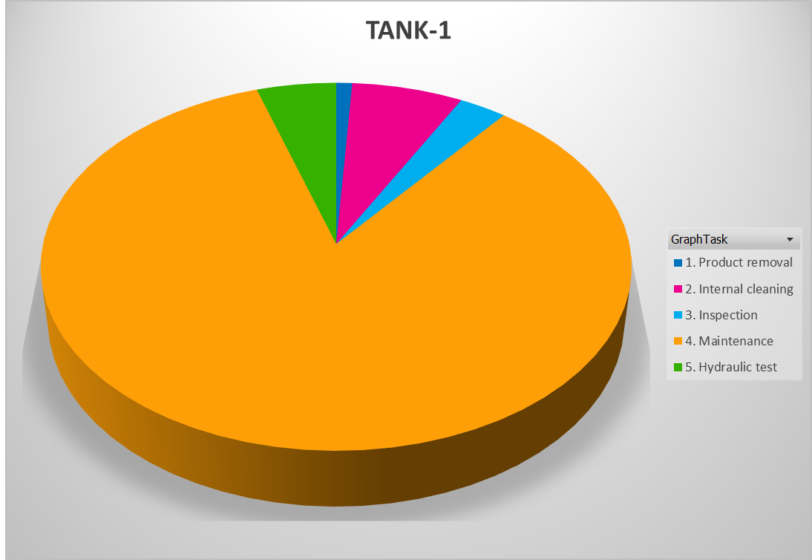
SCOPE ANALYTICS (BI)

